Slide 1


A RELATIVE TO TRUTH
BQ1 Foundations Lesson 10
I can explain the implications of memory working in a reconstructive way
Notes:
See how this lesson links to the course by viewing the final slide
Key TOK terms appear in a red font

Slide 2
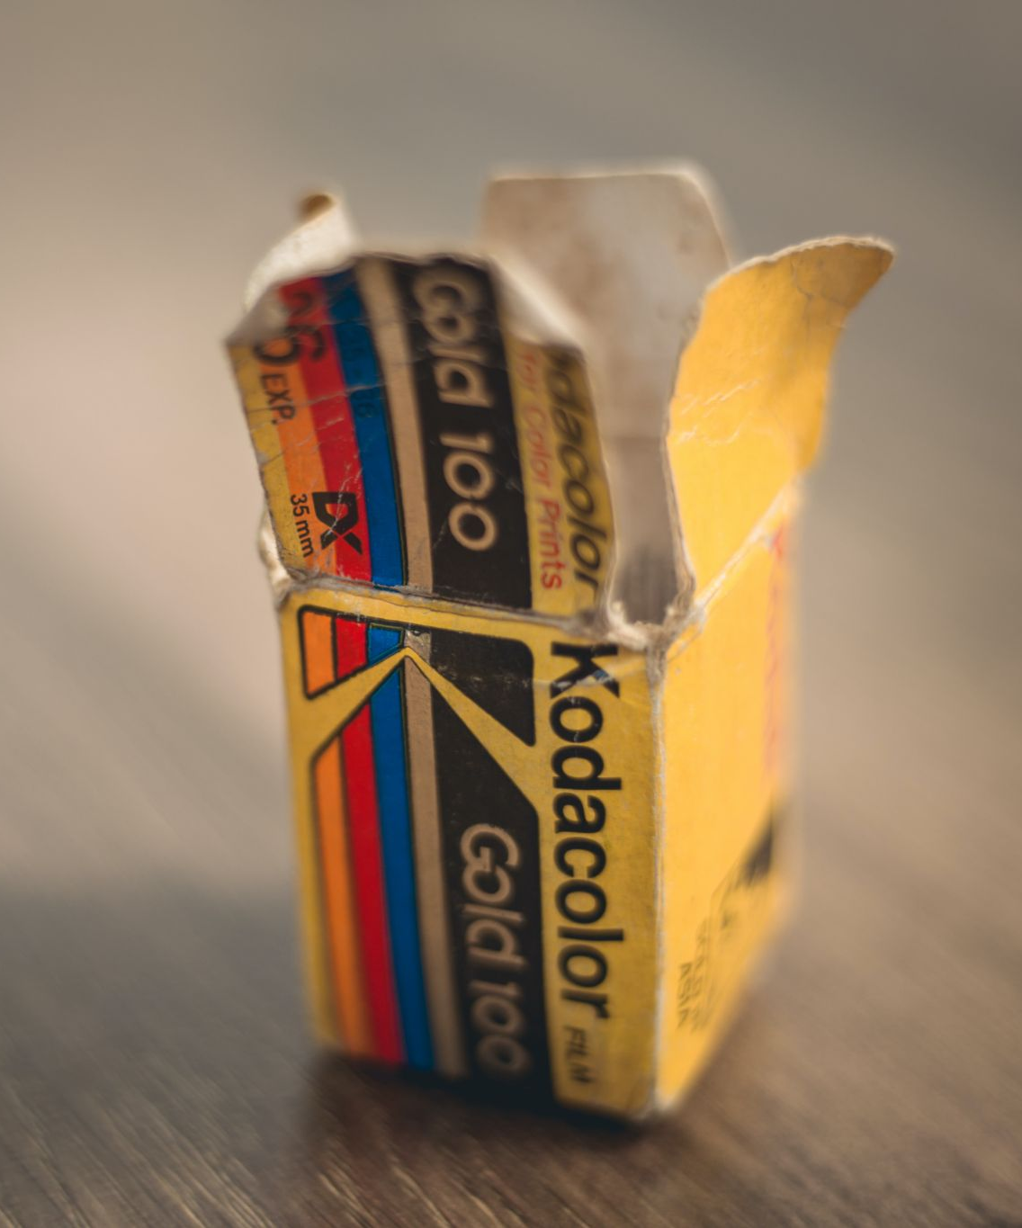
Starter
“Memory is a complicated thing, a relative to truth, but not its twin.” (Barbara Kingsolver)
What do you think Kingsolver meant?
Notes:
The quote suggests some unreliability when it comes to memory.
This is worth discussing - how reliable do you think your memory is? How much do we rely on it? To what extent does it let us down? Good examples? Etc.

Slide 3

Assessing your memory
Discussion - how good is your memory?
What are the advantages in life of having a good memory?
Notes:
This should be a brief and simple discussion with students.
It is partly to get them thinking in terms of the accuracy and power of their memory, which is not quite the point of this lesson.

Slide 4
Memory test
Notes:
I’m going to show you a list of 15 words. I will read them out, clear the screen, and you will then have 1 minute to try to write down as many of them as you can

Slide 5
Memory test
Sour
Honey
Bitter
Heart
Tooth
Nice
Sugar
Chocolate
Taste
Tart
Candy
Soda
Good
Cake
Pie

Slide 7
How did you do?
Notes:
Hands up if you think you did really well…
Hands up if you’d like a second chance with a different list…
Same again; I’ll read out words; then give you 1 minute to write them down.

Slide 8
Memory test 2
Mad
Happy
Rage
Mean
Vengeance
Wrath
Hate
Hatred
Fury
Emotion
Fear
Fight
Temper
Calm
Violence

Slide 10
How did you do this time?
Notes:
Hands up if you included the word ‘sweet’ for list 1?
Hands up if you included the word ‘anger’ or ‘angry’ for list 2?
Second list will probably work better than the first in this respect
If you hands went up, you experienced a false memory. What do you think this is? Why do you think this just happened? What are the implications of this?
LINK TO CONTEXT - students will probably have made up one or two different words. Why did they do it? Probably because of context… Memory works in a similar way to the way the senses do (see Beau Lotto)
(This demonstration is taken from Loftus & Palmer)

Slide 11
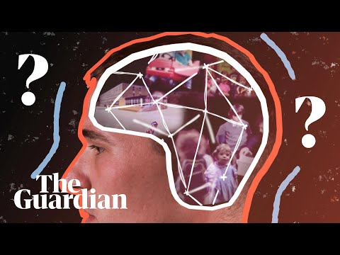
False memories
What are memories - and how are they different to the way we usually conceive of them?
What do Elizabeth Loftus and Julia Shaw say about the permanence of memories?
How can memories be ‘contaminated’?
Explain how memories can go from ‘could’ to ‘would’ to ‘did’.
Give examples of positive and negative consequences of false memories.
Notes:
Video is here.
The video lasts 7.35 seconds, and is definitely worth seeing in its entirety.

Slide 12
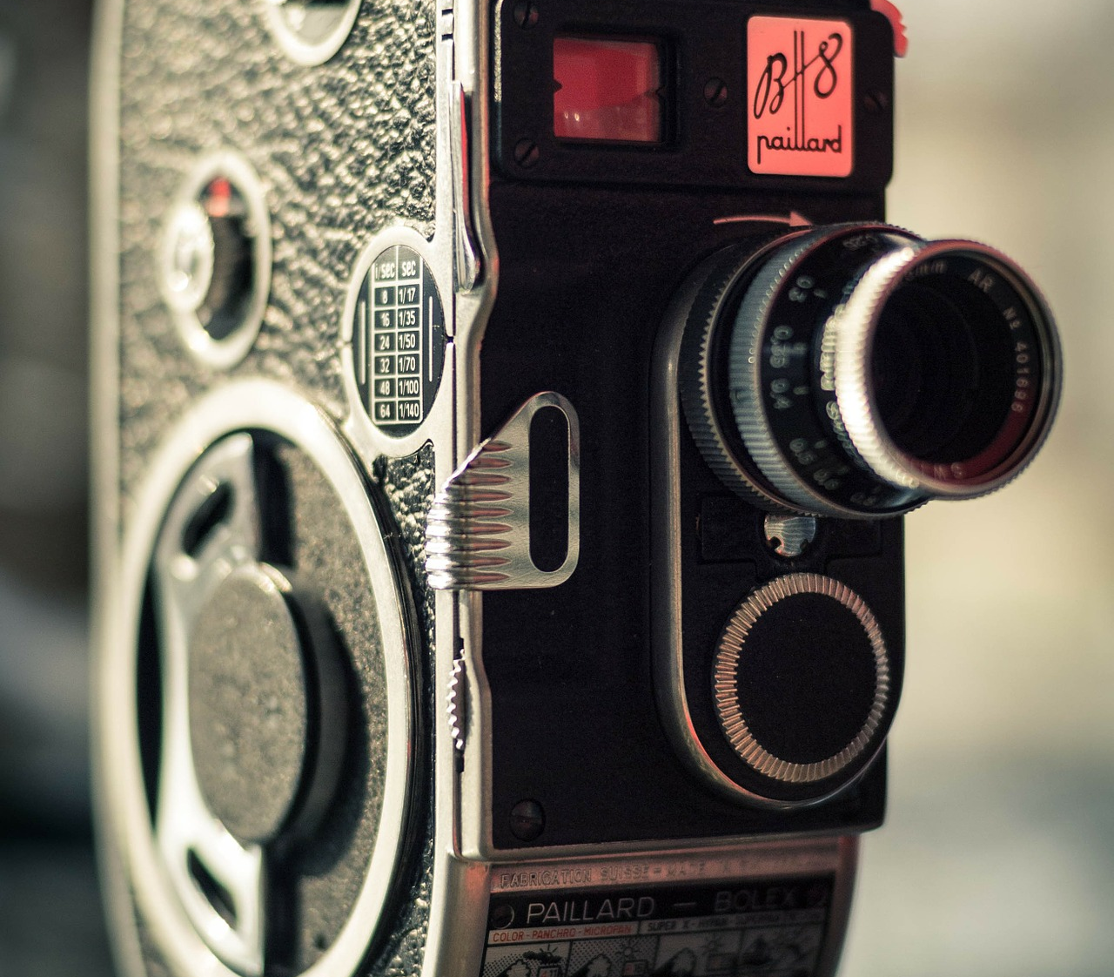
Understanding memory
So, to liken memory to a video recorder or hard-drive gives the wrong idea of memory. What metaphor would work better?
Elizabeth Loftus: “Our memories are constructive. They're reconstructive. Memory works a little bit… like a Wikipedia page: you can go in there and change it, but so can other people.”
Notes:
Animated slide.
Give students 4 minutes or so to come up with a metaphor, then reveal Loftus’s one. Get them to copy down the quote.
See the rest of what Loftus says here; it features a court case in which a person was wrongly convicted, and the experiments that she ran in the 1970s and 80s to implant false memories in volunteers. The first 6 minutes gives a clear idea of her thesis.

Slide 13
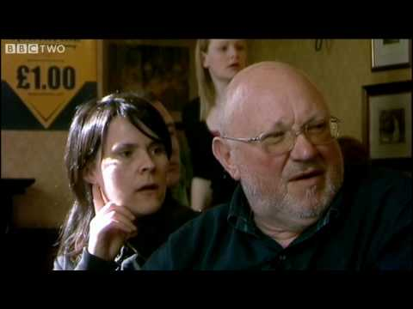
Eyewitness to murder
Write a paragraph explaining what the films reveal about the way memory works.
Include the following terms: Language, emotion, imagination, reconstruction, reliability.
Notes:
First clip is here.
The image above takes you to the first clip. See clip 2, and clip 3 on how well the eyewitnesses were able to recall what happened.

Slide 14

TOK concepts in the real world
Given the nature of memory, should eyewitness testimony be relied on in court cases?
If not, what kind of evidence should replace it?
If it should, how would you ensure that it provides trustworthy evidence?
Debate your points!
Notes:
Give students time to come up with their ideas, and run a debate in class.

Slide 15

Links to the TOK exhibition
Related exhibition prompt Which knowledge features impact on its reliability (IAP-3)?
Refer to the ideas from this lesson to answer this question.
For example, why might memory-based knowledge be problematic? What relationship does language have with memory - and how does this affect its reliability?
Which objects could help to illustrate your answer?
Notes:
Optional slide, if you want to help students to take ownership of the IA prompts (IAPs) for the TOK exhibition
For more ideas on relevant IAPs, see the ‘Linking this lesson to the course’ slide

Slide 16

How can we guard against our memories being manipulated by people seeking to obscure or hide the truth?
Notes:
See the BQ1 assessment tracker for suggestions on providing feedback, and recording students’ progress

Slide 17
Linking this lesson to the course
During this lesson, we consider the highlighted aspects of the TOK course
The images used in the presentation slides can also give students ideas about selecting exhibition objects; see also our link below to specific IA prompts
CORE THEME | OPTIONAL THEMES | AREAS OF KNOWLEDGE | TOK ASSESSMENT
Knowledge & the knower | Indigenous societies | The arts | The TOK essay
 | Language | History
 | Politics | The human sciences | The TOK exhibition Could be linked to IAP-3 (reliability), IAP-5 (evidence), IAP-30 (imagination)
 | Religion | Mathematics
 | Technology | The natural sciences

Slide 18

Explore the TOK themes and areas of knowledge in more depth via a range of thinkers, media sources, and other resources, in our EXPLORATION POINTS DOCUMENTS.
Access the documents via the links below. You’ll also find the EP icons on all of the TOK course pages of the site to help you unpack the quotes, KQs, and real-life situations that you find there.
CORE THEME
Knowledge & the knower
OPTIONAL THEMES
Indigenous societies
Language
Politics
Religion
Technology
AREAS OF KNOWLEDGE
The arts
History
Human sciences
Mathematics
Natural sciences
Notes:
Use this slide to access the ‘Exploration Points’ notes for BQ1, which will help students to develop a deeper knowledge of any TOK theme or area of knowledge. This will not only help them to master the TOK course in general, but also craft a great exhibition or essay.
Be ready to provide more guidance on how to use this resource - ie, which media sources to focus on, which questions to address, which TED talks to watch, and which key terms and ideas to understand.

