Slide 1


THE TOK WORLD
BQ1 Foundations Lesson 2
I can explain the different elements of TOK, and how we’ll explore the course
Notes:
See how this lesson links to the course by viewing the final slide
Key TOK terms appear in a red font

Slide 2
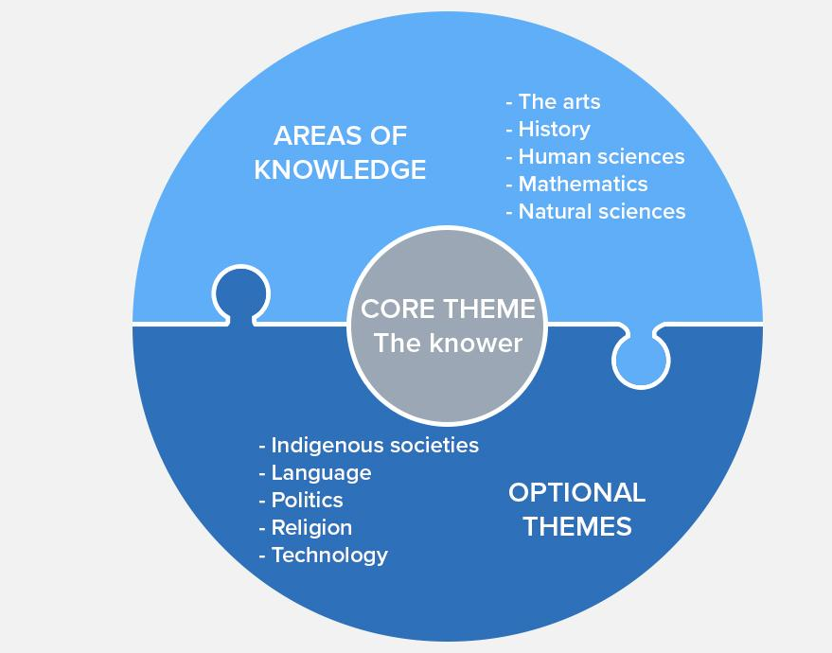
Starter
What do you think this diagram shows us?
What kind of relationship do you think the puzzle connectors represent between the AOKs and the optional themes?
How does this relationship inform us as knowers?
Notes:
Animated slide. Reveal the first question, get students to offer their answers (‘It’s TOK… it’s shows the different parts of the course… etc.’), then the second + third question.
Don’t over-explain or debrief; the next slide guides more depth and detail.

Slide 3
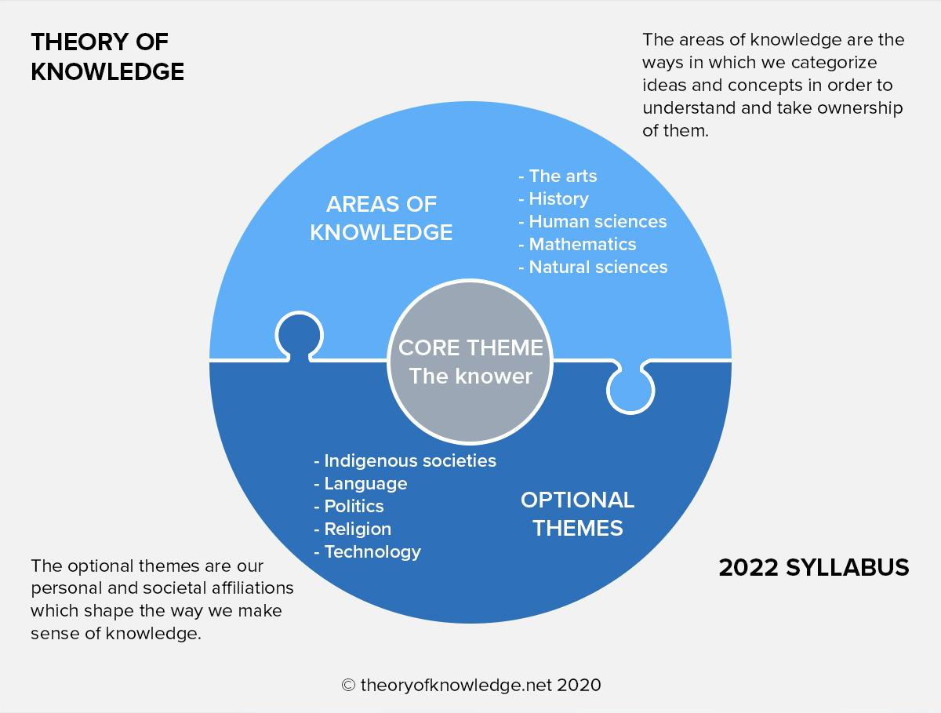
Making links 1
Think of one example of how our ‘personal and societal affiliations’ (an optional theme) can shape the way a knower makes sense of an area of knowledge.
Notes:
For example: the way we understand and use technology (eg social media) might shape the way we acquire knowledge about history; whether we belong to an indigenous society may affect how we view the arts; our religious outlook might shape how we make sense of knowledge in the natural sciences.

Slide 4
12 key concepts in TOK
Certainty Explanation Interpretation
Culture Evidence Justification
Objectivity Perspective Power
Responsibility Truth Values
Notes:
Suggested questions to process this: why do you think the IB has identified these 12 concepts as being particularly important? Would you add anything?
These words will appear throughout the BQ lesson presentations, we’ll use this colour font to make them stand out.

Slide 5

How will we study TOK?
The TOK course is structured into 6 ‘Big Questions’.
We’ll explore each one in the context of different areas of knowledge (AOKs), and consider how our role as knowers is influenced by the optional themes.
Break out groups: Look at the 6 Big Questions on the handout.
Discuss these BQs with your group.
Highlight the BQs in different colours - ‘I get’, ‘I kind of get’, and, ‘I don’t get’
Notes:
Students should read through the handout which provides the 6 Big Questions (and other aspects of the course).
Most should be answerable; some will be a little trickier; the idea is that students familiarise themselves with the questions, rather than offer anything particularly convincing.

Slide 6
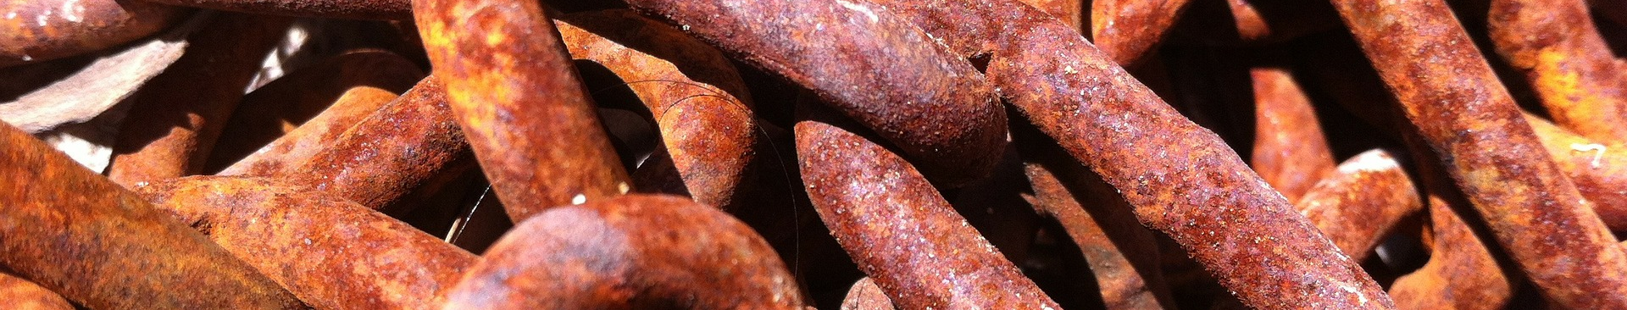
Making links 2
Choose one of the BQs. Answer it by making a connection between an area of knowledge, and an optional theme. Try to include the 12 key concepts in your answer. Example:
BQ5 = How is new knowledge about the world created?
“In the natural sciences, technology plays a crucial role in creating new knowledge, allowing knowers to explain and interpret the world more completely.”
Notes:
Collate answers; hopefully the students will have come up with things that you didn’t think of!
Check out this guide to including the key concepts within the context of the BQs (you can adapt the statements to apply them to AOKs and themes)

Slide 7

If someone asked you the question, ‘What is TOK?’, how would you explain it?
Notes:
Brevity is good
See the BQ1 assessment tracker for suggestions on providing feedback, and recording students’ progress

Slide 8
Linking this lesson to the course
During this lesson, we consider the highlighted aspects of the TOK course
The images used in the presentation slides can also give students ideas about selecting exhibition objects
CORE THEME | OPTIONAL THEMES | AREAS OF KNOWLEDGE | TOK ASSESSMENT
Knowledge & the knower | Indigenous societies | The arts | The TOK essay
 | Language | History
 | Politics | The human sciences | The TOK exhibition
 | Religion | Mathematics
 | Technology | The natural sciences

Slide 9

Explore the TOK themes and areas of knowledge in more depth via a range of thinkers, media sources, and other resources, in our EXPLORATION POINTS DOCUMENTS.
Access the documents via the links below. You’ll also find the EP icons on all of the TOK course pages of the site to help you unpack the quotes, KQs, and real-life situations that you find there.
CORE THEME
Knowledge & the knower
OPTIONAL THEMES
Indigenous societies
Language
Politics
Religion
Technology
AREAS OF KNOWLEDGE
The arts
History
Human sciences
Mathematics
Natural sciences
Notes:
Use this slide to access the ‘Exploration Points’ notes for BQ1, which will help students to develop a deeper knowledge of any TOK theme or area of knowledge. This will not only help them to master the TOK course in general, but also craft a great exhibition or essay.
Be ready to provide more guidance on how to use this resource - ie, which media sources to focus on, which questions to address, which TED talks to watch, and which key terms and ideas to understand.

