Slide 1


HOW WE KNOW VS. WHAT WE KNOW
BQ1 Foundations Lesson 3
I can distinguish between first and second-order knowledge
Notes:
See how this lesson links to the course by viewing the final slide
Key TOK terms appear in a red font

Slide 2

Starter
What’s the difference between what you study in TOK, and what you study in the rest of your DP subjects? Clue - consider the lesson title.
Notes:
In TOK, we are interested in the process of finding out about the world - and ask the overall question, ‘How do we know what we know?’.
In the other DP subjects, there is a much stronger fact-based framework of knowledge (although of course we try to infuse as much critical thinking as well - partly via the application of TOK).

Slide 3
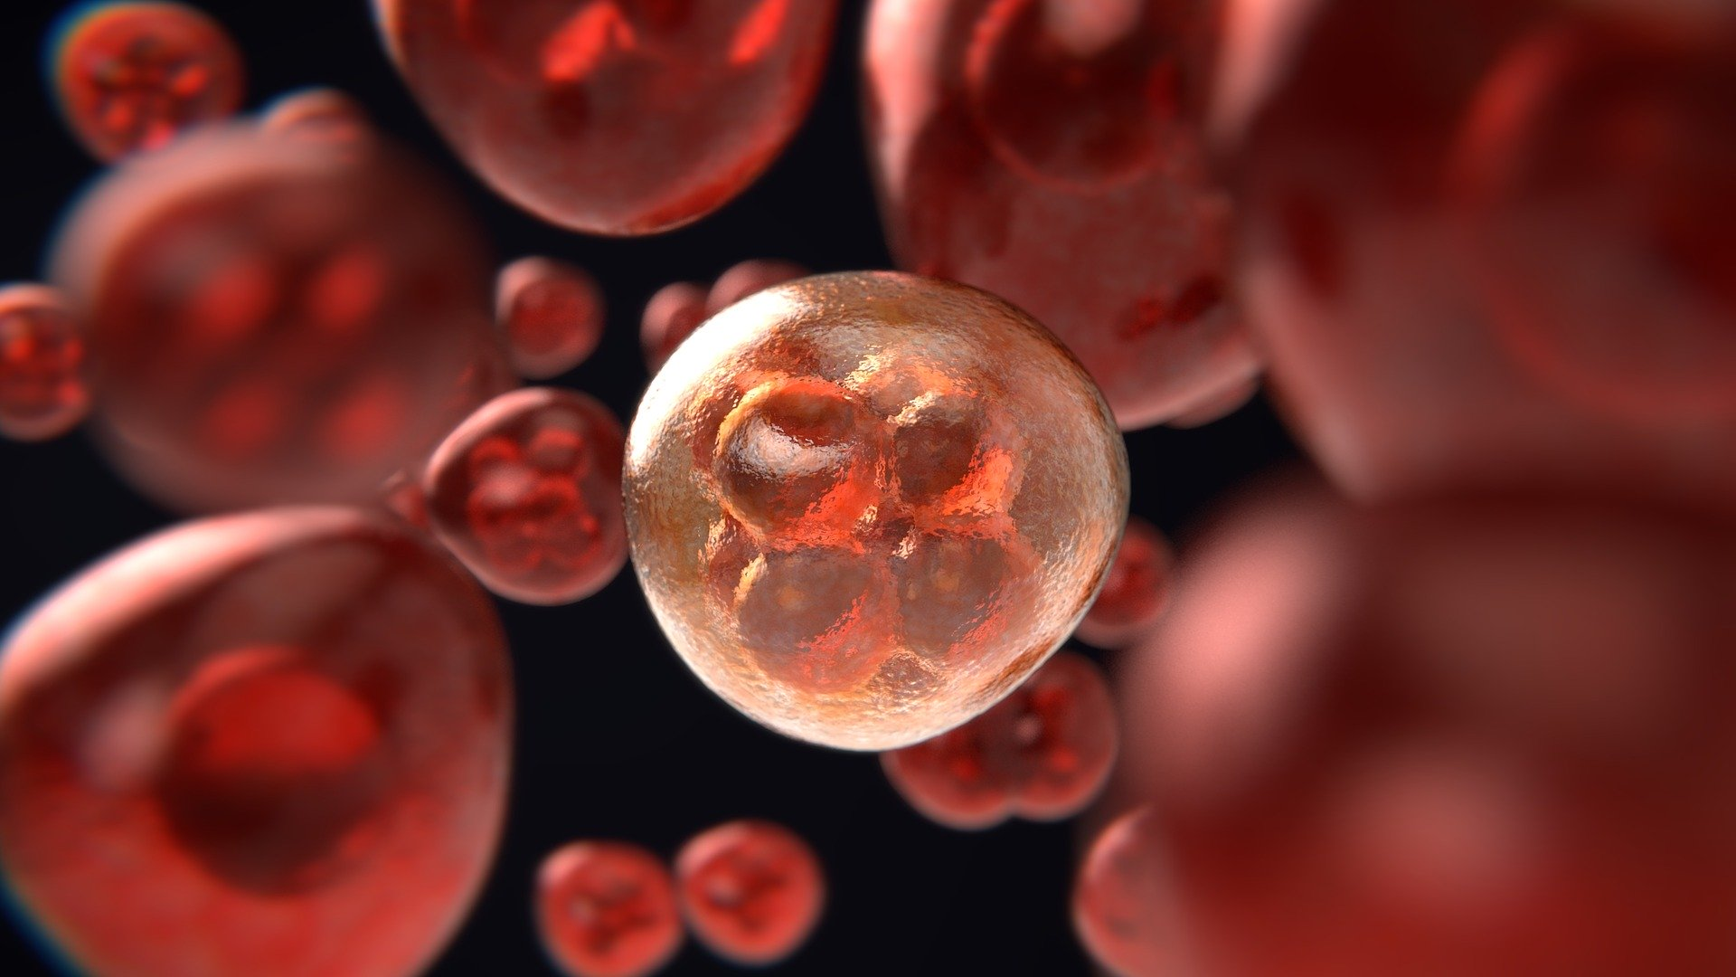
Task 1
Read the Newsweek article.
What real-life situation does the article discuss?
How does this link to TOK (think about the areas of knowledge)?
Notes:
Post article on Google Classroom, or project it on the screen. Be aware that Newsweek only allow a certain number of articles to be read per month.

Slide 4
Task 2
Here are some questions related to what the article discusses. Which of them are about what we know in science, and which ones are about how we know in science?
What are T-Cells?
What role does chance play in making discoveries?
How does the body fight cancer?
What treatments are used to treat cancer?
Why and how does knowledge change over time?
Notes:
What we know - 1, 3, 4
How we know - 2, 5
Note that ‘what we know’ doesn’t necessarily have to be asked via exclusively what-prefixed questions, nor does ‘how we know’ have to asked only via questions beginning with the word ‘how’.

Slide 5

Copy this
First-order knowledge is directly about the world. It has a narrow scope, related to a specific aspect of an area of knowledge. First-order knowledge questions generally (but not always!) ask, ‘What do we know…?’ They are more descriptive and factual.
Second-order knowledge is about the process of finding out about the world. It has a broad scope, related to one or more entire areas of knowledge. Second-order knowledge questions generally (but not always!) ask, ‘How do we know…?’ They are more analytical and debatable.
Your DP subjects are mostly concerned with first-order knowledge. TOK is mostly interested in second-order knowledge.
Notes:
Link all this to the core theme, knowledge and the knower - ie how we perceive and construct our understanding of the world.

Slide 6
A, H, S
You have been assigned an ‘A’, or an ‘H’.
Look on Google Classroom at the links to the articles - find either the one related to the arts, or history, depending on your letter
With a partner, first turn the story into a Tweet, making sure that you mention the area of knowledge dealt with by the article. Then identify one question that is about first-order knowledge, and one question that is about second-order knowledge.
Remember: first-order KQs ask directly about the world, and are more specific in scope, and second-order KQs ask about the process of gaining knowledge about the world, and are broader in scope .
Notes:
Assign pairs of students an ‘A’, an ‘H’, or an ‘S’. Post articles on Google Classroom. Circulate and support students as they do this. Then, cold call, and collate responses.
The arts article is here. KQs that could be connected to this story include (first-order): ‘What is the message of this work of art by Banksy?’ and (second-order): ‘How do the arts help us to understand values?’ (Alternatively, try this article, which helps us to understand the way art is open to huge interpretation - with this artist trying to claim that ‘nothing’ can actually be art, as long as we apply our imagination to view it.)
The history article is here. KQs that could be connected to this story include (first-order): ‘What was the role of Poland in the outbreak of WW2?’ and (second-order): ‘How do different political perspectives lead to different interpretations of history?’ (Alternatively, try this article, which helps us explore the way we learn about the past, asserting that dressing in historical clothing can give us a greater insight into reality than more ‘intellectual’ methods of accessing the past such as textbooks.)
The science article is here. KQs that could be connected to this story include (first-order): ‘What is the risk of death associated with Covid?’ and (second-order): ‘What role do intuitive approaches play in our understanding of the natural world?’

Slide 7

Your turn
In pairs, find an interesting real-life situation. This can be a news story, a personal/learning experience, an issue, or anything else going on at the moment.
Compose a tweet about your RLS, which explains it, and links it to TOK.
Identify a first-order knowledge question.
Identify a second-order knowledge question.
Notes:
This is a tough challenge; give students a few suggestions of media sources (Guardian, BBC, CNN, Atlantic, etc.) that would work, and plenty of time.

Slide 8

Links to the TOK exhibition
Related exhibition prompt How does the way we organize knowledge affect what we know (IAP-6)?
Refer to the ideas from this lesson to answer this question.
For example, how is our understanding of the nature of knowledge changed by classifying it into first and second order knowledge? What other ways can we organize types of knowledge?
Which objects could help to illustrate your answer?
Notes:
Optional slide, if you want to help students to take ownership of the IA prompts (IAPs) for the TOK exhibition
For more ideas on relevant IAPs, see the ‘Linking this lesson to the course’ slide

Slide 9

Why do you think we are more interested in second-order than first-order knowledge in TOK?
Notes:
Because that’s how we reflect on the way in which we construct our understanding of the world, whether we are using knowledge in a valid way, and how to improve our knowledge and interaction with what’s out there.
See the BQ1 assessment tracker for suggestions on providing feedback, and recording students’ progress

Slide 10
Linking this lesson to the course
During this lesson, we consider the highlighted aspects of the TOK course
The images used in the presentation slides can also give students ideas about selecting exhibition objects; see also our link below to a specific IA prompt
CORE THEME | OPTIONAL THEMES | AREAS OF KNOWLEDGE | TOK ASSESSMENT
Knowledge & the knower | Indigenous societies | The arts | The TOK essay
 | Language | History
 | Politics | The human sciences | The TOK exhibition Could be linked to IAP-2 (types), IAP-6 (organize)
 | Religion | Mathematics
 | Technology | The natural sciences

Slide 11

Explore the TOK themes and areas of knowledge in more depth via a range of thinkers, media sources, and other resources, in our EXPLORATION POINTS DOCUMENTS.
Access the documents via the links below. You’ll also find the EP icons on all of the TOK course pages of the site to help you unpack the quotes, KQs, and real-life situations that you find there.
CORE THEME
Knowledge & the knower
OPTIONAL THEMES
Indigenous societies
Language
Politics
Religion
Technology
AREAS OF KNOWLEDGE
The arts
History
Human sciences
Mathematics
Natural sciences
Notes:
Use this slide to access the ‘Exploration Points’ notes for BQ1, which will help students to develop a deeper knowledge of any TOK theme or area of knowledge. This will not only help them to master the TOK course in general, but also craft a great exhibition or essay.
Be ready to provide more guidance on how to use this resource - ie, which media sources to focus on, which questions to address, which TED talks to watch, and which key terms and ideas to understand.

