Slide 1


INTRODUCTION TO BQ2
BQ2 Values Lesson 1
I can compare and contrast BQ2 within the context of different areas of knowledge
Notes:
See how this lesson links to the course by viewing the final slide
Key TOK terms appear in a red font

Slide 2

Starter
What did we say the ‘areas of knowledge’ (AOKs) were?
How many of the areas of knowledge can you list?

Slide 3
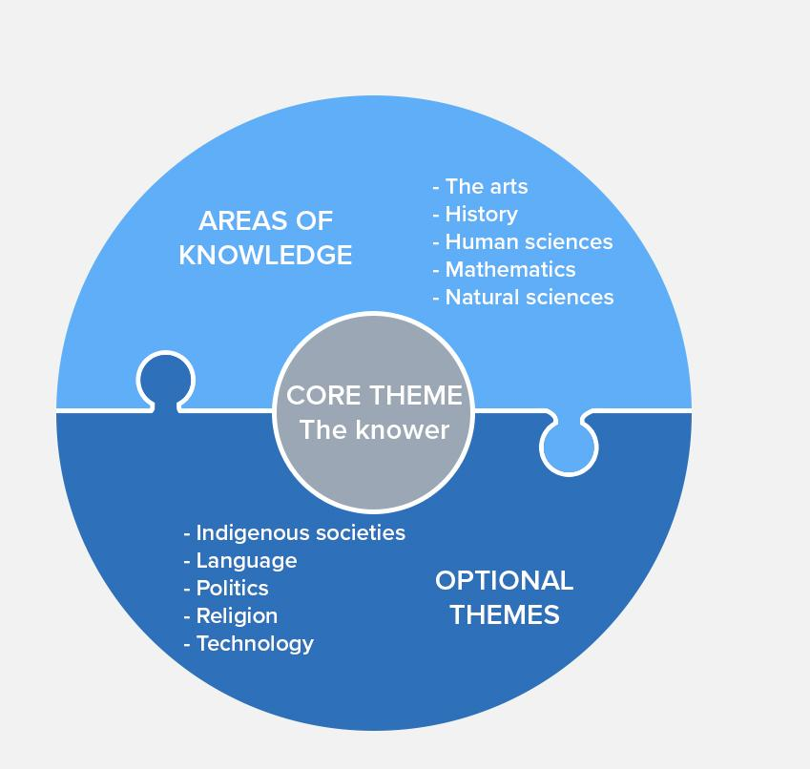
The five AOKs
What initial differences do you see between the areas of knowledge, in terms of the type of knowledge they deal with, and how it is produced?
Notes:
Key idea here is the level of objectiveness (and subjectiveness).
But think in terms of the 6BQs - their relationship with language, expert knowers, how they change over time, etc., etc.

Slide 4

Linking the BQ to the AOKs
BQ2 asks: How does our knowledge about the world inform the way we construct our values?
Select an AOK. With a partner, discuss:
How might ethical considerations affect the way knowledge is produced in this AOK?
How could this AOK help us to understand ethics and morality?
Present your ideas on an A3 sheet of paper. Make them as visual as possible (use limited text)
Notes:
It may be necessary to supply a simple definition of ‘ethics’: “the study of morality”.

Slide 5
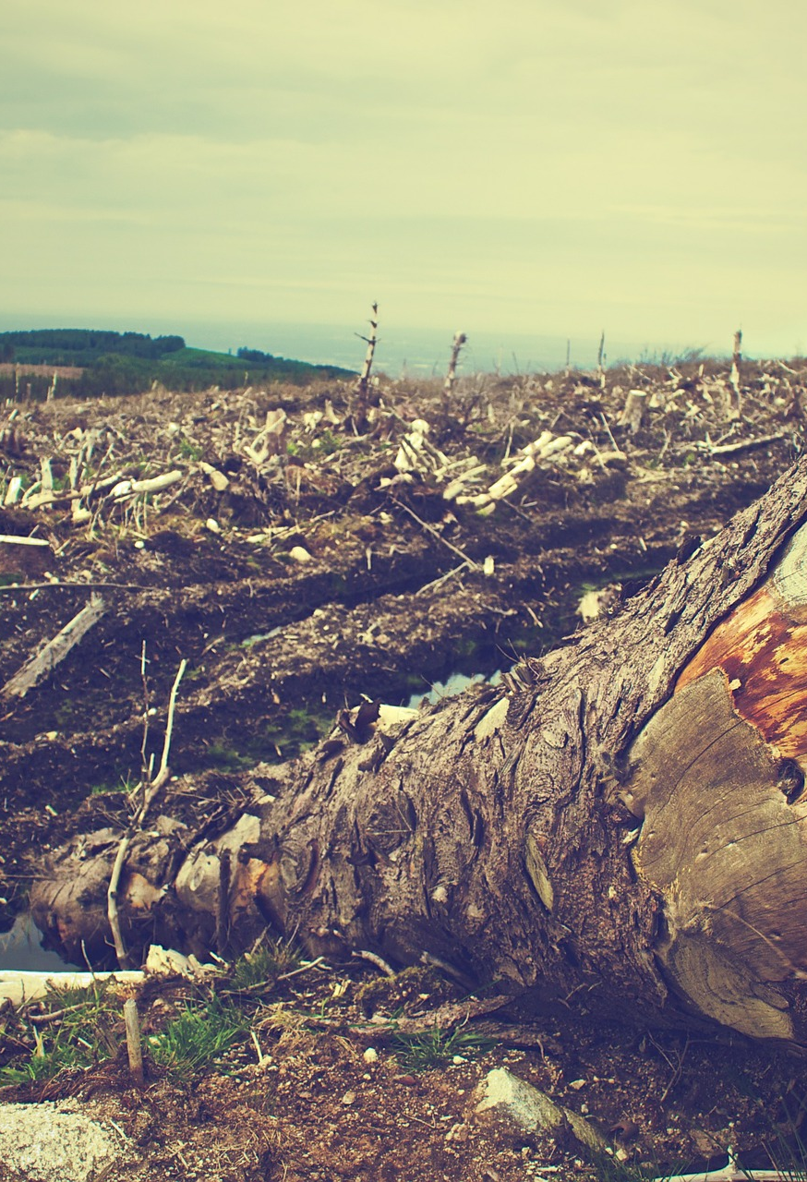
Real- world contexts
What role do real-life situations (RLSs) play in TOK?
Why do you think we value them more than, say, hypothetical situations?
Follow the link to the RLS for your AOK. On your display, add:
A brief outline of your RLS and how it links to your AOK.
What this tells us about the relationship between your AOK and ethics.
Notes:
Links and guidance (students will need a lot of help to identify these ideas, although they’ll probably find a lot more). This is a chance to explain some of the characteristics of ideal RLSs: original, recent, significant, etc. Students should also draw on their own experiences.
The arts - This RLS shows how there is often a difficult relationship between the moral position of the artist, and the work that they produce. It poses questions such as how should we view the art of people who have questionable moral stances, and should we ‘cancel’ it?
History - This RLS shows the importance of remembering events from the past in order to be more aware of moral transgressions in the present. Do we all have a responsibility to know about the past? How does this help us become more morally-aware knowers?
The human sciences - This RLS shows us that we need to become ‘long-term thinkers’ in order to safeguard civilization, and also understand the key issues going on in the human and natural world (specifically, climate change). Do we have a moral obligation to think in this way?
Mathematics - This RLS shows that mathematical knowledge (algorithms) does not provide us with an absolutely objective foundation point for making ethical decisions - because humans are behind their development.
The natural sciences - This RLS shows us there are many ethically controversial issues in the natural sciences, such as lab-grown embryos. This leads us onto questions such as whether there should be limitations on the production of knowledge in science.

Slide 6

Idea swap
Walk around the class, and discuss what the other groups have thought about and produced. Choose another display to present to the rest of the class. Make sure you are clear about:
Their AOK
How ethical considerations could affect the way knowledge is produced in this AOK
How this AOK could help us to understand ethics and morality

Slide 7

Links to the TOK exhibition
Related exhibition prompt Why do we seek knowledge (IAP-17)?
Refer to the ideas from this lesson to answer this question.
For example, do we seek knowledge in order to be able to make more effective moral judgements? Does knowledge make us ‘better’ people?
Think about objects which might help to illustrate your answer.
Notes:
Optional slide, if you want to help students to take ownership of the IA prompts (IAPs) for the TOK exhibition
Note that the IB recommends using the core and/or optional themes as the context of the exhibition commentary, whereas this lesson deals more with areas of knowledge

Slide 8

Choose one of the AOKs that you did NOT consider on your own display, or on the one you presented.
Briefly explain ANY aspect of the relationship between this AOK and the way we construct our values.
Write your response on a Post-It.
Notes:
Exit task option 1
Post-its stuck to displays
See the BQ2 assessment tracker for suggestions on providing feedback, and recording students’ progress

Slide 9
Write a TOK essay-style introduction to BQ1: How does our knowledge about the world inform the way we construct our values?
Submit to GC.
Notes:
Exit task option 2
Outline to students the structure of a TOK essay introduction: ‘hook’, explanation, outline of scope
See the BQ2 assessment tracker for suggestions on providing feedback, and recording students’ progress

Slide 10
Linking this lesson to the course
During this lesson, we consider the highlighted aspects of the TOK course
The images used in the presentation slides can also give students ideas about selecting exhibition objects; see also our link below to a specific IA prompt
CORE THEME | OPTIONAL THEMES | AREAS OF KNOWLEDGE | TOK ASSESSMENT
Knowledge & the knower | Indigenous societies | The arts | The TOK essay
 | Language | History
 | Politics | The human sciences | The TOK exhibition Could be linked to IAP-17 (seek), IAP-20 (experience), IAP-26 (interactions)
 | Religion | Mathematics
 | Technology | The natural sciences

Slide 11

Explore the TOK themes and areas of knowledge in more depth via a range of thinkers, media sources, and other resources, in our EXPLORATION POINTS DOCUMENTS.
Access the documents via the links below. You’ll also find the EP icons on all of the TOK course pages of the site to help you unpack the quotes, KQs, and real-life situations that you find there.
CORE THEME
Knowledge & the knower
OPTIONAL THEMES
Indigenous societies
Language
Politics
Religion
Technology
AREAS OF KNOWLEDGE
The arts
History
Human sciences
Mathematics
Natural sciences
Notes:
Use this slide to access the ‘Exploration Points’ notes for BQ2, which will help students to develop a deeper knowledge of any TOK theme or area of knowledge. This will not only help them to master the TOK course in general, but also craft a great exhibition or essay.
Be ready to provide more guidance on how to use this resource - ie, which media sources to focus on, which questions to address, which TED talks to watch, and which key terms and ideas to understand.

