Slide 1


FENCES
BQ2 Values Lesson 10
I can explain how a society’s values can determine the purpose of its knowledge about the natural world
Notes:
See how this lesson links to the course by viewing the final slide
Key TOK terms appear in a red font

Slide 2
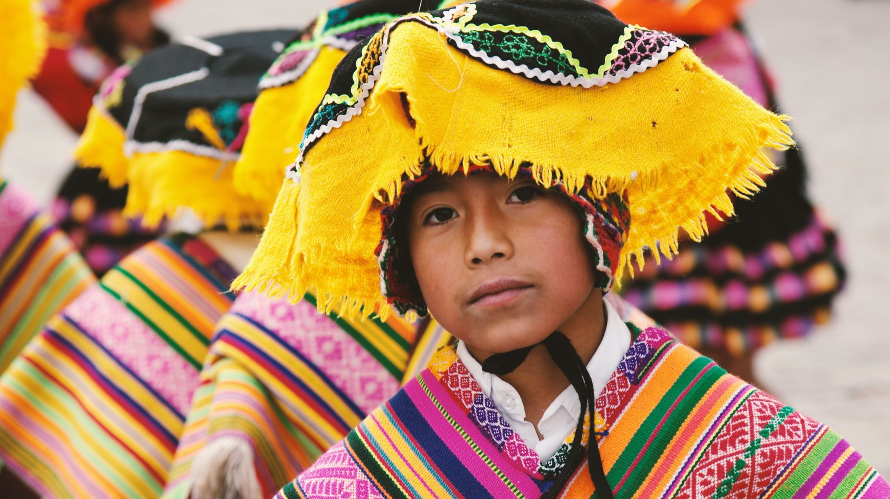
Starter
What does the term indigenous mean?
Be ready to give an example to support your answer.
Notes:
Take ideas, but we’ll explore this in more detail on next slide.

Slide 3
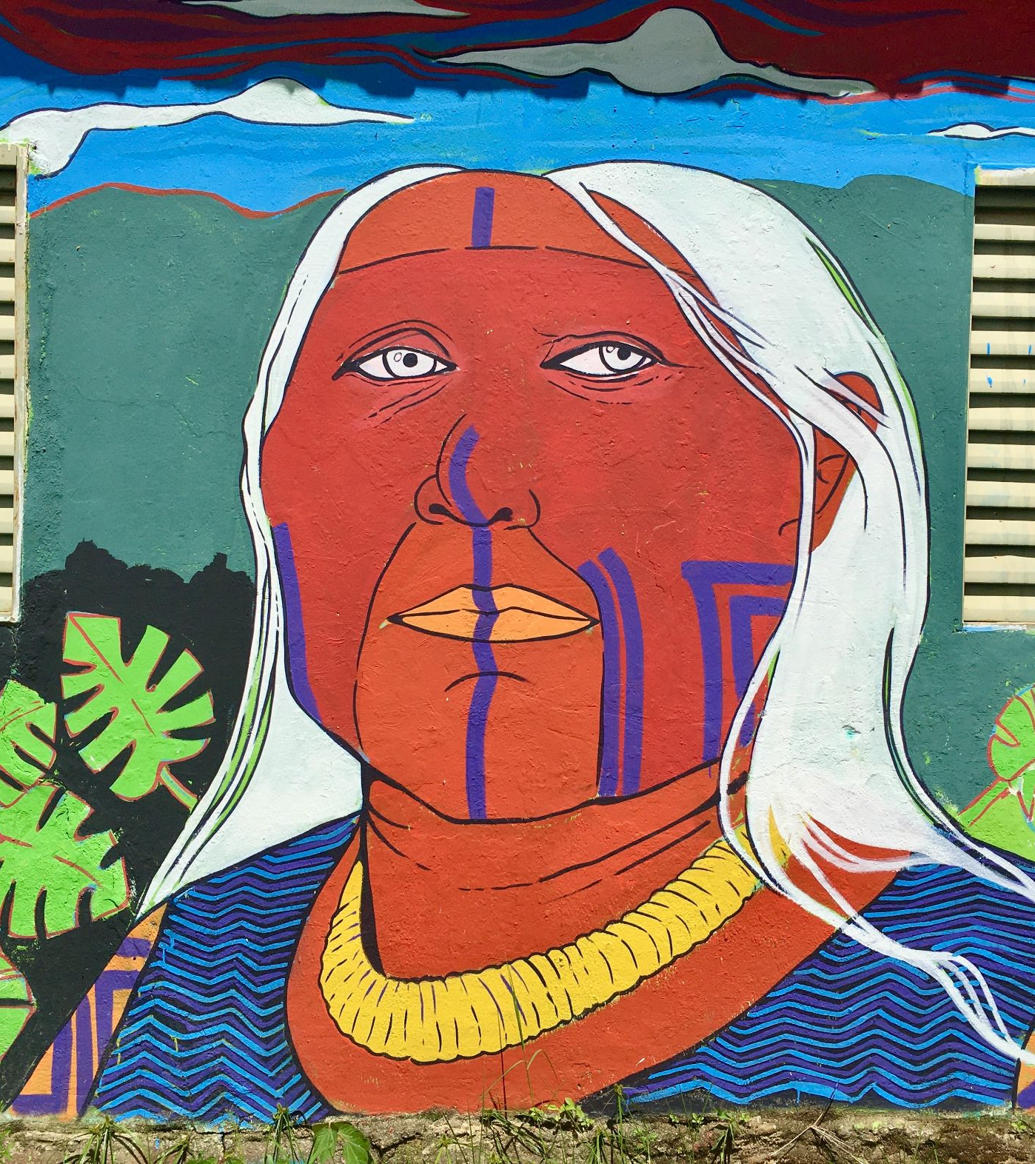
Defining
‘indigenous’
Use the Defining indigenous societies document to explain how these eight terms link to and define indigenous societies:
Diversity
Self-identification
Continuity
Community
Balance & harmony
Spoken language
Art as communication
Small-scale
Notes:
Defining indigenous societies.
Divide big paper into quarters, and write answers on one of these spaces. See next slide for what this should look like.

Slide 4
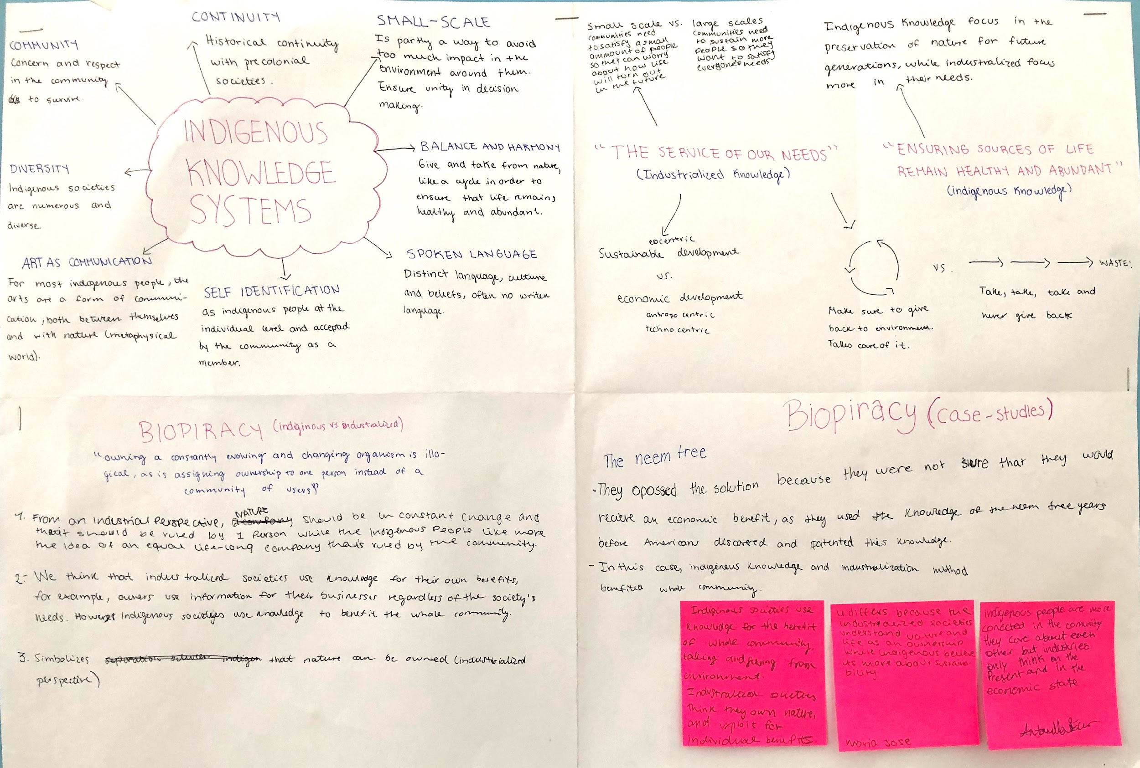
Notes:
Exemplar display - this is what students should be producing by the end of the lesson (show now, or at end of lesson)

Slide 5

Different outlooks
“The whole point of science is to find out… how we can best use our knowledge of nature in the service of our needs.” Neil deGrasse Tyson, US physicist
“Life is sustained through balance and harmony... [indigenous people] give and take from nature in synchrony with natural cycles, ensuring that our sources of life remain healthy and abundant.” Rebecca Adamson, Cherokee economist and founder of First Peoples Worldwide
What differences do these quotes reveal about the way indigenous and industrialised societies think? Copy the bits in green, and add your thoughts to this question on another quarter of your sheet.
Notes:
Copy green part of the quotes onto another quarter of the big paper, and answer the question.
Even though we love NdGT, his quote supports the idea that scientific knowledge is something we use in order to exploit (or at least use) the natural world. Clearly, the Adamson quote reveals a very different purpose to knowledge, and the relationship of indigenous peoples to the natural world.

Slide 6

Owning nature
Read the article on Biopiracy, focusing on this section:
“At the heart of the matter is the idea of ownership… for many traditional farmers or indigenous groups, owning a constantly evolving and changing organism is illogical, as is assigning ownership to one person instead of a community of users.”
Copy the words in green, and answer -
In what distinct ways do industrialized and indigenous societies view the ownership of the natural world?
Why’s there a picture of a fence on this page? Draw one on your sheet!
Notes:
Quote comes from the article (here).
Copy the yellow part of the quote onto the next quarter, and answer the two questions.
Instruction: Refer to the idea of ‘scientific colonialism’. Compare to ‘bioprospecting’. Consider the ethics of what is going on
Image shows a fence - a concept that is often not recognised by indigenous societies.

Slide 7

Biopiracy
Choose an example of biopiracy (/bioprospecting) to find out about. On the final quarter of your paper, give -
A very brief summary of your example.
What it reveals about the different ways indigenous and industrialised societies see their responsibility towards the natural world, and use their knowledge.
A comparison to another case of biopiracy (if time - find out from another pair).
Notes:
Choose from the Wikipedia page on bioprospecting here. Students can choose their own example if they prefer.
The instructions and Wikipedia link is on Google Classroom.

Slide 8

Links to the TOK exhibition
Related exhibition prompt What is the relationship between knowledge and culture (IAP-21)?
Refer to the ideas from this lesson to answer this question.
For example, how does our culture determine the way we acquire and produce knowledge about the natural world?
Think about objects which might help to illustrate your answer.
Notes:
Optional slide, if you want to help students to take ownership of the IA prompts (IAPs) for the TOK exhibition

Slide 9

How does the purpose of knowledge of the natural world differ between indigenous and industrialised societies? Include the word ownership in your answer.
For extra credit, say why you think indigenous approaches to knowledge are being embraced more and more by academics and other expert knowers.
Notes:
Post-Its, added to the big paper
Because of the damage we’re doing to the environment, we’re becoming more and more interested in the way indigenous societies value, look after, and live in balance with the natural world
See the BQ2 assessment tracker for suggestions on providing feedback, and recording students’ progress

Slide 10
Linking this lesson to the course
During this lesson, we consider the highlighted aspects of the TOK course
The images used in the presentation slides can also give students ideas about selecting exhibition objects; see also our link below to a specific IA prompt
CORE THEME | OPTIONAL THEMES | AREAS OF KNOWLEDGE | TOK ASSESSMENT
Knowledge & the knower | Indigenous societies | The arts | The TOK essay
 | Language | History
 | Politics | The human sciences | The TOK exhibition Could be linked to IAP-21 (culture), IAP-34/35 (values)
 | Religion | Mathematics
 | Technology | The natural sciences

Slide 11

Explore the TOK themes and areas of knowledge in more depth via a range of thinkers, media sources, and other resources, in our EXPLORATION POINTS DOCUMENTS.
Access the documents via the links below. You’ll also find the EP icons on all of the TOK course pages of the site to help you unpack the quotes, KQs, and real-life situations that you find there.
CORE THEME
Knowledge & the knower
OPTIONAL THEMES
Indigenous societies
Language
Politics
Religion
Technology
AREAS OF KNOWLEDGE
The arts
History
Human sciences
Mathematics
Natural sciences
Notes:
Use this slide to access the ‘Exploration Points’ notes for BQ2, which will help students to develop a deeper knowledge of any TOK theme or area of knowledge. This will not only help them to master the TOK course in general, but also craft a great exhibition or essay.
Be ready to provide more guidance on how to use this resource - ie, which media sources to focus on, which questions to address, which TED talks to watch, and which key terms and ideas to understand.

