Slide 1
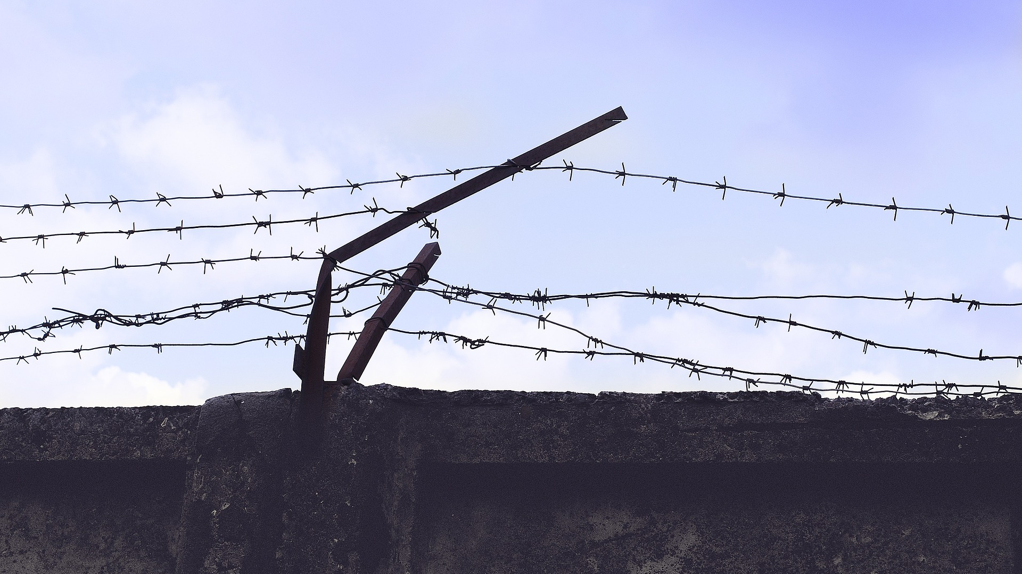

ART VS. ARTIST
BQ2 Values Lesson 7
I can assess how our ethical principles affect the way we interpret art
Notes:
See how this lesson links to the course by viewing the final slide
Key TOK terms appear in a red font

Slide 2
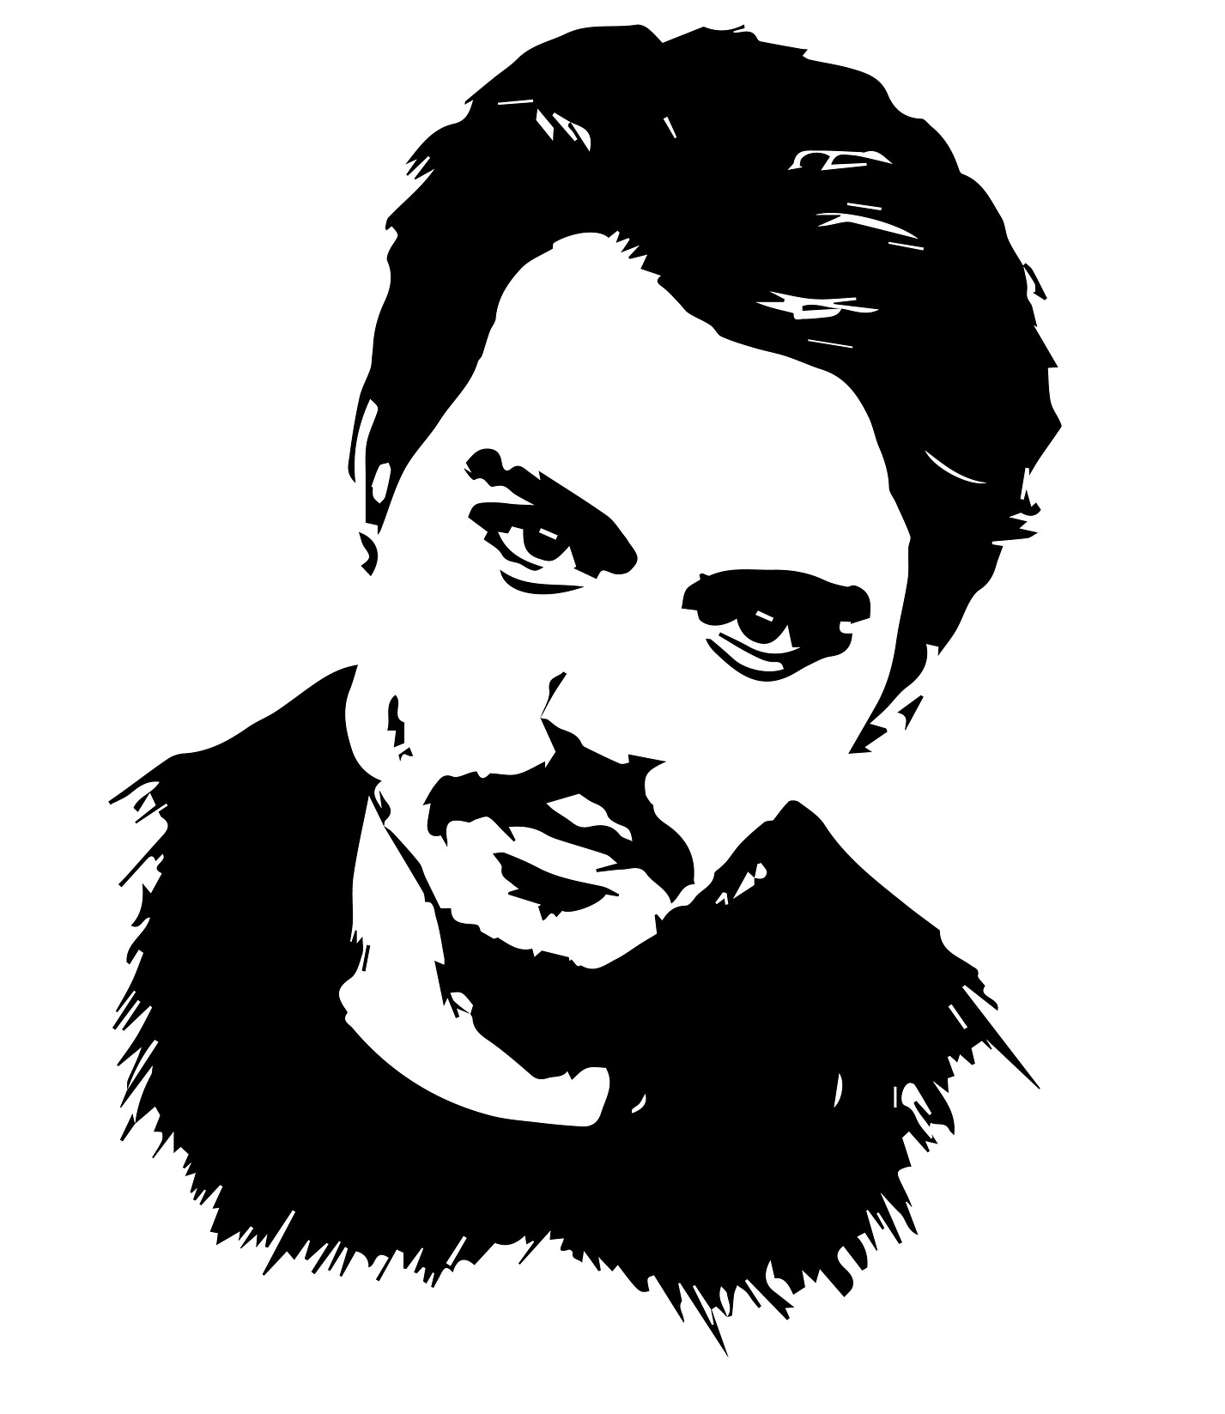
Starter
“Johnny Depp accused of physically abusing ex-wife Amber Heard”
“XXXTentacion beat up his pregnant girlfriend”
“K-pop stars jailed for rape”
When you see headlines like these, does it put you off the music, movies, or other art forms associated with the people involved?

Slide 3

Podcast
“we are not obliged to devalue works of art we once admired in view of the acts of horror or violence involved in their creation” (Shahidha Bari - listen to her podcast)
What did Bari mean?
Do you agree with her?

Slide 4
Instructions
Look through the gallery of artists
Choose 3 to explore - each from a different century (when they were born, or when they worked), and a different field
Outline why they are considered outstanding artists
Explain how their lives are/were controversial
Assess whether and how this controversy should shape our judgement of their achievements

Slide 5
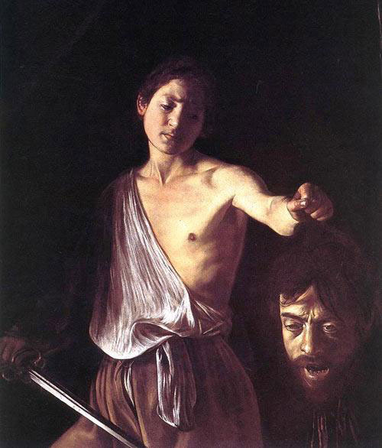
Caravaggio, artist, 1571 - 1610

Slide 6
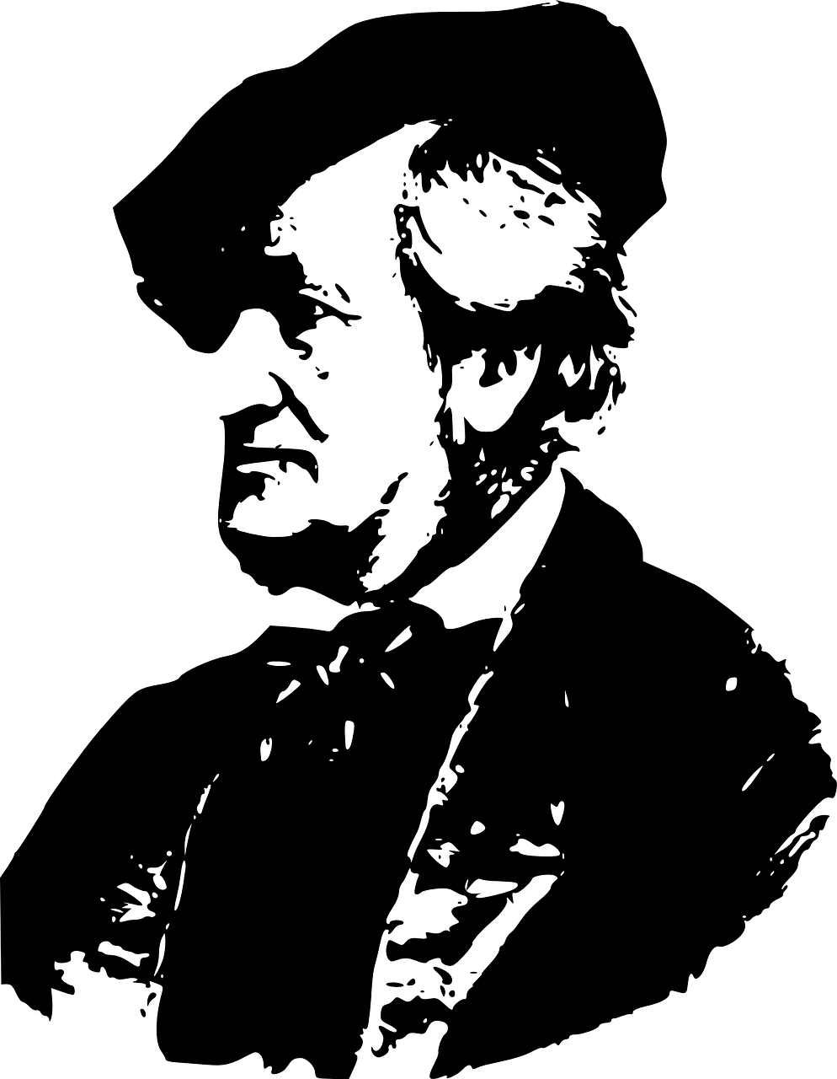
Richard Wagner, composer, 1813 - 1883

Slide 7
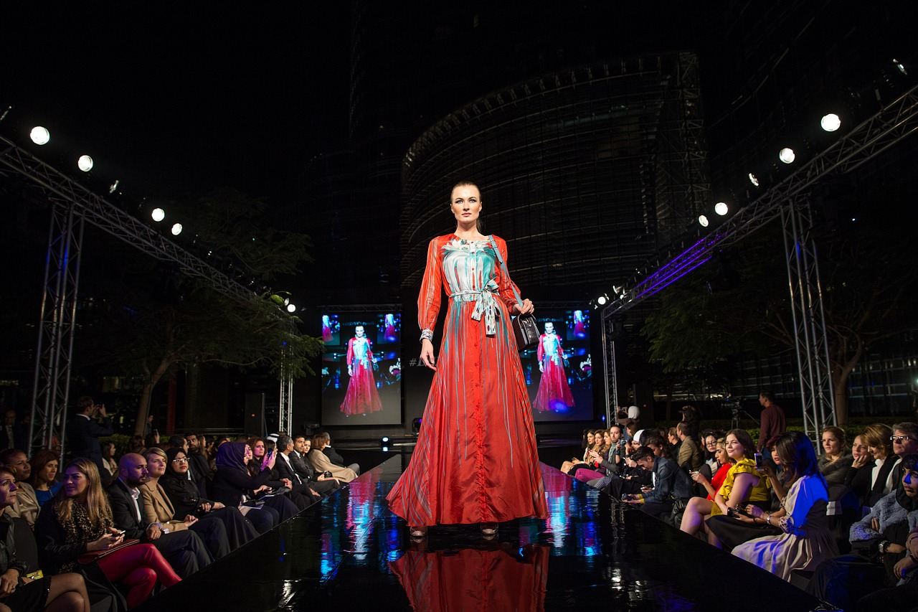
John Galliano, fashion designer, 1960 -

Slide 8
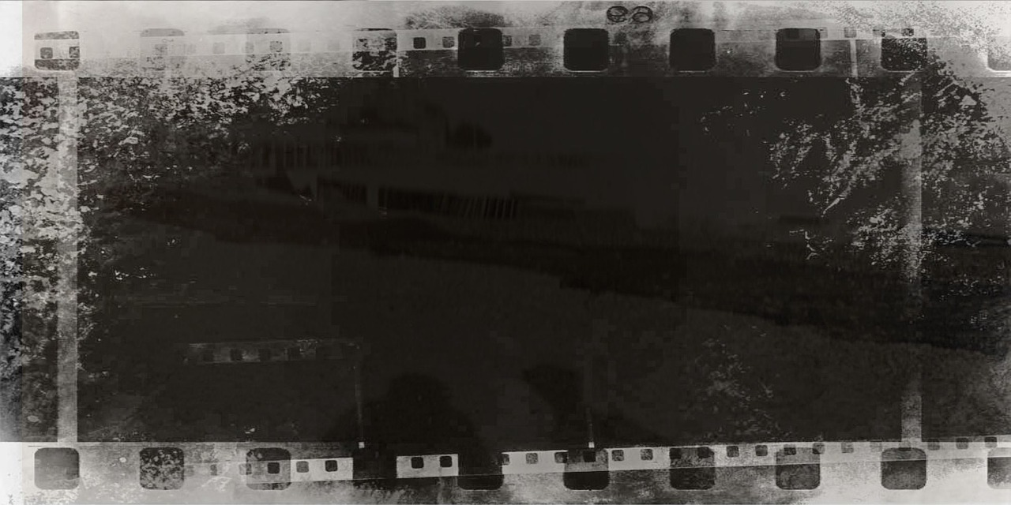
Roman Polanski, movie director, 1933 -

Slide 9
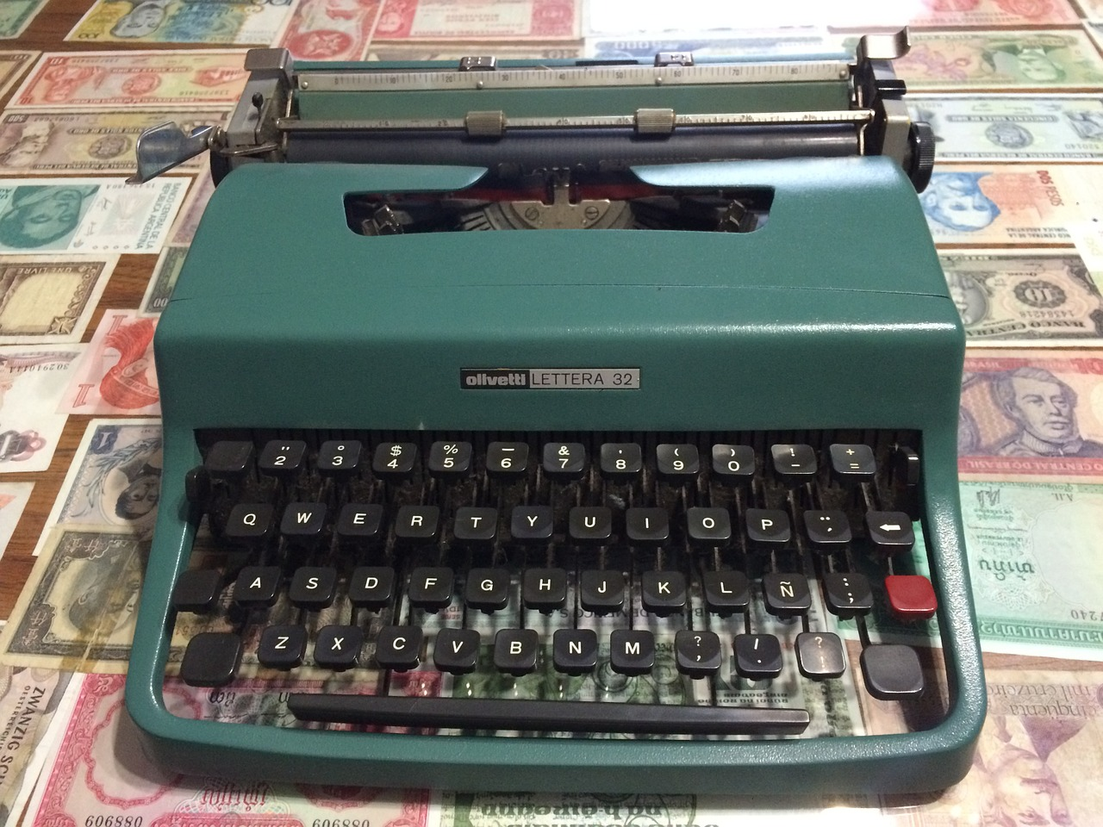
Norman Mailer, writer, 1923 - 2007

Slide 10
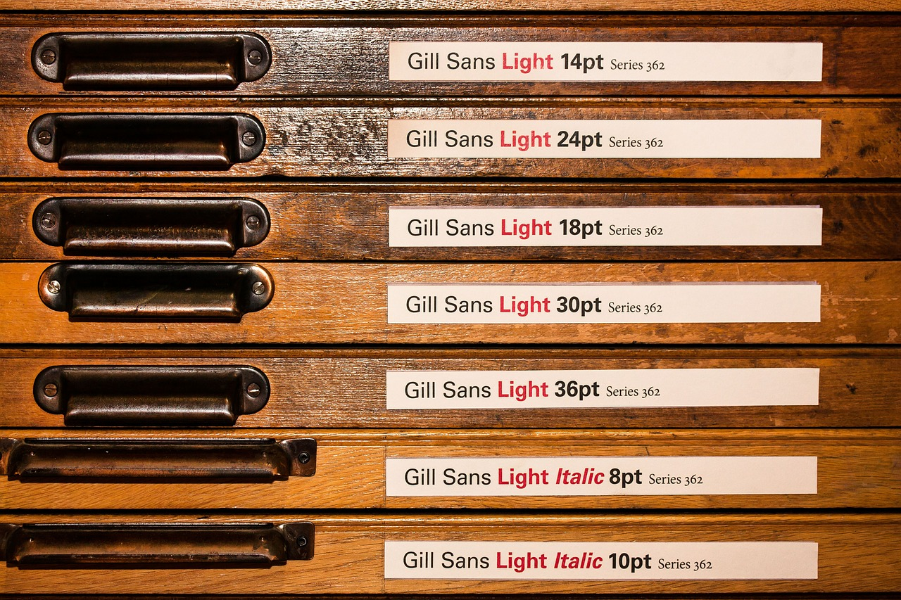
Eric Gill, designer and typographer, 1882 - 1940

Slide 11

Woody Allen, movie director, 1935 -

Slide 12

Links to the TOK exhibition
Related exhibition prompt Should some knowledge not be sought on ethical grounds? (IAP-16)?
Refer to the ideas from this lesson to answer this question.
For example, should we ‘cancel’ certain artworks if they come from artists whose moral or political standpoints are objectionable? What are the implications of doing this?
Think about objects which might help to illustrate your answer.
Notes:
Optional slide, if you want to help students to take ownership of the IA prompts (IAPs) for the TOK exhibition
Note that the IB recommends using the core and/or optional themes as the context of the exhibition commentary, whereas this lesson deals more with areas of knowledge (the arts)

Slide 13

Is it possible to assess the value of art without considering the moral integrity of its creator?
Notes:
See the BQ2 assessment tracker for suggestions on providing feedback, and recording students’ progress

Slide 14
Linking this lesson to the course
During this lesson, we consider the highlighted aspects of the TOK course
The images used in the presentation slides can also give students ideas about selecting exhibition objects; see also our link below to a specific IA prompt
CORE THEME | OPTIONAL THEMES | AREAS OF KNOWLEDGE | TOK ASSESSMENT
Knowledge & the knower | Indigenous societies | The arts | The TOK essay
 | Language | History
 | Politics | The human sciences | The TOK exhibition Could be linked to IAP-16 (ethical), IAP-34 (values)
 | Religion | Mathematics
 | Technology | The natural sciences

Slide 15

Explore the TOK themes and areas of knowledge in more depth via a range of thinkers, media sources, and other resources, in our EXPLORATION POINTS DOCUMENTS.
Access the documents via the links below. You’ll also find the EP icons on all of the TOK course pages of the site to help you unpack the quotes, KQs, and real-life situations that you find there.
CORE THEME
Knowledge & the knower
OPTIONAL THEMES
Indigenous societies
Language
Politics
Religion
Technology
AREAS OF KNOWLEDGE
The arts
History
Human sciences
Mathematics
Natural sciences
Notes:
Use this slide to access the ‘Exploration Points’ notes for BQ2, which will help students to develop a deeper knowledge of any TOK theme or area of knowledge. This will not only help them to master the TOK course in general, but also craft a great exhibition or essay.
Be ready to provide more guidance on how to use this resource - ie, which media sources to focus on, which questions to address, which TED talks to watch, and which key terms and ideas to understand.

