Slide 1


VALUE-FREE OR VALUE-LADEN?
BQ2 Values Lesson 9
I can assess whether scientific and mathematical knowledge can be produced in a ‘value-free’ way
Notes:
See how this lesson links to the course by viewing the final slide
Key TOK terms appear in a red font
Mathematics doesn’t have to be covered if you are not doing slide 7. Adjust LO is this is the case.

Slide 2

Starter
How does the knowledge within sciences differ from artistic knowledge? Hint - use the words ‘objective’ and ‘subjective’ in your answer.
Notes:
Scientific knowledge is generally regarded as more objective than artistic knowledge, and far less open to interpretation.
Students may even point out (thinking in the context of the BQ) that science has less of a role in shaping our moral awareness - although we’ll be looking at the validity of that in this lesson.

Slide 3

Group thinking
Form yourself into groups.
Come up with a definition of science that you all agree with.
Notes:
This should not be an easy question!
Try to get students think about where they’re placing the emphasis - on the method, on the knowledge itself, or on something else?

Slide 4

Compare your definition...
This is the definition of science according to the British Science Council.
"...Science is the pursuit of knowledge and understanding of the natural and social world following a systematic methodology based on evidence."
Whose definition do you prefer?
What do we commonly call this ‘systematic’ methodology?
Notes:
Article about this definition here.
The British Science Council spent one year and over £1,000,000 coming up with this definition - if time, discuss with your students why it so important to get this definition right.
This methodology is often called ‘the scientific method’. We’ll think about it on the next slide...

Slide 5
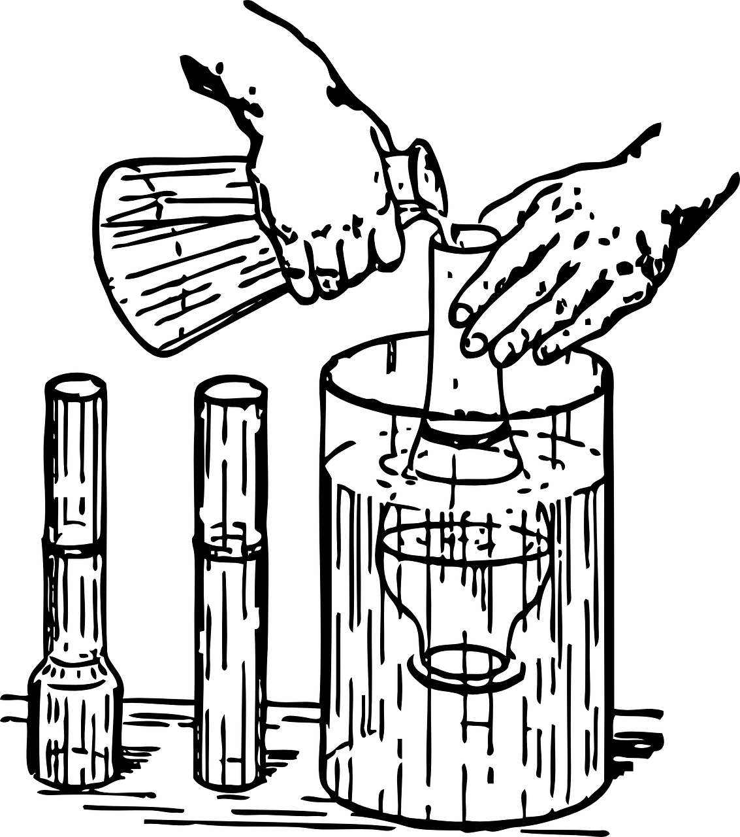
Typical stages of the scientific method
1. Asking a question
2. Initial research
3. Hypothesis
4. Experimentation
5. Analysis of data
6. Peer Review
7. Publication
8. Replication
Examine the step of the scientific method.
How have they been designed to ensure that knowledge is produced in an objective way?
What role do values play in the production of scientific knowledge?
How else is objectivity ensured in science?
Notes:
The SM - as it is traditionally viewed - is designed to be highly objective.
Values therefore seem to play no part in it (but we’ll question this during the next two slides).
We try to ensure objectivity via the use of instruments and technology, an agreed-upon language used by scientists, an academic community that is strictly regulated, etc., etc., etc.
NOTE - we’ll revisit the scientific method in BQ5 - Creativity.

Slide 6

Value-free vs. value- laden science
Write three short paragraphs answering these questions, based on this Conversation article, and including the quotes mentioned.
1. Why does Kevin Elliot say that science is “value-laden”?
“real-world problems”
“extrapolate beyond the available data”
“language employed by scientists is often laden with values”
2. How should this influence the way we produce scientific knowledge?
“Recognizing values helps science’s integrity”
“promote as much transparency in science as possible”
“science is done by and for human beings.”
3. How does the article challenge the idea of science being carried out in a ‘value-free’ way?

Slide 7

Value-free vs. value-laden mathematics
Mathematics is commonly seen as the most objective of all the AOKs.
One of the most important ways in which mathematical knowledge plays a role in society is in the creation of algorithms.
What is Cathy O’Neil’s argument in this 3-minute video that algorithms do not provide us with the means to make objective decisions about the world?
Notes:
This is not science, so can be viewed as an optional slide. But it’s a nice video, and links well to what we’ve just been looking at.
Video link here.

Slide 8

Links to the TOK exhibition
Related exhibition prompt: In what ways do values affect the production of knowledge (IAP-35)?
Refer to the ideas from this lesson to answer this question.
For example, how can our values impinge on the way scientific and mathematical knowledge is produced? Does this undermines or strengthens the integrity of the knowledge?
Think about objects which might help to illustrate your answer.
Notes:
Optional slide, if you want to help students to take ownership of the IA prompts (IAPs) for the TOK exhibition
Note that the IB recommends using the core and/or optional themes as the context of the exhibition commentary, whereas this lesson deals more with areas of knowledge (mathematics/natural sciences)

Slide 9

Are science and mathematics value-free or value-laden?
Is this a problem?
Notes:
See the BQ2 assessment tracker for suggestions on providing feedback, and recording students’ progress

Slide 10
Linking this lesson to the course
During this lesson, we consider the highlighted aspects of the TOK course
The images used in the presentation slides can also give students ideas about selecting exhibition objects; see also our link below to a specific IA prompt
CORE THEME | OPTIONAL THEMES | AREAS OF KNOWLEDGE | TOK ASSESSMENT
Knowledge & the knower | Indigenous societies | The arts | The TOK essay
 | Language | History
 | Politics | The human sciences | The TOK exhibition Could be linked to IAP-27 (obligations), IAP-28 (objectivity), IAP-35 (values)
 | Religion | Mathematics
 | Technology | The natural sciences

Slide 11
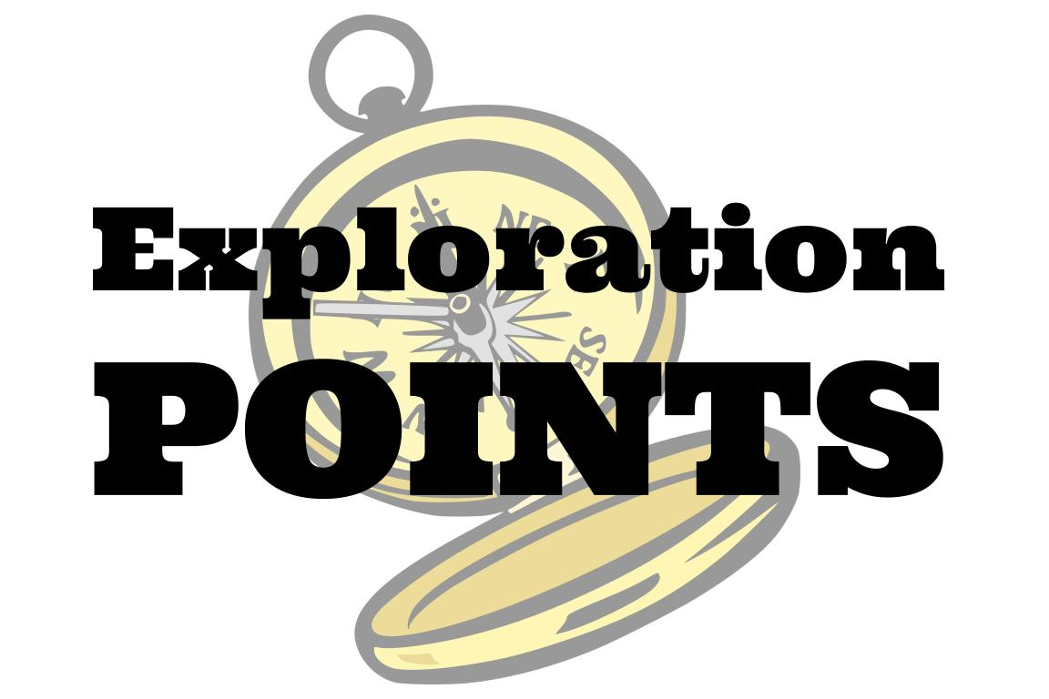
Explore the TOK themes and areas of knowledge in more depth via a range of thinkers, media sources, and other resources, in our EXPLORATION POINTS DOCUMENTS.
Access the documents via the links below. You’ll also find the EP icons on all of the TOK course pages of the site to help you unpack the quotes, KQs, and real-life situations that you find there.
CORE THEME
Knowledge & the knower
OPTIONAL THEMES
Indigenous societies
Language
Politics
Religion
Technology
AREAS OF KNOWLEDGE
The arts
History
Human sciences
Mathematics
Natural sciences
Notes:
Use this slide to access the ‘Exploration Points’ notes for BQ2, which will help students to develop a deeper knowledge of any TOK theme or area of knowledge. This will not only help them to master the TOK course in general, but also craft a great exhibition or essay.
Be ready to provide more guidance on how to use this resource - ie, which media sources to focus on, which questions to address, which TED talks to watch, and which key terms and ideas to understand.

