Slide 1
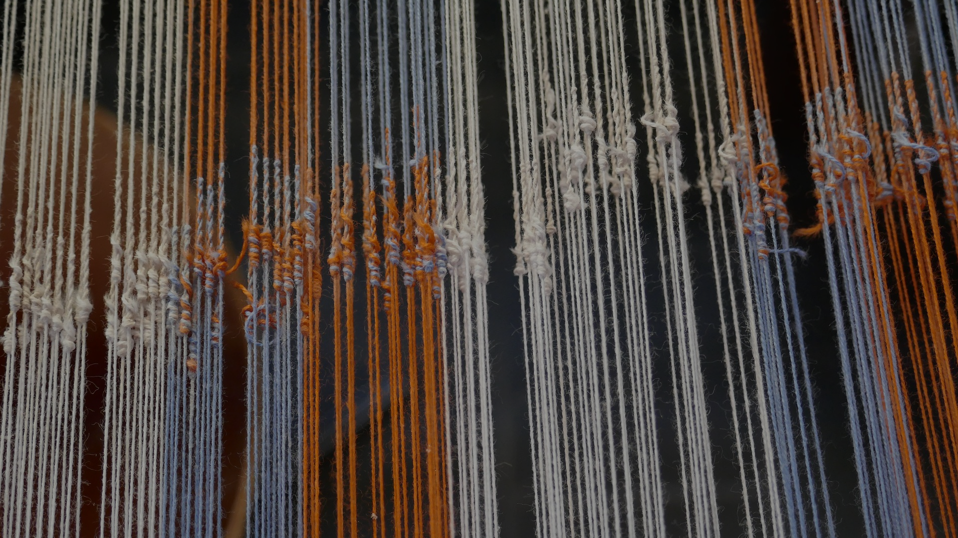

INTRODUCTION TO BQ3
BQ3 Spin Lesson 1
I can compare and contrast BQ3 within the context of different areas of knowledge
Notes:
See how this lesson links to the course by viewing the final slide
Key TOK terms appear in a red font

Slide 2
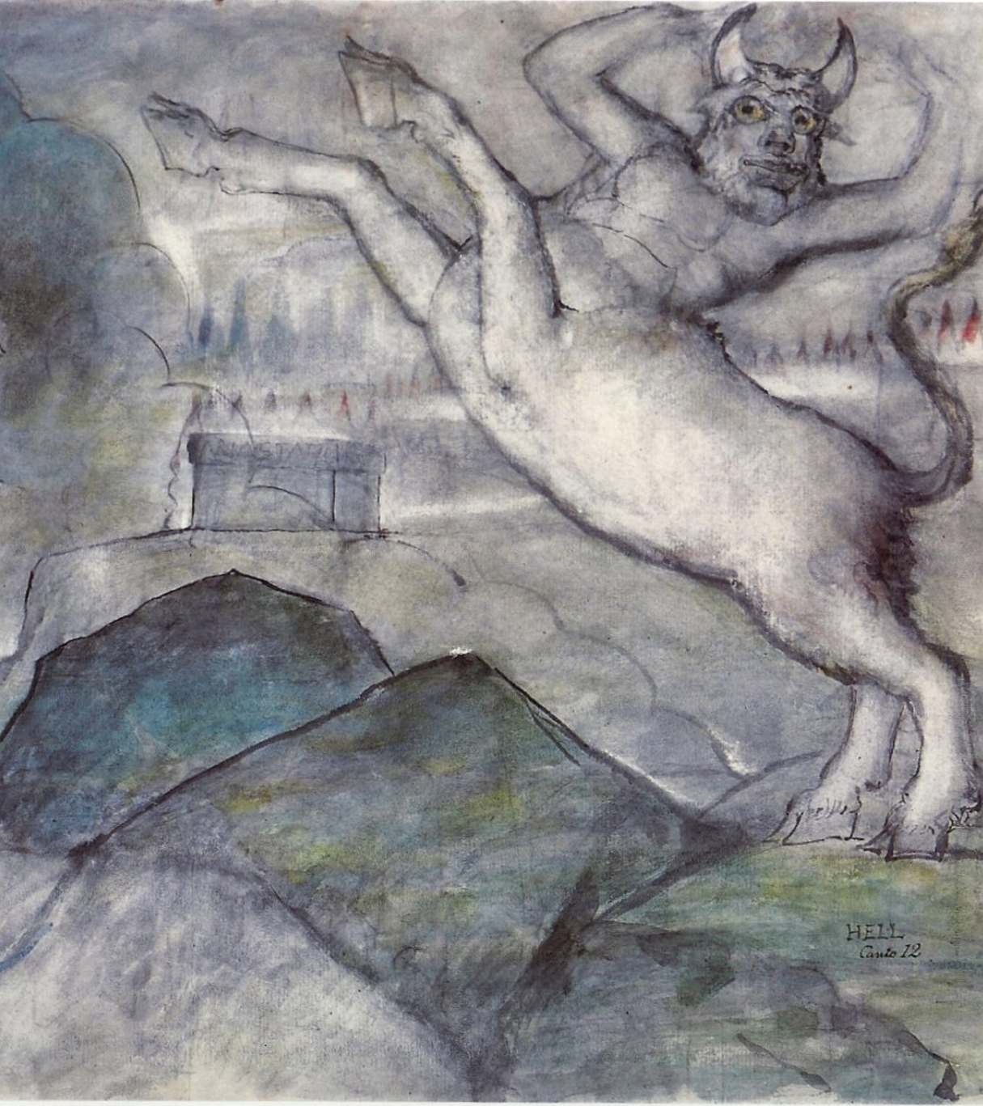
Starter
"A truth that's told with bad intent
Beats all the lies you can invent."
(William Blake)
What do you think Blake meant, and can you link this to BQ3?
Notes:
This is what we mean by ‘spin’ (coming up in next slide). Misleading and unreliable information doesn’t have to be an actual lie - it can be information that is accurate, but told in order to influence us.
Can students can think of any examples of this?
Image by William Blake - Public Domain, https://commons.wikimedia.org/w/index.php?curid=1235623

Slide 3
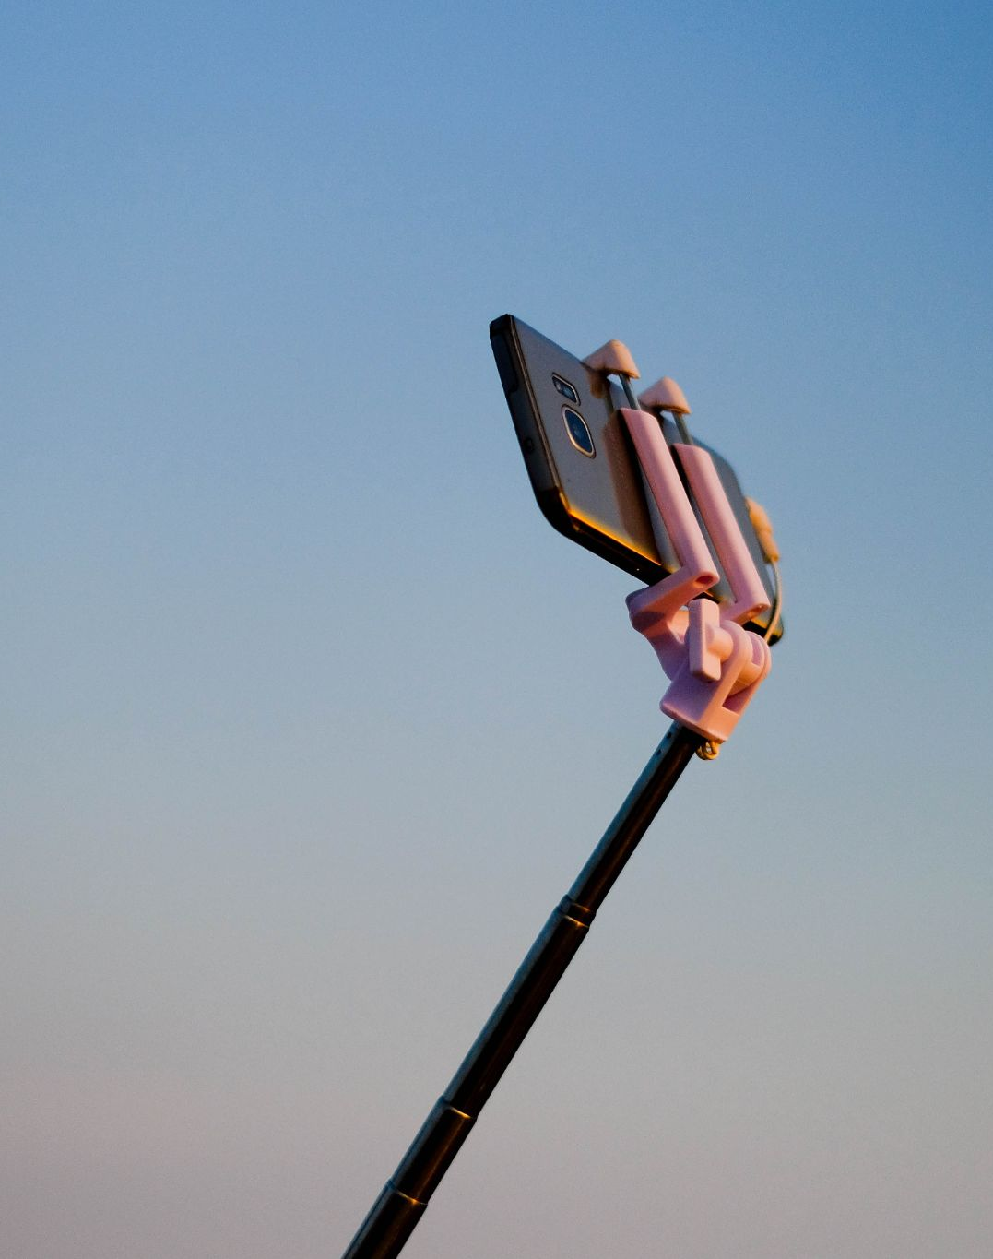
(Mis)representing ourselves
How accurately do you use social media to represent yourself? Be honest!
Overall, do you think social media gives us -
The truth about other people?
A truth about other people?
False information about other people?
Answer this question by positioning yourself in a line, with one side of the class representing truth, and the other side representing misleading
Notes:
Animated slide. Reveal first question, getting students to reflect on this honestly, and admit ways in which they represent certain traits about themselves in an exaggerated or enhanced way - and why. Great chance for a long discussion!
Then the second task - note we are not necessarily talking about ‘lies’ here - we could be talking about using things that are factually accurate to create a misleading picture of something.

Slide 4
Our key term for BQ3: SPIN
Spin (verb)
to tell a story, either to deceive someone or for entertainment or profit:
He spun some tale about needing to take time off work because his mother was ill.
They spun us a story about being in desperate need of money.
Spin (noun)
a way of describing an idea or situation that makes it seem better than it really is, especially in politics or business:
They have attempted to put a positive spin on the situation.
This report puts a positive spin on the issue.
Notes:
Discuss ‘spin’ with students. This term is a central aspect of this BQ, and should be referred to as often as possible.
Adapted from the Cambridge Dictionary

Slide 5
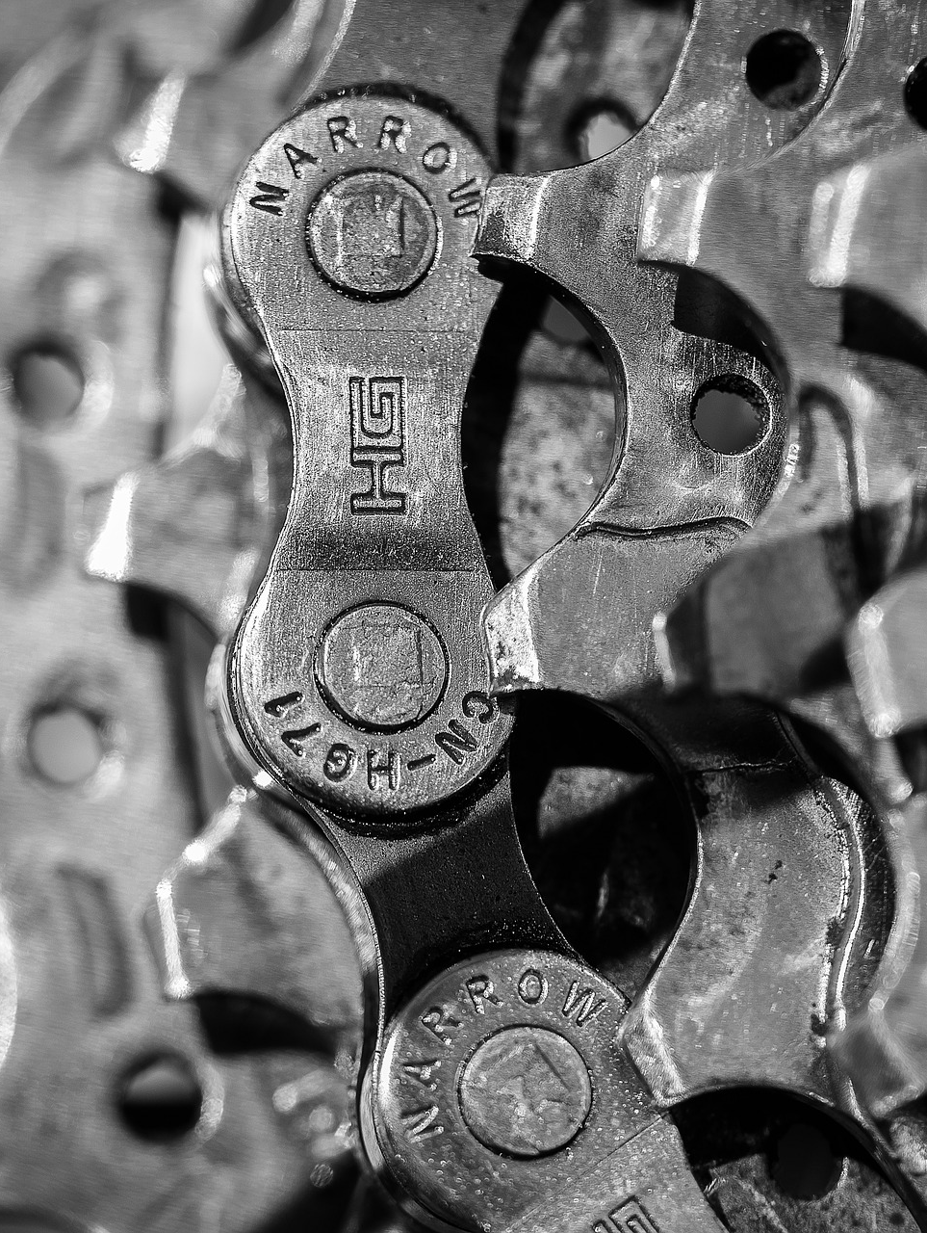
Linking BQ3 to the AOKs
How is our understanding of the world influenced by the way knowledge is communicated?
In pairs, choose one AOK (different to the one you chose for BQ2).
Discuss how our understanding of it can be affected by different ways of representing and communicating ideas.
Possible ideas you might consider - using synonyms, visual representations, selecting evidence carefully (‘cherry-picking’), technical language, social media, etc.
Present your ideas on an A3 sheet of paper. Make them as visual as possible (use limited text). Leave space for additional ideas and thoughts.
Notes:
You may need to remind students of the five areas of knowledge. Write on board (they can help you recap them).

Slide 6
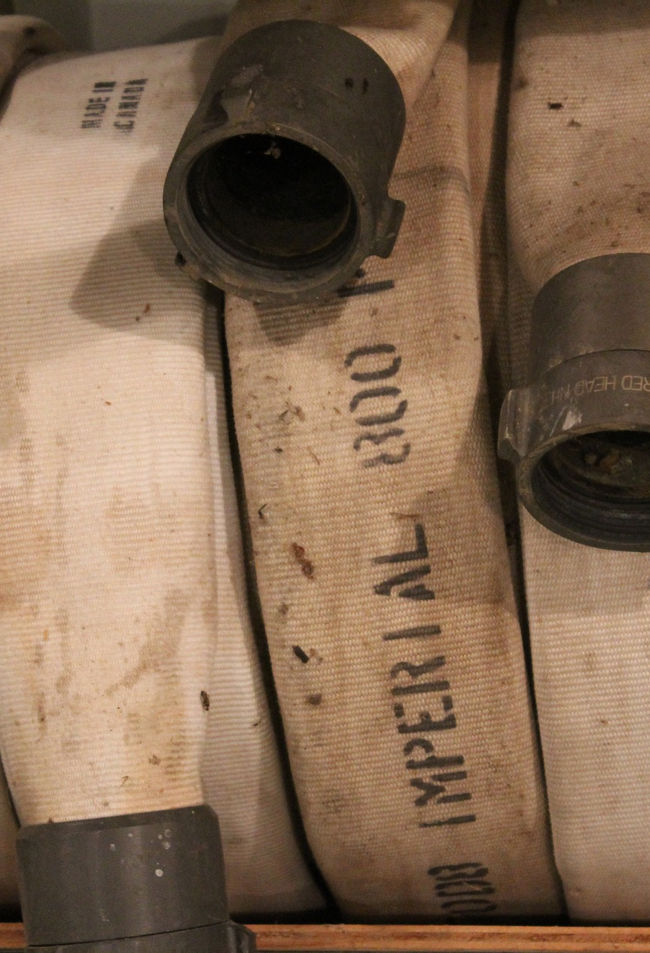
Real-world contexts
Follow the link to the RLS for your AOK. On your display, add:
A brief outline of your RLS and how it links to your AOK.
What this tells us about how our understanding can shift according to how ideas and knowledge is communicated.
Notes:
Links and guidance (students will need a lot of help to identify these ideas, although they’ll probably find a lot more). This is a chance to explain some of the characteristics of ideal RLSs: original, recent, significant, etc. Students should also draw on their own experiences. Note the term in the third RLS - firehosing - it’s a particularly useful one, and all students should be aware of it (hence the image above).
The arts - This RLS shows how the arts can be used to represent something in a completely different way, challenging our understanding. In this case, the Mexican artist Fabián Cháirez, painting the revolutionary Zapata in high heels and a pink sombrero...
History - This RLS shows how social media can be both helpful and harmful in the pursuit of history - and in both cases, have a profound effect on the way we understand aspects of the past. It gives the opinions of four different historians on the matter.
The human sciences - This RLS shows us how the amount of information communicated can ‘drown’ out different (more truthful) ideas, and allow views to dominate the Internet. This is called ‘firehosing’. The RLS mentions anti-vaxxers and political leaders - broadly, the human sciences.
Mathematics - This RLS shows that mathematical terms (in this case, ‘zero’) allow us to understand completely new concepts. Before we had a term for zero, “humans didn’t understand the number zero. It’s not innate in us. We had to invent it”
The natural sciences - This RLS shows us that ways of representing ideas in natural sciences can be completely removed from their reality (in this case, the nature of atoms). Representing or simplifying them in this way shifts how we conceive of elements of the natural world.

Slide 7

Idea swap
Walk around the class, and discuss what the other groups have thought about and produced. Choose another display to explain to the rest of the class. Make sure you are clear about:
Their AOK
General ideas about how knowledge can be spun or represented within their AOK
Their real-life situation, and how it links to their AOK
What the RLS shows about how our understanding of the world can be affected by the way knowledge is represented

Slide 8
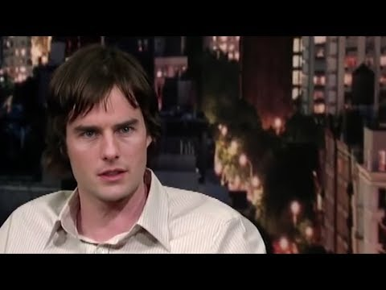
A game-changer?
Watch this new ‘deep-fake’ video.
What does the video suggest about increasing difficulties in discerning the truth when it comes to communicating ideas?
Notes:
Video link is here.
Again, an optional slide - but great fun for students (although the implications of this video are, perhaps, rather disconcerting…)
Technology (particularly online technology), obviously, represents new challenges for us in understanding the world.
For a range of deep-fake videos (and shallow-fakes), and an analysis of them from the British Film Institute, see this link. It has a lot of different types of deep-fakes, showing how you can rewrite history, the present, and even fictional movies. You can use it in addition to, or instead of, the video above (particularly if students are not familiar with the actors who are being faked)

Slide 9

Links to the TOK exhibition
Related exhibition prompt What challenges are raised by the dissemination and/or communication of knowledge? (IAP-10)
Refer to the ideas from this lesson to answer this question.
For example, think about how different ways of communicating an idea can end up misrepresenting that idea, either deliberately or by accident.
Which objects could help to illustrate your answer?
Notes:
Optional slide, if you want to help students to take ownership of the IA prompts (IAPs) for the TOK exhibition
For more ideas on relevant IAPs, see the ‘Linking this lesson to the course’ slide

Slide 10

Which AOK do you think is most vulnerable to ‘spin’? Why?
Write your answer on a Post-It note, and add to your lesson display.
Notes:
Exit task option 1
See the BQ3 assessment tracker for suggestions on providing feedback, and recording students’ progress

Slide 11
Write a TOK essay-style introduction to BQ3: How is our understanding of the world influenced by the way knowledge is communicated?
Submit to GC.
Notes:
Exit task option 2
Outline to students the structure of a TOK essay introduction: ‘hook’, explanation, outline of scope
See the BQ3 assessment tracker for suggestions on providing feedback, and recording students’ progress

Slide 12
Linking this lesson to the course
During this lesson, we consider the highlighted aspects of the TOK course
The images used in the presentation slides can also give students ideas about selecting exhibition objects; see also our link below to specific IA prompts
CORE THEME | OPTIONAL THEMES | AREAS OF KNOWLEDGE | TOK ASSESSMENT
Knowledge & the knower | Indigenous societies | The arts | The TOK essay
 | Language | History
 | Politics | The human sciences | The TOK exhibition Could be linked to IAP-4 (doubt), IAP-10 (communication), IAP-24 (context)
 | Religion | Mathematics
 | Technology | The natural sciences

Slide 13

Explore the TOK themes and areas of knowledge in more depth via a range of thinkers, media sources, and other resources, in our EXPLORATION POINTS DOCUMENTS.
Access the documents via the links below. You’ll also find the EP icons on all of the TOK course pages of the site to help you unpack the quotes, KQs, and real-life situations that you find there.
CORE THEME
Knowledge & the knower
OPTIONAL THEMES
Indigenous societies
Language
Politics
Religion
Technology
AREAS OF KNOWLEDGE
The arts
History
Human sciences
Mathematics
Natural sciences
Notes:
Use this slide to access the ‘Exploration Points’ notes for BQ3, which will help students to develop a deeper knowledge of any TOK theme or area of knowledge. This will not only help them to master the TOK course in general, but also craft a great exhibition or essay.
Be ready to provide more guidance on how to use this resource - ie, which media sources to focus on, which questions to address, which TED talks to watch, and which key terms and ideas to understand.

