Slide 1
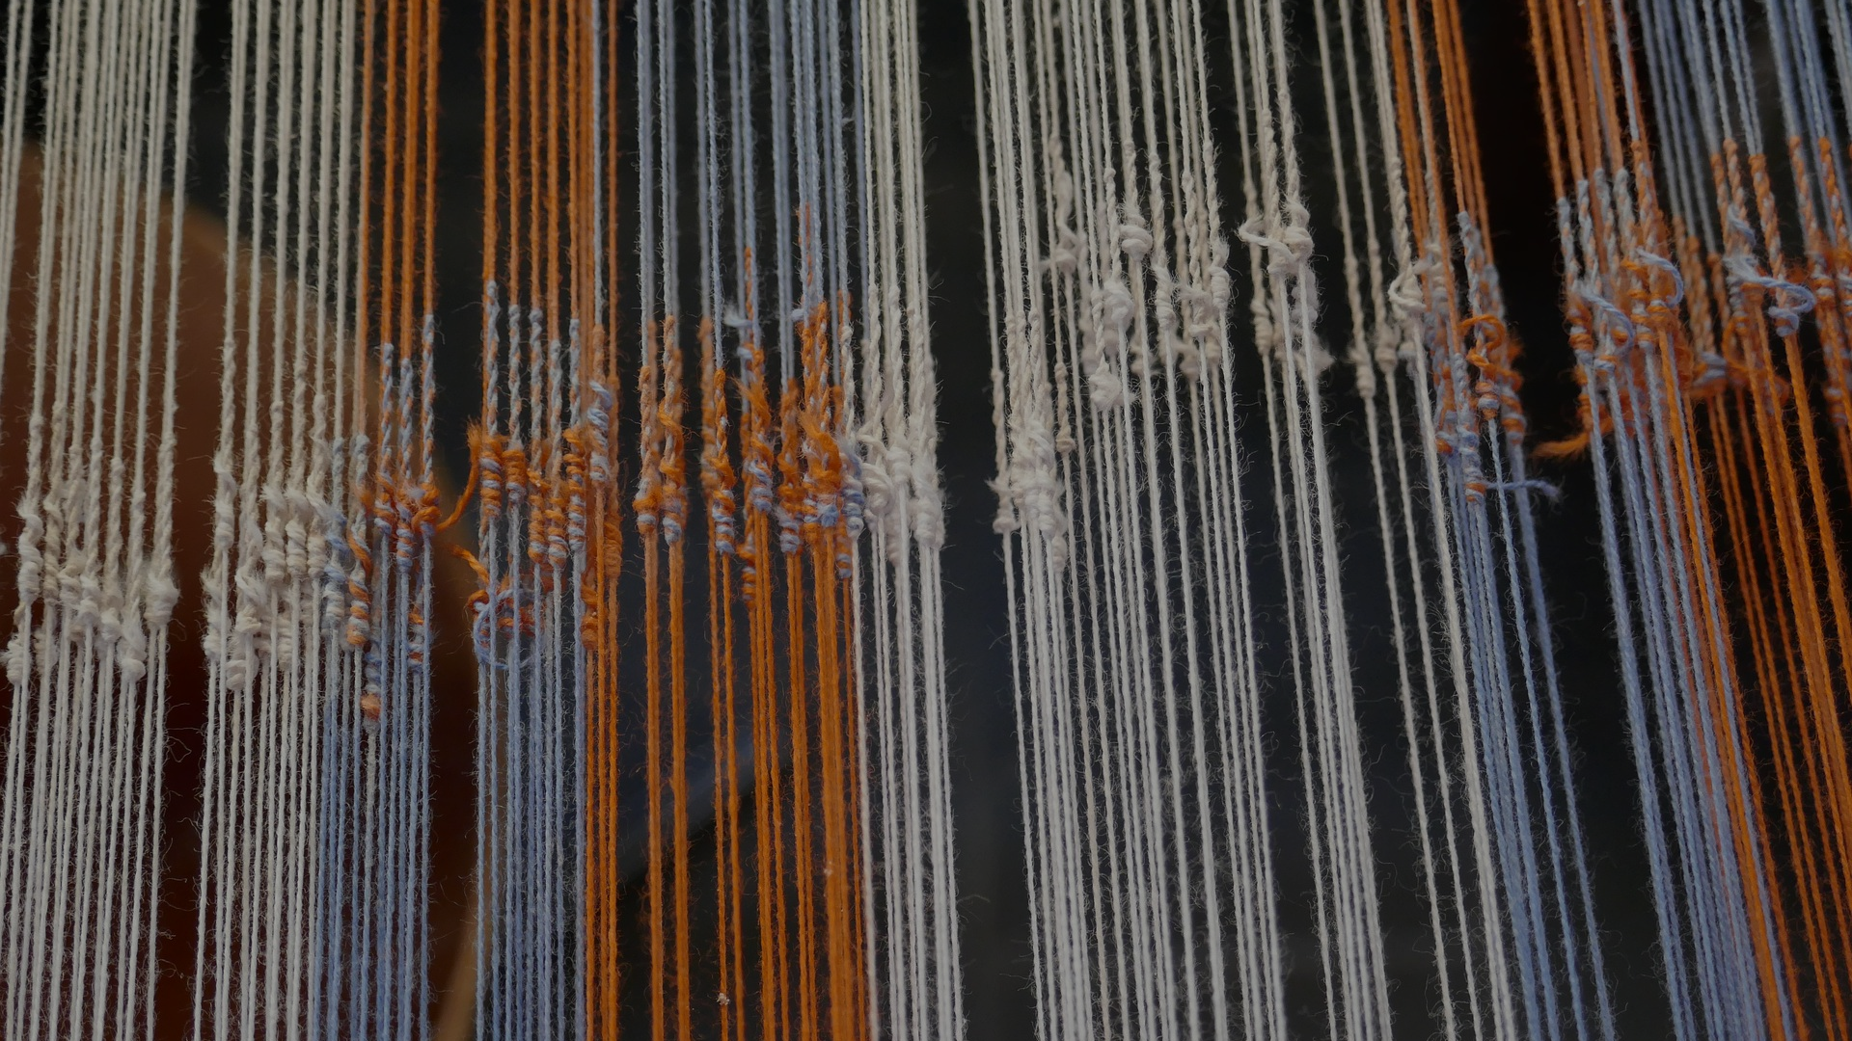

NEURO-BUNK
BQ3 Spin Lesson 10
I can explain how and why organisations try to ‘spin’ scientific knowledge
Notes:
See how this lesson links to the course by viewing the final slide
Key TOK terms appear in a red font

Slide 2
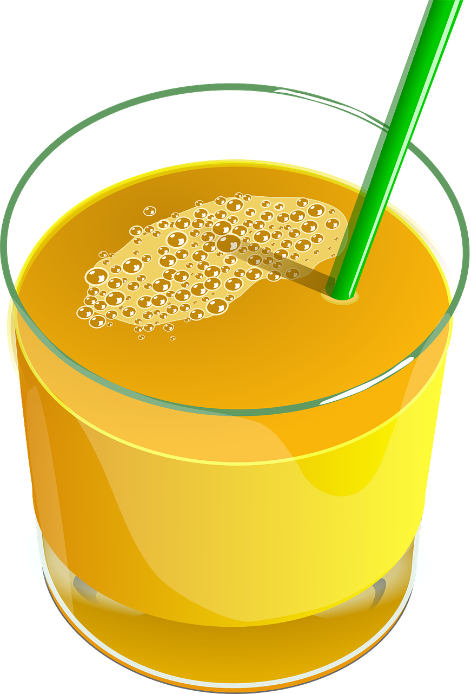
Starter
Claims on a label of a (real) drinks product, called ‘Neurobliss’:
Helps to reduce stress
Enhances your mood
Promotes a more focused concentration
Increases a positive outlook
Would you pay money for this product? Explain your answer.
Notes:
This starter can lead onto a great discussion. Consideration points include:
How could these claims be checked?
How can we distinguish between actual results, and ones associated with a placebo effect?
To what extent is our willingness to part with money for a product like this linked to our need for it (eg - during stressful time, like exams, etc.)?
Can these claims be falsified, after Popper?
Can these claims be fully explained, after Feynman (for example, what does it mean - scientifically - to have a ‘more focused concentration’ or ‘positive outlook’)?
To what extent might the manufacturer be banking on the fact that everyone would pay money for this product just once to try it?
We return to Neurobliss in the talk by Molly Crockett (slide 4)

Slide 3
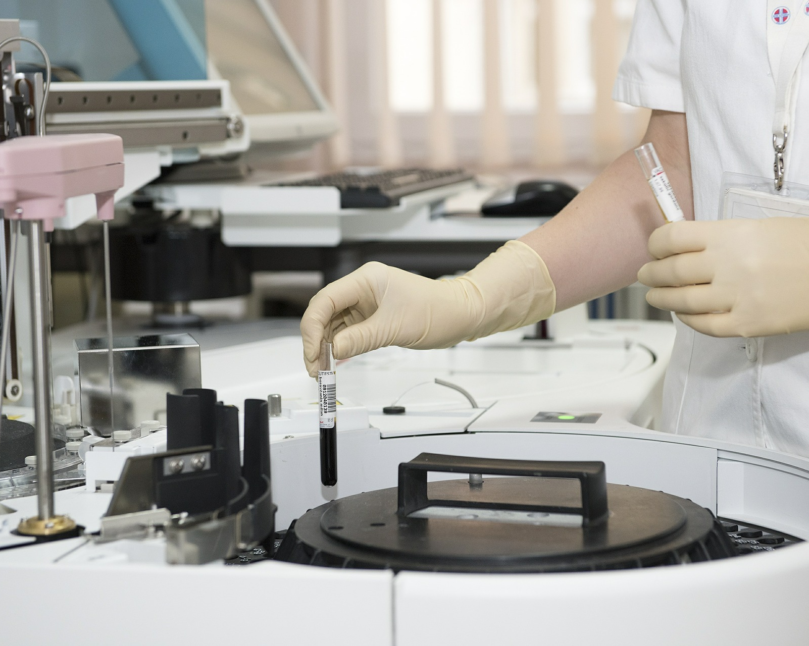
‘Clinically proven’
What does this phrase mean, and why do you think is it used on so many products?
Watch the video. Is the reality of ‘clinically proven’ the same as your interpretation of what this meant?
Notes:
Video is here.
Animated slide - after revealing the first paragraph, demonstrate to students a quick Google search of the extent of ‘clinically proven cosmetics’ (images). This will indicate how ubiquitous this word is - and get them thinking about the second element of the first question.
‘Clinically’ - scientific conditions, experts, controlled, laboratory, etc.
‘Proven’ - certain, overwhelming evidence, trials, extensive testing, etc.
Something that is ‘clinically proven’ is something (we would expect) that has been tested in strict scientific conditions, and which has been replicated many times, leading to something we can trust with a great deal of confidence.
Note the level of governmental authentication of products termed ‘clinically proven’ - or more accurately, the lack of authentication.

Slide 4

Molly Crockett on ‘neuro-bunk’
Watch Molly Crockett’s TED talk Beware neuro-bunk.
Answer these questions; try to include ‘pseudoscience’ and ‘correlation and causation’ within your answers.
What was MC’s original experiment?
How did the media alter this?
Why did she conclude this was a big deal?
Why do you think Crockett refers to these type of claims as ‘neuro-bunk’?
Why are people vulnerable to it, and how can we detect when it is being used?
Notes:
Crockett’s TED talk is here (YouTube alternative - here). It lasts for 11 minutes. Watch the first 5 minutes (up to ‘Dr Love’).
It’s worth playing this in very small segments:
Play from 0.00 - 1.15 for the first question. Discuss what she had done, referring to serotonin and tryptophan.
From 1.15 - 2.05 for the second question. You can use this to introduce SYLLOGISMS - Tryptophan helps us to make good decisions. Tryptophan is found in cheese sandwiches. Therefore, cheese sandwiches help us to make good decisions. To highlight the flaw in this reasoning, offer a second syllogism: Humans can breathe oxygen. Oxygen is found in water. Therefore, humans can breathe water.
From 2.05 - 4.30 for the third question. Think about ‘going beyond the science’ - in other words, lying - and how wide-spread this is. Think about how many people would have taken up the marketers on their offers to promote products.
For questions 4 & 5, let students discuss on tables, and offer ideas.
You don’t need to go beyond this - just ask students to offer their thoughts on why this could all be called ‘neuro-bunk’ or ‘psycho-babble’, and then why we are so vulnerable to it (NEED!).
To expand this part of the lesson, use the optional handout. Discuss in more detail the issues that she raises, and the answers students have come up with. Particularly worthy of consideration is question 6, which illustrates that it isn’t just commercial and non-scientific groups that seek to exploit us with ‘psycho-babble’. Link this to the last lesson, in which we thought about the implications of pseudo-science.

Slide 5
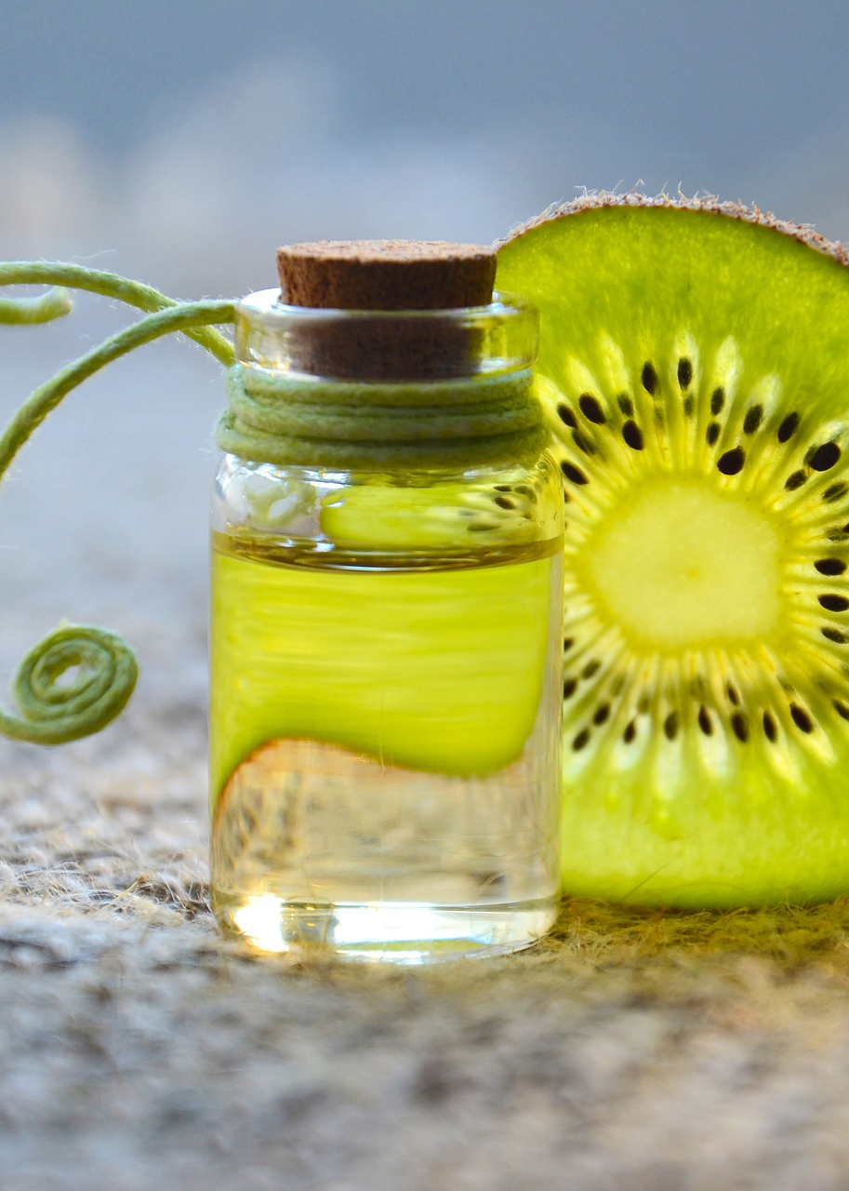
Neuro-bunk companies
Go online, and try to find examples of companies making claims about products that don’t have scientific evidence to support them.
Try to find ones in particular that rely on ‘neuro-bunk’ and ‘psycho-babble’
Use the Feynman test to help you!
Start with Gwyneth Paltrow’s ‘Goop’ company.
This is fantastically successfully, but has been accused (fairly? Unfairly?) of producing pseudo-scientific products.
Notes:
This can be turned into a presentation, a written piece of work, a classroom discussion - whatever you want, or what time dictates.
If you have lots of time, check out our Feynman-Crockett Award for Spurious Science as a possible task.

Slide 6

Links to the TOK exhibition
Related exhibition prompt On what grounds might we doubt a claim? (IAP-4)
Refer to the ideas from this lesson to answer this question.
For example, think about what might ‘flag’ a claim as being dubious or unfounded, and how we can then test if it is valid or not.
Which objects could help to illustrate your answer?
Notes:
Optional slide, if you want to help students to take ownership of the IA prompts (IAPs) for the TOK exhibition

Slide 7
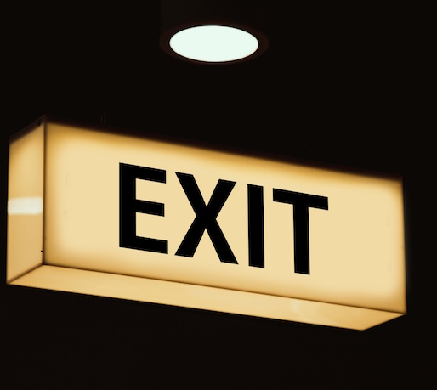
“Extraordinary claims require extraordinary evidence.” (Carl Sagan)
How does Carl Sagan’s ‘ECREE’ maxim relate to what we’ve looked at today?
Notes:
ECREE is fantastically useful for us! Make sure students really take it in and appreciate it
See the BQ3 assessment tracker for suggestions on providing feedback, and recording students’ progress

Slide 8
Linking this lesson to the course
During this lesson, we consider the highlighted aspects of the TOK course
The images used in the presentation slides can also give students ideas about selecting exhibition objects; see also our link below to specific IA prompts
CORE THEME | OPTIONAL THEMES | AREAS OF KNOWLEDGE | TOK ASSESSMENT
Knowledge & the knower | Indigenous societies | The arts | The TOK essay
 | Language | History
 | Politics | The human sciences | The TOK exhibition Could be linked to IAP-4 (doubt), IAP-5 (evidence), IAP-24 (context), IAP-32 (explanation)
 | Religion | Mathematics
 | Technology | The natural sciences

Slide 9
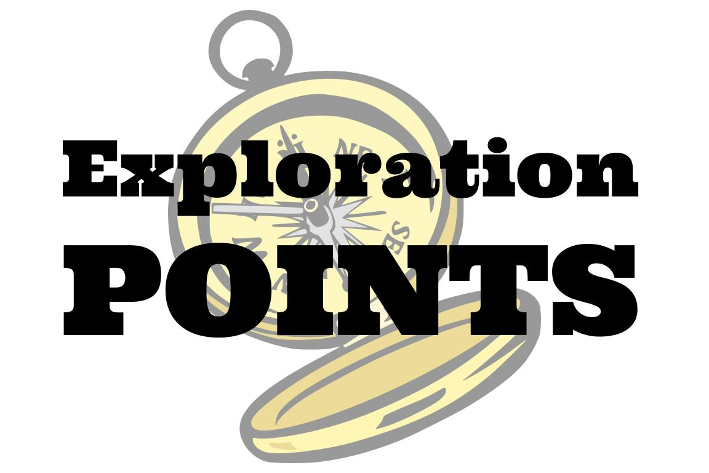
Explore the TOK themes and areas of knowledge in more depth via a range of thinkers, media sources, and other resources, in our EXPLORATION POINTS DOCUMENTS.
Access the documents via the links below. You’ll also find the EP icons on all of the TOK course pages of the site to help you unpack the quotes, KQs, and real-life situations that you find there.
CORE THEME
Knowledge & the knower
OPTIONAL THEMES
Indigenous societies
Language
Politics
Religion
Technology
AREAS OF KNOWLEDGE
The arts
History
Human sciences
Mathematics
Natural sciences
Notes:
Use this slide to access the ‘Exploration Points’ notes for BQ3, which will help students to develop a deeper knowledge of any TOK theme or area of knowledge. This will not only help them to master the TOK course in general, but also craft a great exhibition or essay.
Be ready to provide more guidance on how to use this resource - ie, which media sources to focus on, which questions to address, which TED talks to watch, and which key terms and ideas to understand.

