Slide 1
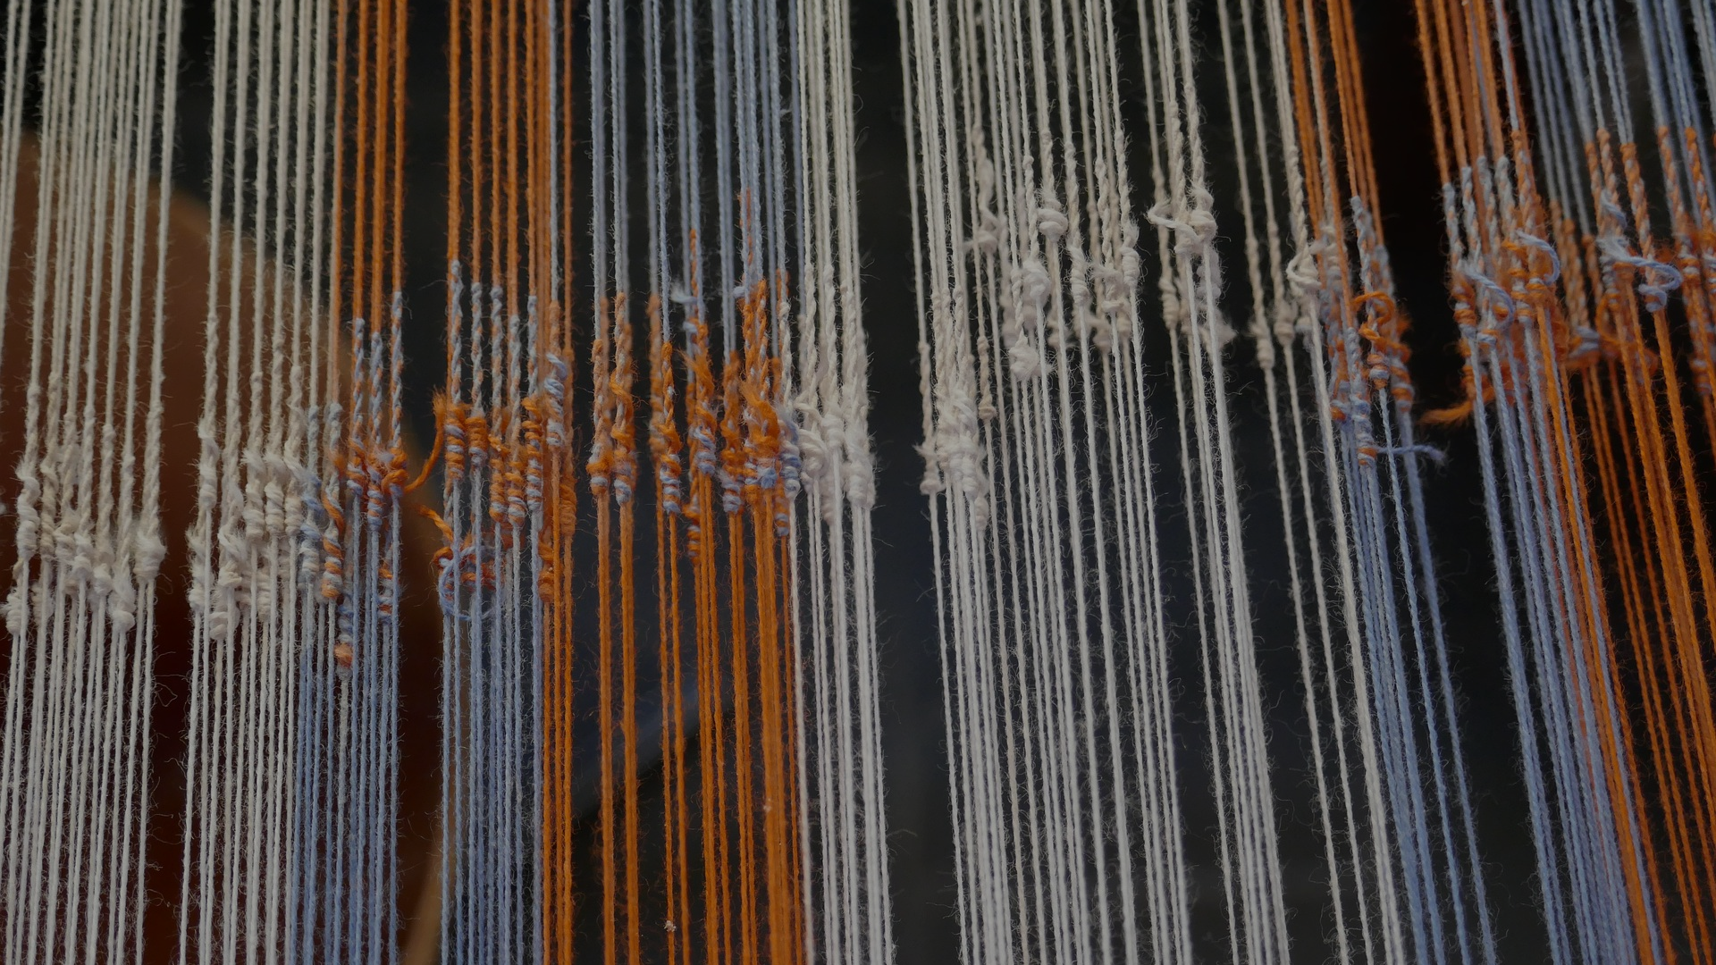

WRAPPING UP BQ3
BQ3 Spin Lesson 12
I can answer Big Question 3, referring to the key terms, ideas, and thinkers from the unit
Notes:
See how this lesson links to the course by viewing the final slide
Key TOK terms appear in a red font

Slide 2
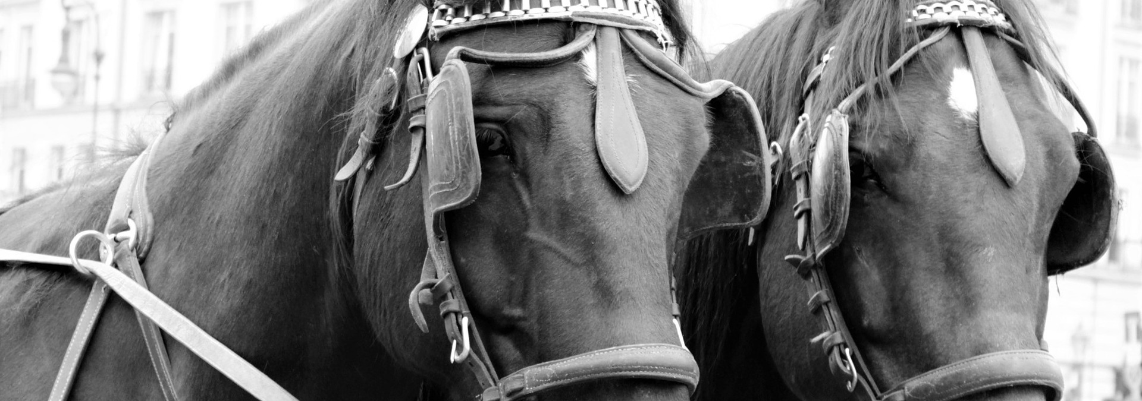
Starter
What was BQ3?
List one key idea we considered, and one key thinker we met.
Notes:
Debrief responses.
BQ3 is “How is our understanding of the world influenced by the way knowledge is communicated?”
Thinkers and ideas are listed on next slide.
The image links to our lesson on ‘Seeing what we want to see’ - confirmation bias. Another chance to discuss this massively important idea!

Slide 3
What & who we’ve looked at in BQ3
William Blake
Jonathan Swift
George Orwell
Ludwig Wittgenstein
Edward Sapir
Benjamin Whorf
Johnny Harris
Trevor Noah
Richard Feynman
Hannah Critchlow
Derren Brown
Olivia Gordon
Molly Crockett
Julia Belluz
Carl Sagan
Spin
Firehosing
Cherry-picking
Using social media to (mis)represent ideas
Deep fake videos
The TOK essay
Newspeak
Linguistic determinism
Linguistic relativism
Causation vs. correlation
Misleading map projections
The Feynman test
Pseudoscience
The cognitive cost of changing your mind
Confirmation bias
The Barnum/Forer Effect
Cold readings
Clinically proven
Neuro-bunk
ECREE
Notes:
Give students plenty of time to review this in groups. Check notes if necessary!
All tables should be able to briefly outline any/all of the ideas and thinkers - and link many of ideas to the thinkers.
Cold call, and reward accurate answers!

Slide 4

Kahoot!
Get into the same teams as last time.
Answer the Kahoot questions on BQ3...
Notes:
Kahoot is here.

Slide 5

Concluding tweets
With a partner, create two 280-character Tweets.
One should give an overall answer to BQ3 (“How is our understanding of the world influenced by the way knowledge is communicated?”)
The other should outline a specific aspect of BQ3 (you’ll be allocated this)
Notes:
This is one version of the main lesson task. If you’d prefer to get your students to write a more formal, TOK essay-style conclusion, do slide 6 instead.
Allocate students different questions about BQ3 - see this document. Tweets can be collated on a shared document to give an overall summary of BQ3.

Slide 6

Writing a TOK essay-style conclusion
What is the purpose of a conclusion in a (TOK) essay?
Write a 150 word conclusion to BQ3 (‘How is our understanding of the world influenced by the way knowledge is communicated?’)
Include at least two of the concepts we’ve looked at and a quote from at least one of our thinkers (see the unit outline to help you)
Submit to Google Classroom.
Notes:
This is one version of the main lesson task. If you’d prefer to get your students to write a less formal, Tweet-style conclusion, do slide 5 instead.

Slide 7

Which idea from Big Question 3 made the biggest impression on you, and why?
Notes:
See the BQ3 assessment tracker for suggestions on providing feedback, and recording students’ progress

Slide 8
Linking this lesson to the course
During this lesson, we consider the highlighted aspects of the TOK course
The images used in the presentation slides can also give students ideas about selecting exhibition objects; see also our link below to a specific IA prompt
CORE THEME | OPTIONAL THEMES | AREAS OF KNOWLEDGE | TOK ASSESSMENT
Knowledge & the knower | Indigenous societies | The arts | The TOK essay
 | Language | History
 | Politics | The human sciences | The TOK exhibition Could be linked to a lot of the prompts, as this lesson wraps up the BQ
 | Religion | Mathematics
 | Technology | The natural sciences

Slide 9
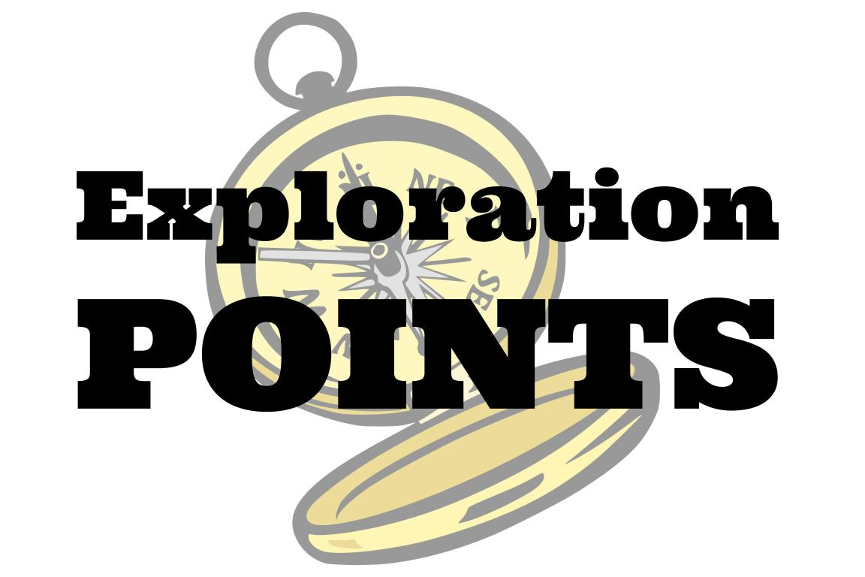
Explore the TOK themes and areas of knowledge in more depth via a range of thinkers, media sources, and other resources, in our EXPLORATION POINTS DOCUMENTS.
Access the documents via the links below. You’ll also find the EP icons on all of the TOK course pages of the site to help you unpack the quotes, KQs, and real-life situations that you find there.
CORE THEME
Knowledge & the knower
OPTIONAL THEMES
Indigenous societies
Language
Politics
Religion
Technology
AREAS OF KNOWLEDGE
The arts
History
Human sciences
Mathematics
Natural sciences
Notes:
Use this slide to access the ‘Exploration Points’ notes for BQ3, which will help students to develop a deeper knowledge of any TOK theme or area of knowledge. This will not only help them to master the TOK course in general, but also craft a great exhibition or essay.
Be ready to provide more guidance on how to use this resource - ie, which media sources to focus on, which questions to address, which TED talks to watch, and which key terms and ideas to understand.

