Slide 1
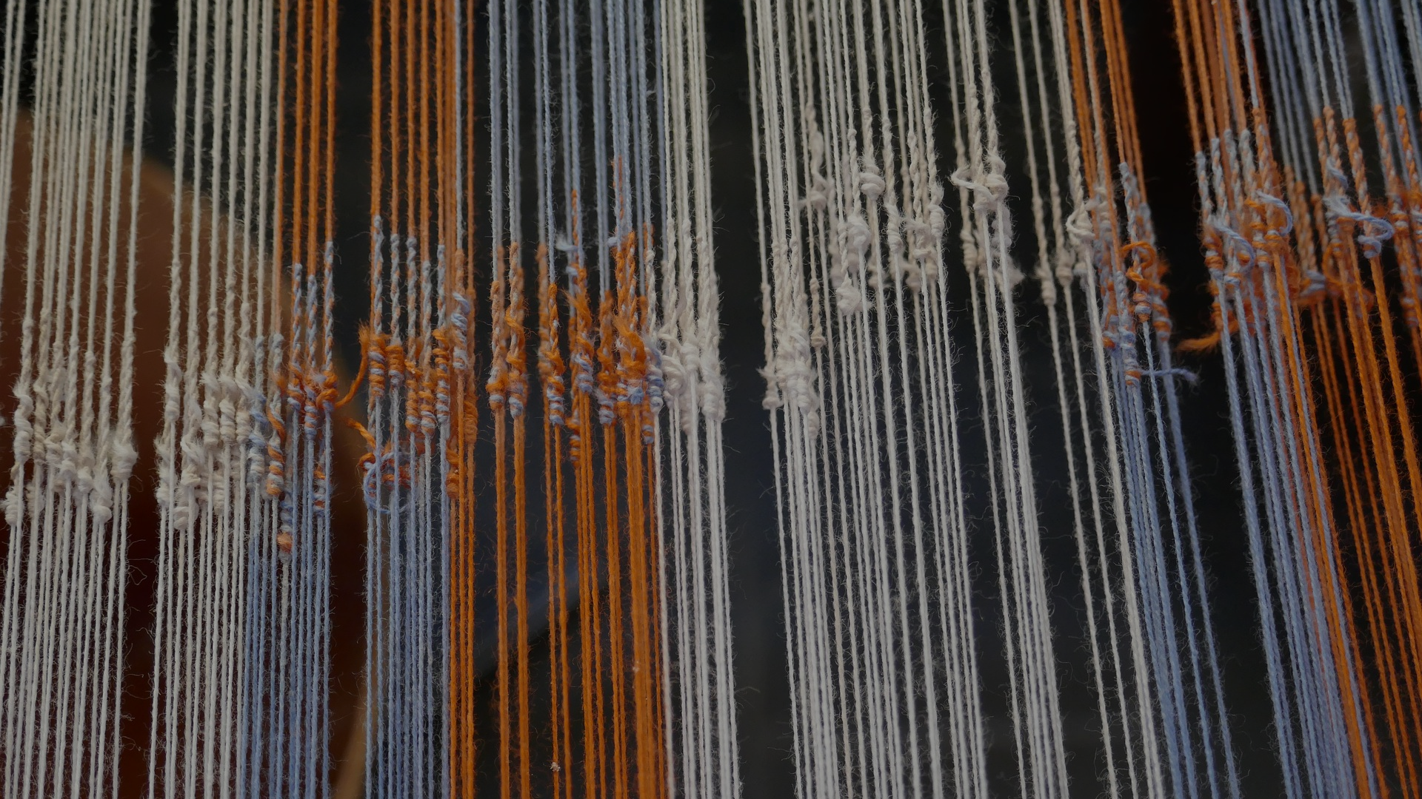

FALSEHOOD FLIES
BQ3 Spin Lesson 2
I can explain why unreliable knowledge spreads more quickly than reliable knowledge
Notes:
See how this lesson links to the course by viewing the final slide
Key TOK terms appear in a red font

Slide 2
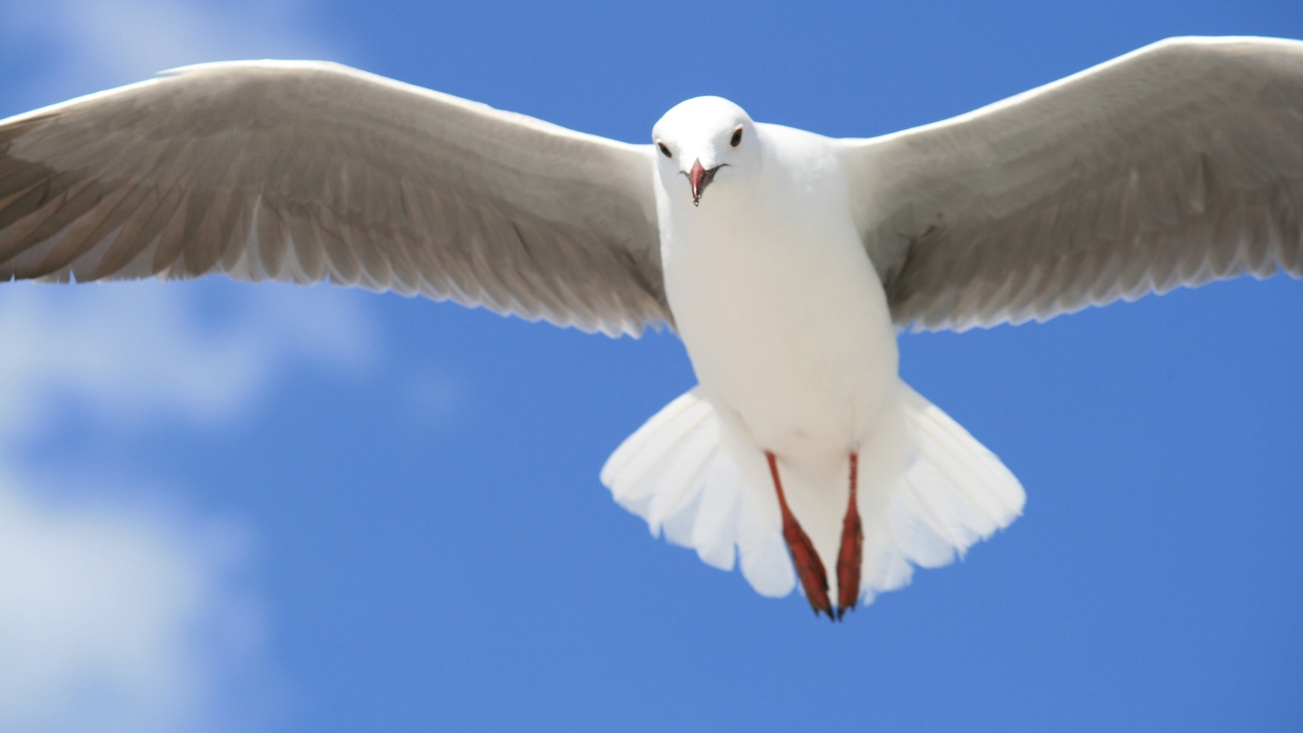
Starter
“Falsehood flies, and the truth comes limping after it” (Jonathan Swift, 1710)
What do you think Swift meant?
Do falsehoods always have to be lies? Think about the Blake quote from our last lesson.

Slide 3
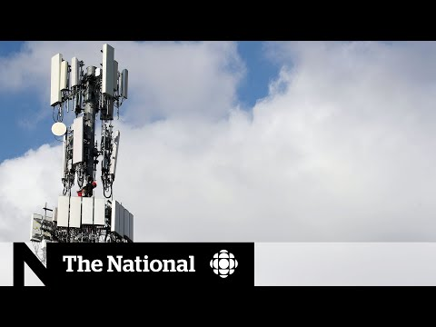
Viral virus
Why did this rumour spread so fast about Coronavirus?
Notes:
Great discussion point - which we’ll analyze with more precision in the next slide.
People are desperate, worried, looking for solutions; technology supports the spread of rumours, he’s a doctor, etc., etc.
Link to the video also here.

Slide 4
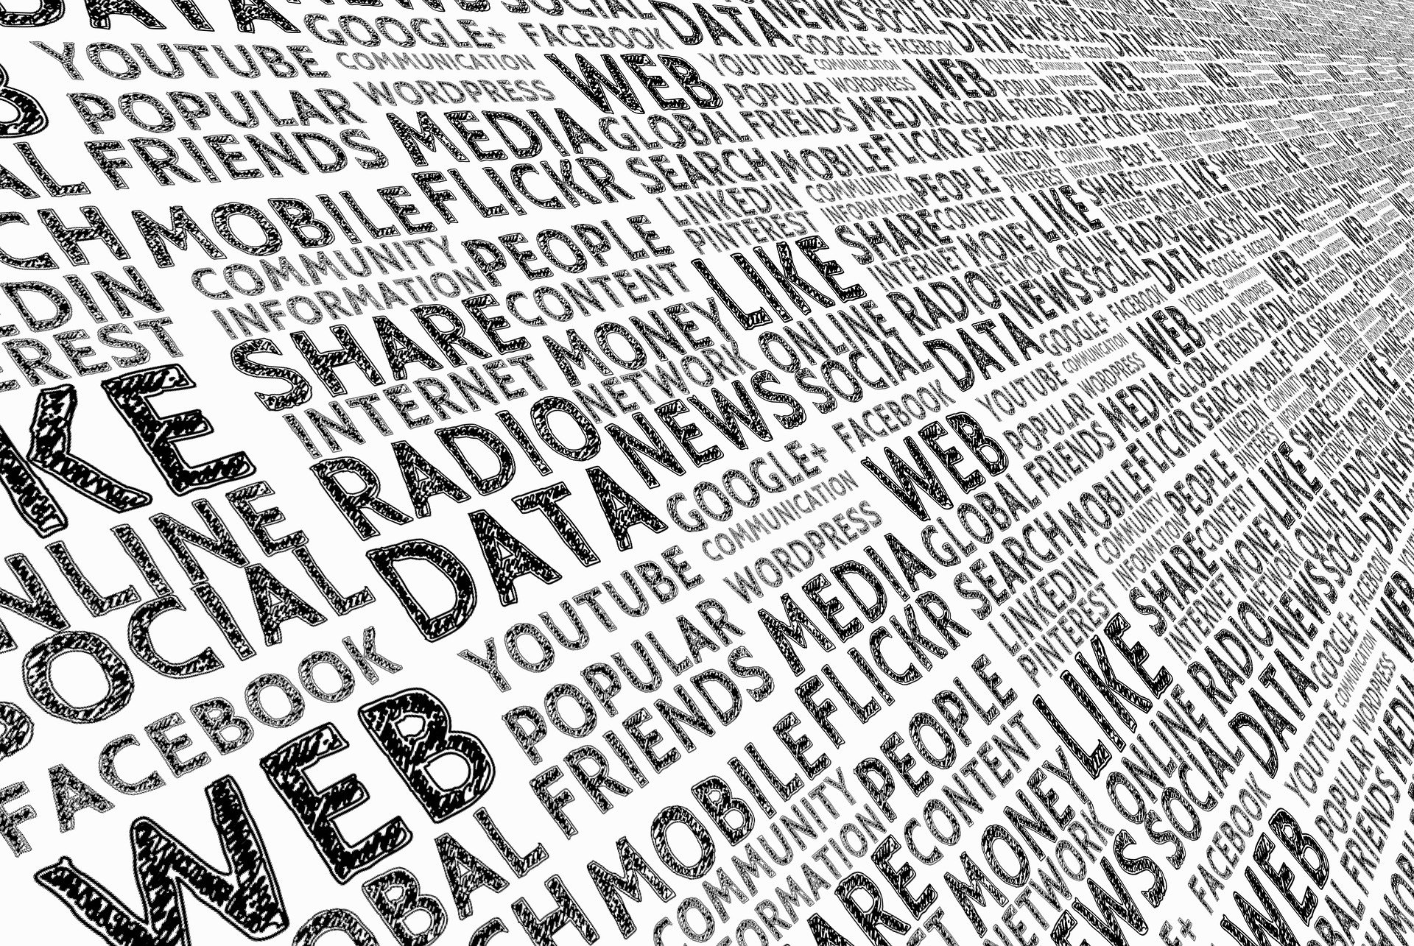
Online filtering
Think back to the critical thinking activity we did in BQ1. How vulnerable did you say you were to stories and posts on social media?
How do the following factors affect your willingness to believe a story:
Provenance (who you hear the rumour from)
Mode of communication (how the rumour represented)
Resonance (how emotionally impactful the rumour is)
Credibility (how (in)credible the rumour is).

Slide 5

What the experts say...
Read the two sources, and use them to help you create a display about online stories. Use the title: “Falsehood flies, and the truth comes limping after it”. Include the following details on your display:
Details of the fake news research (brief).
Results of the research.
The hypothesis advanced to explain the results - try to link this to one of our four factors.
Your analysis of the hypothesis - would you add anything to their explanation?
What you think the implications are of this in terms of the way we seek to understand the world?
Notes:
Two sources: Guardian and Wired

Slide 6

Links to the TOK exhibition
Related exhibition prompt What challenges are raised by the dissemination and/or communication of knowledge (IAP-10)?
Refer to the ideas from this lesson to answer this question.
For example, think about how different ways of communicating an idea can end up misrepresenting that idea, either deliberately or by accident.
Which objects could help to illustrate your answer?
Notes:
Optional slide, if you want to help students to take ownership of the IA prompts (IAPs) for the TOK exhibition
For more ideas on relevant IAPs, see the ‘Linking this lesson to the course’ slide

Slide 7
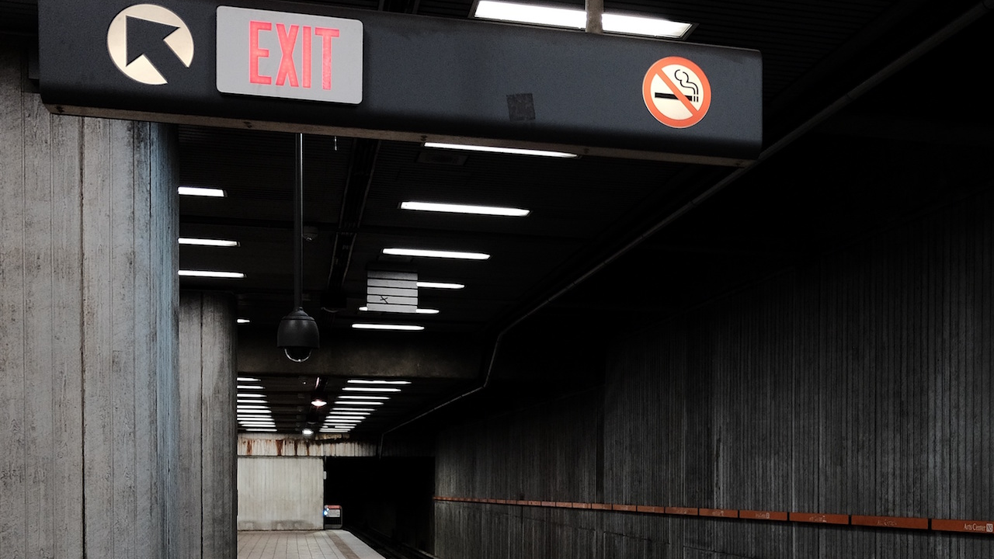
Why do false rumours spread so quickly? Try to include as many of today’s terms as possible in your answer.
Notes:
See the BQ3 assessment tracker for suggestions on providing feedback, and recording students’ progress

Slide 8
Linking this lesson to the course
During this lesson, we consider the highlighted aspects of the TOK course
The images used in the presentation slides can also give students ideas about selecting exhibition objects; see also our link below to specific IA prompts
CORE THEME | OPTIONAL THEMES | AREAS OF KNOWLEDGE | TOK ASSESSMENT
Knowledge & the knower | Indigenous societies | The arts | The TOK essay
 | Language | History
 | Politics | The human sciences | The TOK exhibition Could be linked to IAP-
 | Religion | Mathematics
 | Technology | The natural sciences

Slide 9
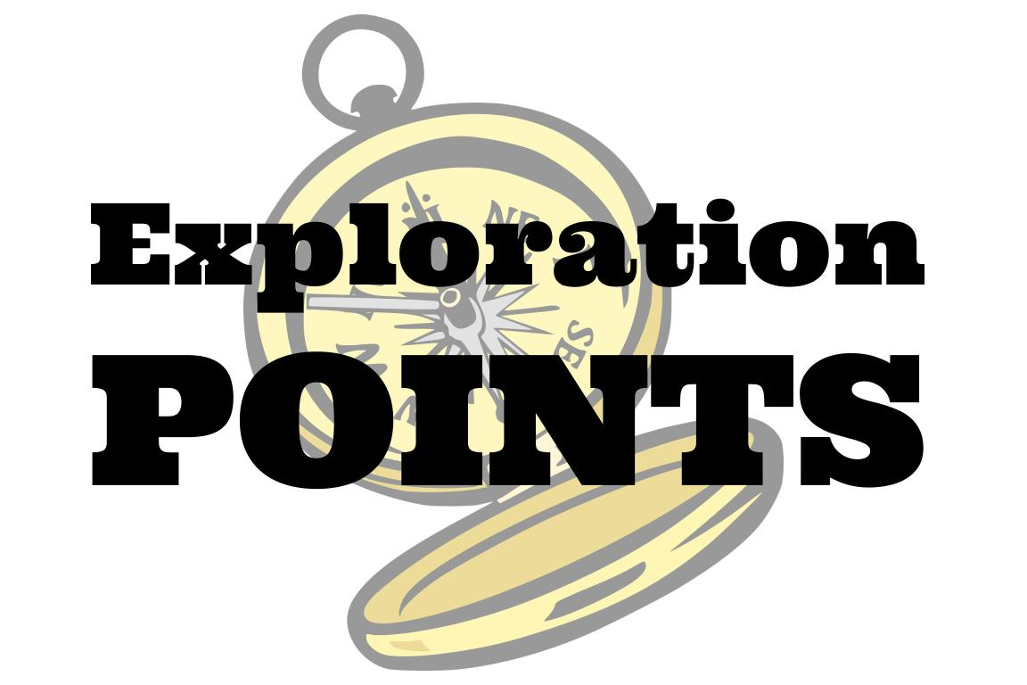
Explore the TOK themes and areas of knowledge in more depth via a range of thinkers, media sources, and other resources, in our EXPLORATION POINTS DOCUMENTS.
Access the documents via the links below. You’ll also find the EP icons on all of the TOK course pages of the site to help you unpack the quotes, KQs, and real-life situations that you find there.
CORE THEME
Knowledge & the knower
OPTIONAL THEMES
Indigenous societies
Language
Politics
Religion
Technology
AREAS OF KNOWLEDGE
The arts
History
Human sciences
Mathematics
Natural sciences
Notes:
Use this slide to access the ‘Exploration Points’ notes for BQ3, which will help students to develop a deeper knowledge of any TOK theme or area of knowledge. This will not only help them to master the TOK course in general, but also craft a great exhibition or essay.
Be ready to provide more guidance on how to use this resource - ie, which media sources to focus on, which questions to address, which TED talks to watch, and which key terms and ideas to understand.

