Slide 1
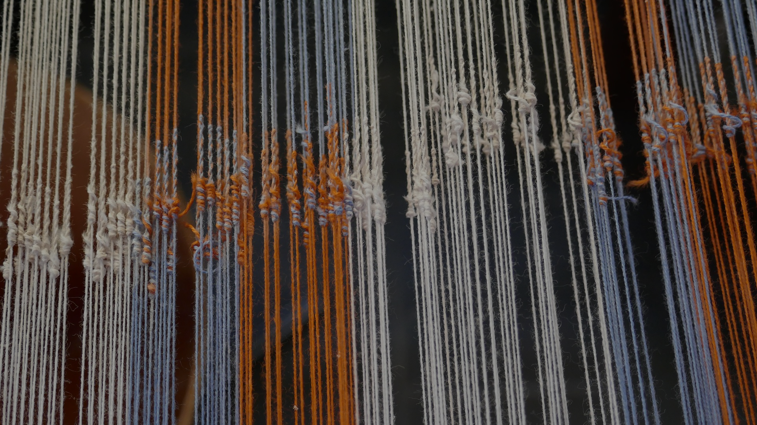

A GLOBAL CONSPIRACY
BQ3 Spin Lesson 6
I can explain how different representations of the globe change our understanding of it
Notes:
See how this lesson links to the course by viewing the final slide
Key TOK terms appear in a red font

Slide 2
Starter: Draw a map of the world
Notes:
Students should find this very difficult! After they have displayed their efforts, you need to move swiftly onto the next slide.

Slide 3
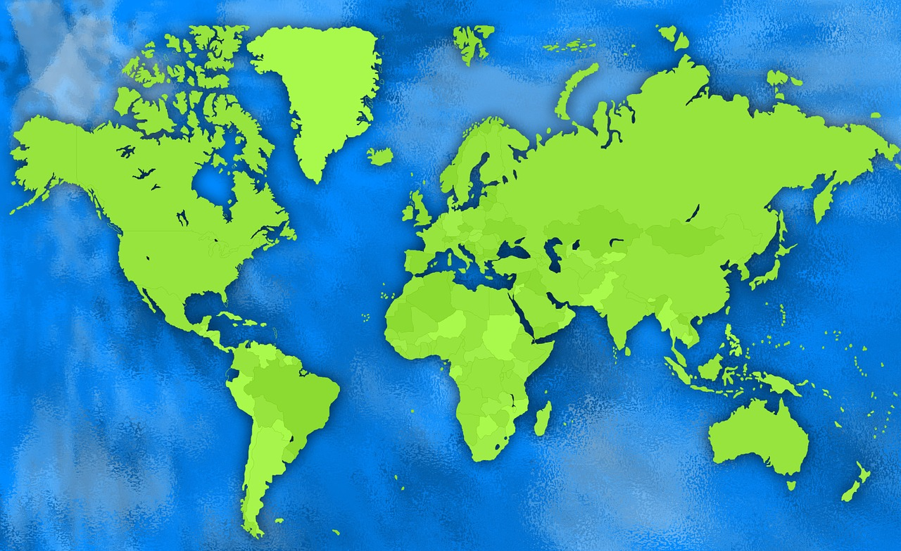
Notes:
...this is how it should look (or is it?… more on this later). In the discussion you should discuss why their maps are so dissimilar (or perhaps, in some cases, so accurate) to this one. Lack of artistic skill? Lack of knowledge? Awareness of some parts of the world more than others? Digging deeper - why is this? Lack of travel? Lack of education? Lack of interest? Lack of those places having a voice in the world?
This, of course, is a rather cliched TOK activity, but this lesson approaches it in a different way to usual, by thinking not about why students’ maps are not accurate, but why the model by which we judge that accuracy is itself inaccurate.

Slide 4
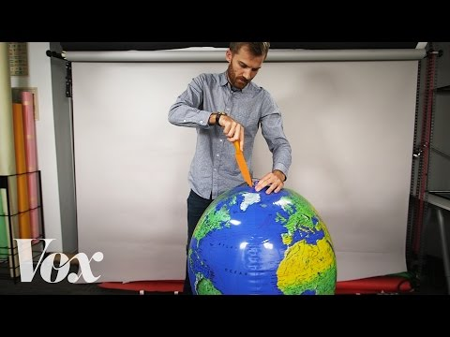
The impossibility of maps
Why are ‘all [2D] maps wrong’?
Why is the Mercator Projection the most common representation of the globe?
What are the implications of using the Mercator representation?
What solution do you propose?
Notes:
Link to video also found here.

Slide 5
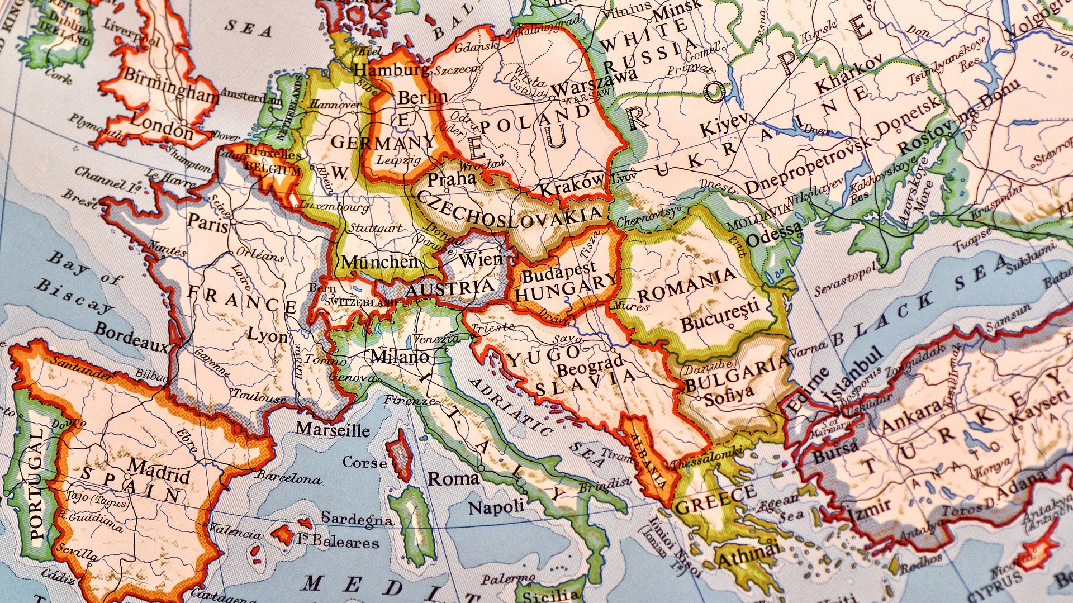
Quick question
What information should be conveyed by maps?
Notes:
Students will probably come up with the standard answers - names of countries, physical features, political features, settlements, population, etc. - but hopefully, some will suggest some more creative types of data, explored on our next slide...

Slide 6

Alternative maps
Pairs - Your number corresponds to a link taking you to a description of a ‘different’ type of map. Follow the link, and find out the following things:
What information is represented by your map?
How does this change your understanding of the globe?
How useful is this way of representing information about the globe?
Swap your information with the other groups. Overall, which map gives us the most useful information about the world? Why?
Notes:
Map based on cultural values, @BigThink, replacing geographic accuracy with closeness in terms of values.
Map based on population size @Vox. Alters the size of many countries (India, China, Russia, Nigeria), and gives us an alternative vision of ‘power’. (See also this map from Big Think.)
Map based on debt per head of capita, @BigThink. Many so-called rich countries are vastly in debt, whereas many of the poorer countries are not, giving us a different understanding of what it means to be wealthy.
Map based on number of languages spoken, @TheLinguisticsRoadshow. This shows how linguistically rich some countries/continents are (India, Nigeria, Papua New Guinea), compared to others (South America).
Map showing the extent to which different countries want free speech in their country, @bigthink. This shows how different cultures have a different approach to ethical issues.
Map showing the cities with the highest GDPs in the world, comparing them to countries with similar GDPs @BigThink. Suggests that cities, rather than countries, are the significant economic force in the world.

Slide 7

‘If it were my home’
Go to the ‘if it were my home’ website.
Find a fact about another country or culture that most surprises or shocks you.
What extra insight do we gain when we approach information about the world in a comparative way?
Notes:
Link to the site is here.

Slide 8

Worldometers.info
How does seeing information in ‘real time’ change the way you understand the world?
Notes:
Students should make sure they have spelt this wrong (it’s ‘worldometers’, not ‘worldmeters’!)
Direct link here.

Slide 9

Links to the TOK exhibition
Related exhibition prompt What challenges are raised by the dissemination and/or communication of knowledge? (IAP-10)
Refer to the ideas from this lesson to answer this question.
For example, think about how different ways of communicating an idea can end up misrepresenting that idea, either deliberately or by accident.
Which objects could help to illustrate your answer?
Notes:
Optional slide, if you want to help students to take ownership of the IA prompts (IAPs) for the TOK exhibition
For more ideas on relevant IAPs, see the ‘Linking this lesson to the course’ slide

Slide 10

How should - and shouldn’t - information about the world be represented?
Notes:
Hopefully not just in one way! Perhaps not at all.
Maybe technology gives us a much better opportunity to represent the world in a more meaningful way.
Should all classrooms have a 3D globe of the world?
See the BQ3 assessment tracker for suggestions on providing feedback, and recording students’ progress

Slide 11
Linking this lesson to the course
During this lesson, we consider the highlighted aspects of the TOK course
The images used in the presentation slides can also give students ideas about selecting exhibition objects; see also our link below to specific IA prompts
CORE THEME | OPTIONAL THEMES | AREAS OF KNOWLEDGE | TOK ASSESSMENT
Knowledge & the knower | Indigenous societies | The arts | The TOK essay
 | Language | History
 | Politics | The human sciences | The TOK exhibition Could be linked to IAP-6 (organize), IAP-24 (context), IAP-33 (development)
 | Religion | Mathematics
 | Technology | The natural sciences

Slide 12

Explore the TOK themes and areas of knowledge in more depth via a range of thinkers, media sources, and other resources, in our EXPLORATION POINTS DOCUMENTS.
Access the documents via the links below. You’ll also find the EP icons on all of the TOK course pages of the site to help you unpack the quotes, KQs, and real-life situations that you find there.
CORE THEME
Knowledge & the knower
OPTIONAL THEMES
Indigenous societies
Language
Politics
Religion
Technology
AREAS OF KNOWLEDGE
The arts
History
Human sciences
Mathematics
Natural sciences
Notes:
Use this slide to access the ‘Exploration Points’ notes for BQ3, which will help students to develop a deeper knowledge of any TOK theme or area of knowledge. This will not only help them to master the TOK course in general, but also craft a great exhibition or essay.
Be ready to provide more guidance on how to use this resource - ie, which media sources to focus on, which questions to address, which TED talks to watch, and which key terms and ideas to understand.

