Slide 1
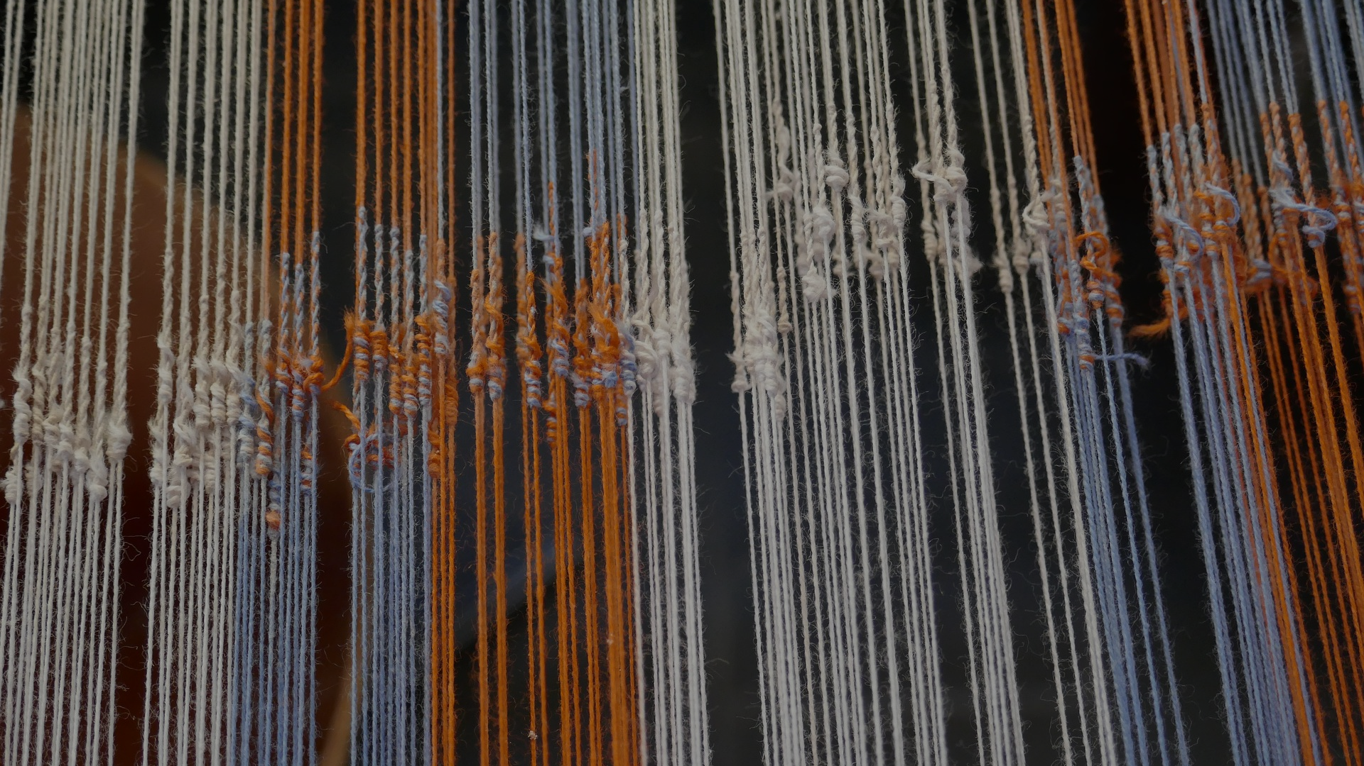

ICE CREAM CONSUMPTION VS. SHARK ATTACKS
BQ3 Spin Lesson 7
I can explain how confusing causation and correlation can affect the way we represent and understand the world
Notes:
See how this lesson links to the course by viewing the final slide
Key TOK terms appear in a red font

Slide 2

Starter
Name as many ‘human sciences’ as you can.
What purpose do human sciences share?
Notes:
Students can use this link.
The basic purpose of the human sciences is to explain all the ways in which humans behave, interact, and develop, and to help improve society as a whole - primarily by looking at the cause of things.

Slide 3

Distinguishing between causation & correlation
Causation = the stimulus that makes something happen directly.
Correlation = a relationship between two things, which does not necessarily involve one causing the other to occur.
To explain our actions and behaviour, human scientists try to gather evidence to explain the cause of things, rather than simply spot factors that are just correlated.
Why could it be a problem mistaking these two things?
Notes:
Stress this is one of the key purposes of the human sciences (as we’ll demonstrate).
Ask for responses to question at the bottom, but don’t give a definitive answer yet - return to this question after slide 6.
It may be helpful to give a few examples of causation and correlation - but there are examples coming up.

Slide 4
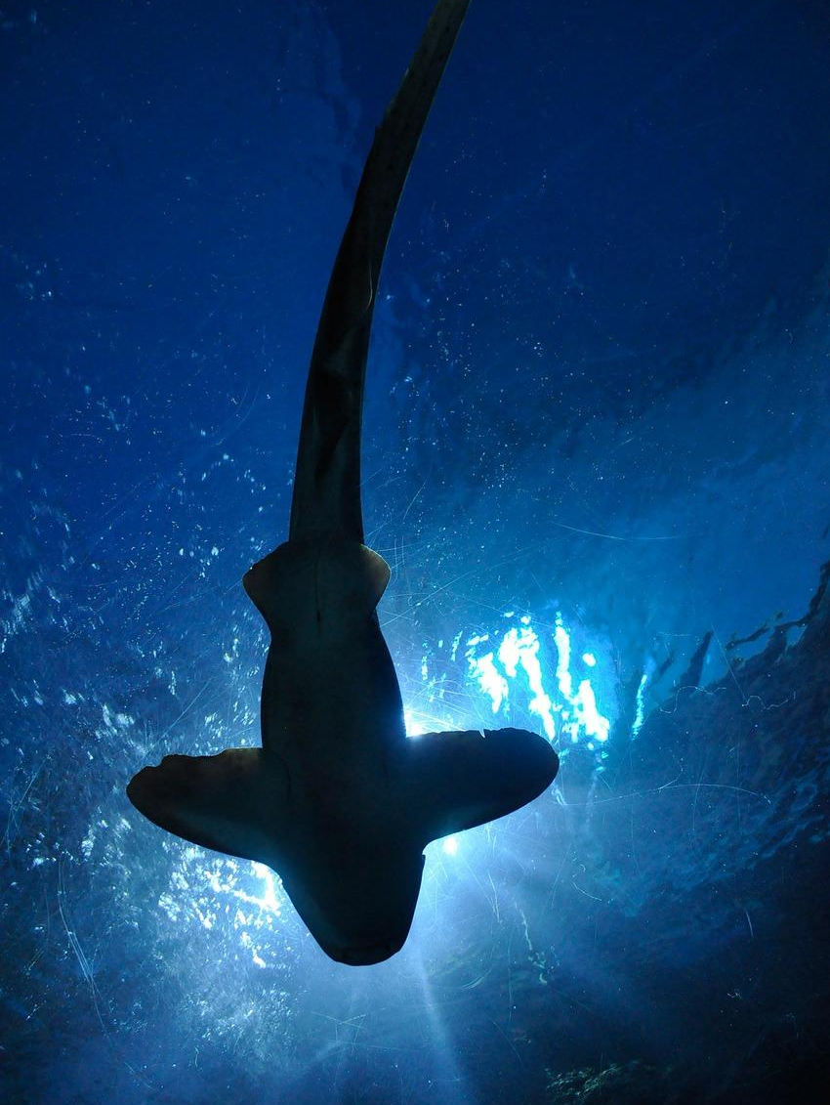
Some correlations are obvious...
The amount of ice cream consumed increases at the same time as the number of shark attacks. Does that mean one causes the other?
Sleeping with your shoes on is linked to the rate of headaches experienced in the morning. Does that mean one causes the other?
Notes:
Ask students to figure out the link…
No: the amount of ice cream consumed is correlated to the number of shark attacks (people eat ice-cream in the summer, and spend time at the beach)
No: sleeping with your shoes on correlates to suffering from headaches in the morning (people who are sleeping with their shoes on have often collapsed after hitting too many bars, and will go on to have a hangover)

Slide 5

...some are more difficult to distinguish
Cigarette smoking amongst young people is linked to poor grades at school. But does it cause it?
A higher consumption of chocolate is linked to a lower body mass index (BMI)
Notes:
Ask students to figure out the links, then return to that question about the implications of confusing causation and correlation.
Although there is some evidence for cigarette smoking to impair intellectual development, cigarette smoking is often a sign of deliberate rebellion, something that is embraced by those who have poorer attendance records at school, and/or prevalent within families where there is less awareness (or concern) about the health-risks connected to smoking. In other words, it’s hard to prove that there is a smoking causes the poor grades directly, rather than these other factors.
We’re not sure why this is the case, but a University of California study noticed this relationship. The media went mad, but… possible answers may include those who exercise or lose weight may reward themselves with chocolate, or those who eat chocolate do so because they’re thinner, or there may be socio-economic reasons, or it may be a combination of all of these. It is NOT chocolate causing weight loss.
If you want to get students exploring this, try this video (for the shorter version of this, see Big Think)

Slide 6
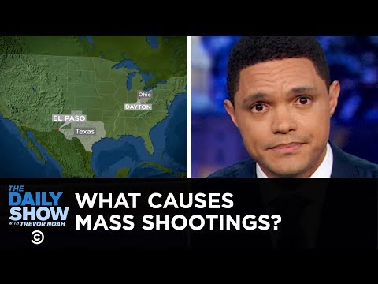
Explaining US gun violence
What are the 4 theories about mass shootings that Trevor Noah explores? Can you think of any others? (Alternative video link here)
Which ones seem to be causes, and which ones seem to merely correlate to mass shootings? How can we tell?
Notes:
Link to the video here.
Be aware that the Daily Show obviously has a clear bias and agenda - which is worth discussing. But also note that he tries to be objective by comparing DT with stuffed-crust pizza and crocs...
Other causes may include too many guns, too few guns, moral decline, socio-economic disparities, etc. Worth discussing, although length of time spent talking depends on whether you do the next slide - this sets students up with a research task to explore these theories. If no time, skip to slide 8 after your discussion.
How can we tell - well, it’s very difficult!
The Internet & media coverage
Video games
Anti-immigration rhetoric
Mental illness

Slide 7

Exploring US gun violence
The Internet & media coverage
Video games
Anti-immigration feelings
Mental illness
Other factors (too many guns, too few guns, moral decline, socio-economic inequality)
Which one/s of these seems the best explanation for gun violence in the US?
More importantly, how might your answer to that question be shaped by your political, religious, and other perspectives?
Notes:
Links here - The Internet & media coverage / Video games / Anti-immigration feelings / Mental illness / Other factors (too many guns, too few guns, moral decline, socio-economic inequality)Research task - give students one of the theories to research. They can then swap their findings, and arrive at an answer to the questions. Alternatively, you can skip this slide
The opinions are based on analyses of a range of mass shootings.
See quite a good overall analysis of gun violence here.
We will return to this question about perspectives at the beginning of BQ4
Image is of El Paso, where the deadliest mass shooting against the Latino community took place in August 2019.

Slide 8
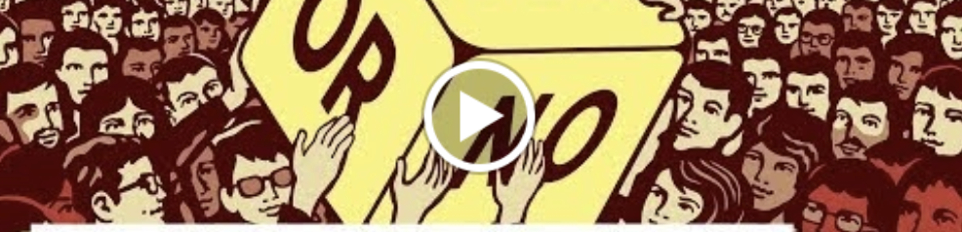
Applying Hoffman’s rule
What did Donald Hoffman say about making claims, and communicating ideas clearly?
How should we define the term ‘mass shootings’?
Check out the Washington Post article to see how difficult this can be.
Notes:
See lesson 1.1 for our discussion featuring Donald Hoffman.

Slide 9

Links to the TOK exhibition
Related exhibition prompt Why do we seek knowledge? (IAP-17)
Refer to the ideas from this lesson to answer this question.
For example, think about whether we seek knowledge to help us distinguish between causation and correlation in order to develop a more nuanced understanding of the world.
Which objects could help to illustrate your answer?
Notes:
Optional slide, if you want to help students to take ownership of the IA prompts (IAPs) for the TOK exhibition
For more ideas on relevant IAPs, see the ‘Linking this lesson to the course’ slide

Slide 10

What are the implications of confusing causation and correlation when we try to communicate our understanding of the world?
Notes:
See the BQ3 assessment tracker for suggestions on providing feedback, and recording students’ progress

Slide 11
Linking this lesson to the course
During this lesson, we consider the highlighted aspects of the TOK course
The images used in the presentation slides can also give students ideas about selecting exhibition objects; see also our link below to specific IA prompts
CORE THEME | OPTIONAL THEMES | AREAS OF KNOWLEDGE | TOK ASSESSMENT
Knowledge & the knower | Indigenous societies | The arts | The TOK essay
 | Language | History
 | Politics | The human sciences | The TOK exhibition Could be linked to IAP-8 (certainty), IAP-17 (seek), IAP-19 (justification)
 | Religion | Mathematics
 | Technology | The natural sciences

Slide 12

Explore the TOK themes and areas of knowledge in more depth via a range of thinkers, media sources, and other resources, in our EXPLORATION POINTS DOCUMENTS.
Access the documents via the links below. You’ll also find the EP icons on all of the TOK course pages of the site to help you unpack the quotes, KQs, and real-life situations that you find there.
CORE THEME
Knowledge & the knower
OPTIONAL THEMES
Indigenous societies
Language
Politics
Religion
Technology
AREAS OF KNOWLEDGE
The arts
History
Human sciences
Mathematics
Natural sciences
Notes:
Use this slide to access the ‘Exploration Points’ notes for BQ3, which will help students to develop a deeper knowledge of any TOK theme or area of knowledge. This will not only help them to master the TOK course in general, but also craft a great exhibition or essay.
Be ready to provide more guidance on how to use this resource - ie, which media sources to focus on, which questions to address, which TED talks to watch, and which key terms and ideas to understand.

