Slide 1
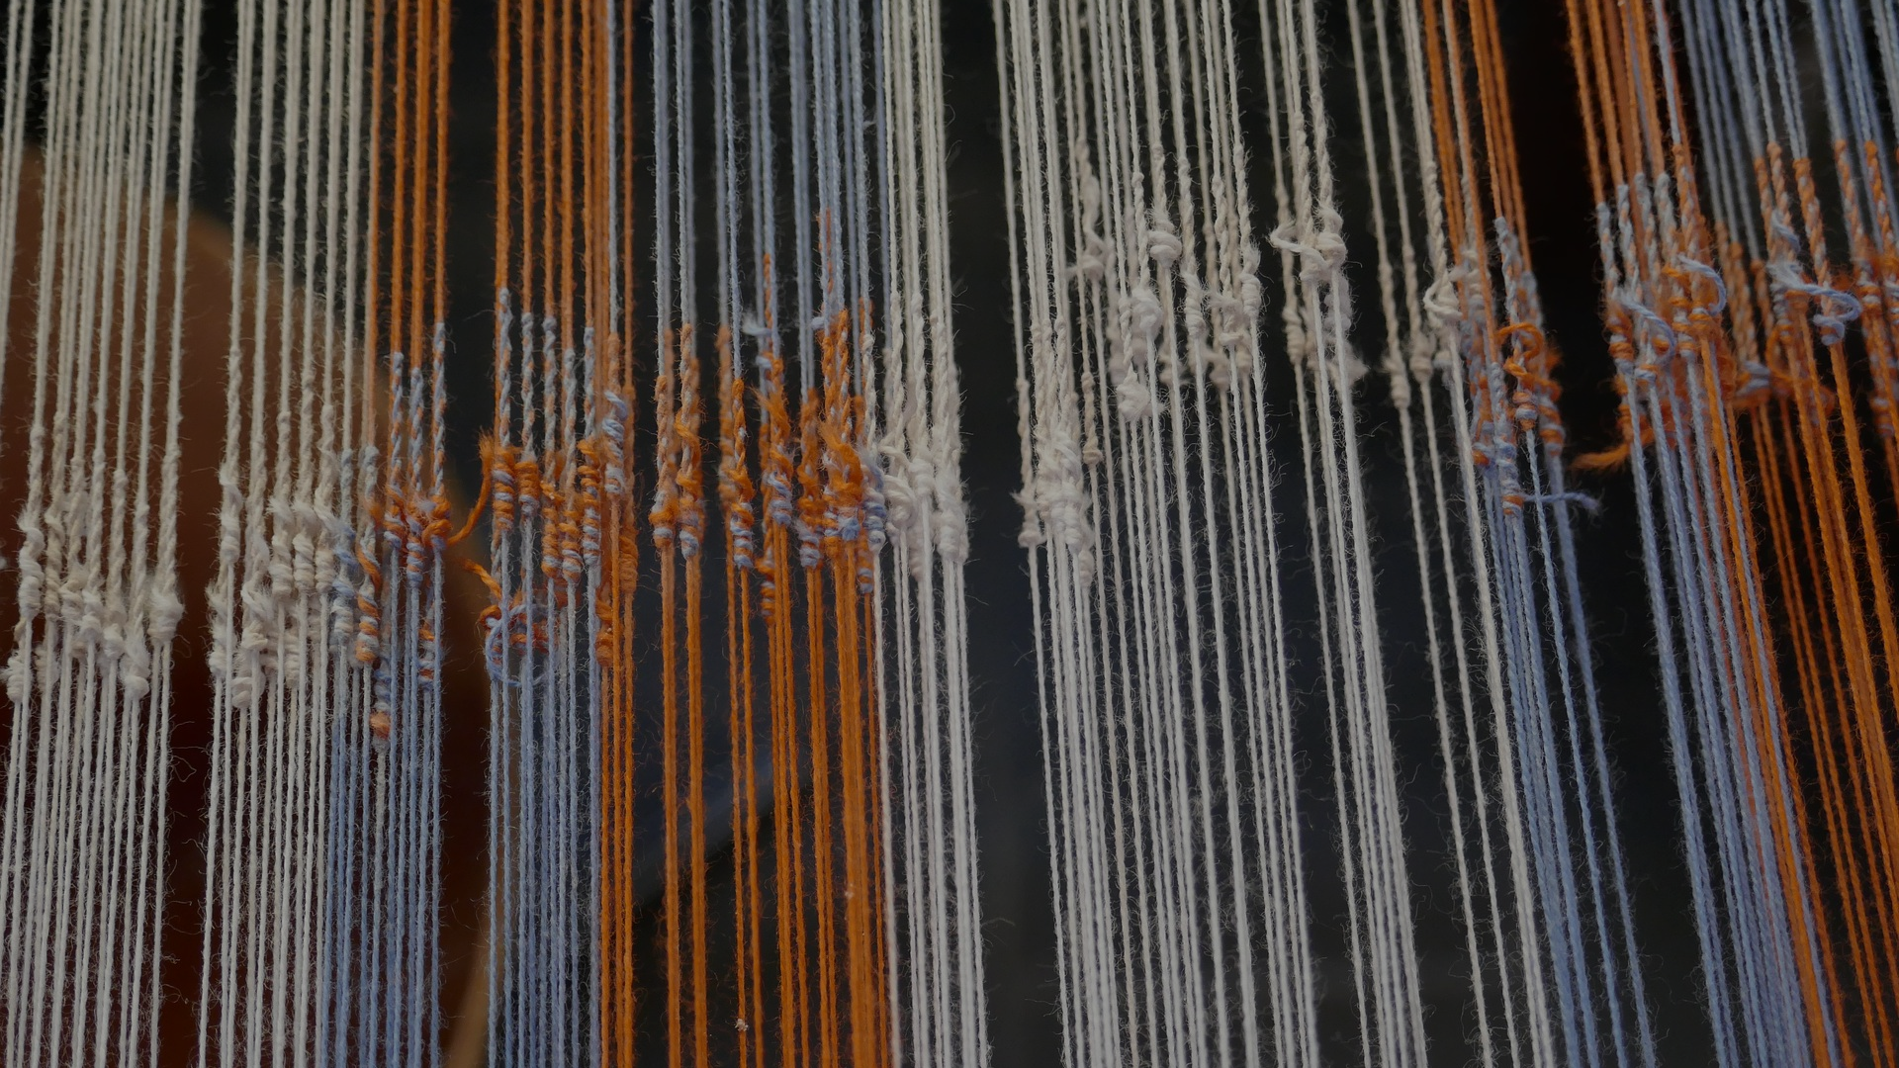

AN INTERRELATION OF VIBRATIONS
BQ3 Spin Lesson 8
I can evaluate the trustworthiness of a field via the way in which it represents ideas and concepts
Notes:
See how this lesson links to the course by viewing the final slide
Key TOK terms appear in a red font

Slide 2

Starter
What was our definition of ‘scientific’? If you can’t remember, come up with your own definition
Notes:
See BQ2 and the definition created by the British Science Council (next slide).

Slide 3
“Science...
… is the pursuit of knowledge and understanding of the natural and social world following a systematic methodology based on evidence."
The British Science Council

Slide 4
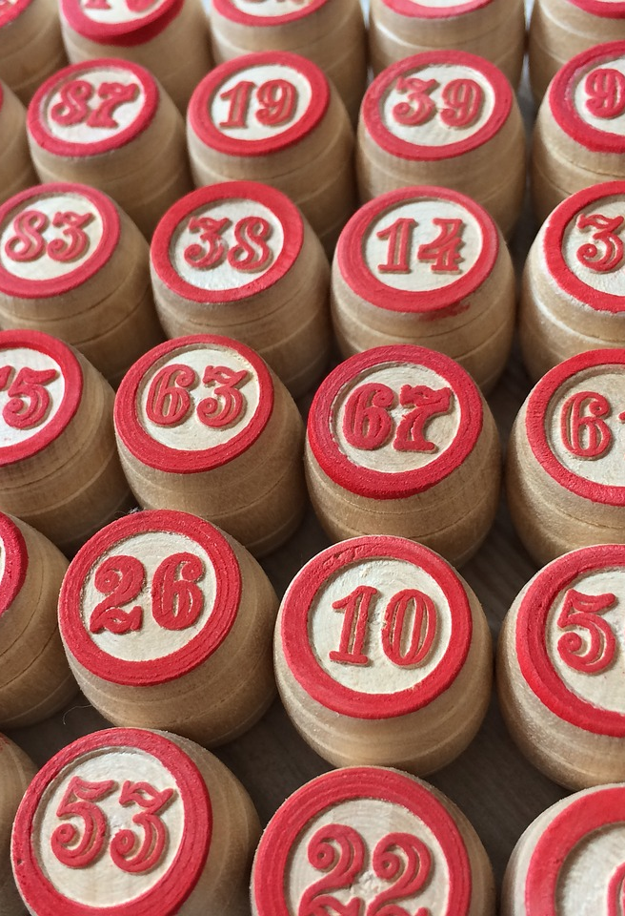
“Numerology is the study of numbers, and the occult manner in which they reflect certain aptitudes and character tendencies, as an integral part of the cosmic plan. Each letter has a numeric value that provides a related cosmic vibration. The sum of the numbers in your birth date and the sum of value derived from the letters in the name provide an interrelation of vibrations.”
(from the website www.astrology-numerology.com)
In what ways does numerology seem to be scientific?
Notes:
Get students to write down a short bullet point list. Stress that they shouldn’t try to be too evaluative at this point. Points they might include are -
The name (it’s an ‘ology’)
It’s devoted to the ‘study’ of something
It seems to apply a method to that study
It draws on mathematics (the subject matter, and working out the sum of numbers)
It looks at ‘cosmic’ matters, and ‘vibrations’ - related to physics in some way
(etc.)

Slide 5
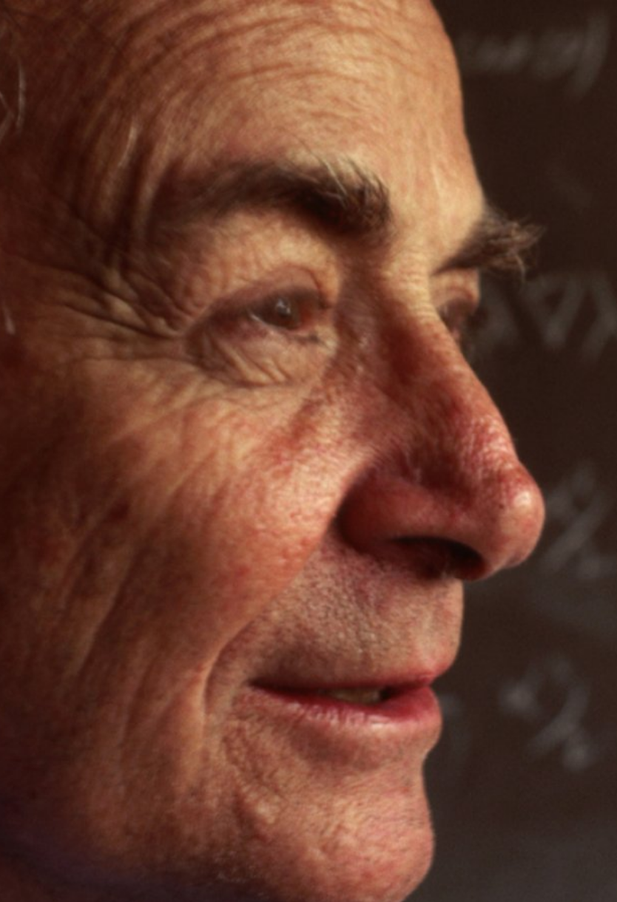
Introducing Richard Feynman
The Feynman jargon test:
“It turns out, all you need to do when you read or hear something that sounds smart, is try to translate it back into ordinary language - or better yet, have the person explain it for you - without using any scientific jargon or terms, and see if it still makes sense.”
Notes:
This is Richard Feynman’s test to see if something is genuine knowledge, or if it is just using terminology that doesn’t mean anything to cloak the absence of genuine knowledge. Get students to write this down (from ‘try to translate…)
Richard Feynman - 1918-1988, American theoretical physicist, regarded as one of the greatest physicists of all time, involved in the development of the atomic bomb in WWII, won the Nobel Prize in 1965, helped us to develop our understanding of quantum mechanics. Also one of the best ever communicators of scientific knowledge. This is an opportunity to set the students off on a little extra research on why is he considered such a significant figure.
Image has no known rights restrictions

Slide 6
“Numerology is the study of numbers, and the occult manner in which they reflect certain aptitudes and character tendencies, as an integral part of the cosmic plan. Each letter has a numeric value that provides a related cosmic vibration. The sum of the numbers in your birth date and the sum of value derived from the letters in the name provide an interrelation of vibrations.”
(from the website www.astrology-numerology.com)
Apply the ‘Feynman test’ to this statement. Which words are hard to translate into ordinary language? Does this undermine its aims?
Notes:
There are a lot of words that cannot be explained - ‘occult’, ‘aptitudes’ and ‘character tendencies’ of numbers, ‘cosmic plan’, ‘cosmic vibration’.
There’s also no indication (in this statement, anyway) of why there should be a causal relation (refer back to last lesson!) between the structure of the universe, and numbers making up our birth date.

Slide 7
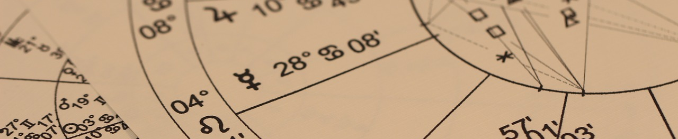
Pseudoscience
Copy this definition:
Pseudosciences are disciplines, fields, or beliefs that claim to offer systematic knowledge about the natural world, but which are not based on the scientific method
Notes:
For example - replication, objective demonstrable evidence, a testable hypothesis, etc.

Slide 8

Research task
On a poster, explore one example of a common pseudoscience. Include information about -
Its name + a brief description
How it seems to be scientific
Why it isn’t scientific
The reasons why you think it is popular
Add the findings of one other group to your poster.
Leave room for a final question...
...OVERALL Why do you think so many people around the world believe in pseudosciences? Is this a problem, and if so, how could/should we try to solve it?
Notes:
Animated slide. Reveal the instructions 1-5 first. Then set the overall question.
Examples include: acupuncture, Creation science, Crystal healing, Conversion therapy, Ghost-hunting, Homeopathy, Phrenology, Ufology, ETC., ETC.
The Wikipedia list of pseudosciences is excellent; the link can be provided, and students should find their pseudosciences
Note that this is not a test of whether knowledge dealt with in these fields is ‘true’ or not, only whether it can be termed ‘scientific’. Whether scientifically-verified knowledge is the only valid knowledge would be a different question…
Here’s a link to a recent story about a pseudoscience craze, which could be shown before the OVERALL question is displayed.

Slide 9

Links to the TOK exhibition
Related exhibition prompt What makes a good explanation? (IAP-32)
Refer to the ideas from this lesson to answer this question.
For example, think about how a good explanation depends on how clear and coherent its terms are.
Which objects could help to illustrate your answer?
Notes:
Optional slide, if you want to help students to take ownership of the IA prompts (IAPs) for the TOK exhibition
For more ideas on relevant IAPs, see the ‘Linking this lesson to the course’ slide

Slide 10

What are the implications of being unable to distinguish between scientific and pseudoscientific claims?
Notes:
Remember this question - it’s one of the biggest ones we consider. Worth recording these exit slip answers (as always, I suggest Post-It notes, stuck on a wall around the question)
See the BQ3 assessment tracker for suggestions on providing feedback, and recording students’ progress

Slide 11
Linking this lesson to the course
During this lesson, we consider the highlighted aspects of the TOK course
The images used in the presentation slides can also give students ideas about selecting exhibition objects; see also our link below to specific IA prompts
CORE THEME | OPTIONAL THEMES | AREAS OF KNOWLEDGE | TOK ASSESSMENT
Knowledge & the knower | Indigenous societies | The arts | The TOK essay
 | Language | History
 | Politics | The human sciences | The TOK exhibition Could be linked to IAP-4 (doubt), IAP-10 (communication), IAP-19 (justification), IAP-32 (explanation)
 | Religion | Mathematics
 | Technology | The natural sciences

Slide 12

Explore the TOK themes and areas of knowledge in more depth via a range of thinkers, media sources, and other resources, in our EXPLORATION POINTS DOCUMENTS.
Access the documents via the links below. You’ll also find the EP icons on all of the TOK course pages of the site to help you unpack the quotes, KQs, and real-life situations that you find there.
CORE THEME
Knowledge & the knower
OPTIONAL THEMES
Indigenous societies
Language
Politics
Religion
Technology
AREAS OF KNOWLEDGE
The arts
History
Human sciences
Mathematics
Natural sciences
Notes:
Use this slide to access the ‘Exploration Points’ notes for BQ3, which will help students to develop a deeper knowledge of any TOK theme or area of knowledge. This will not only help them to master the TOK course in general, but also craft a great exhibition or essay.
Be ready to provide more guidance on how to use this resource - ie, which media sources to focus on, which questions to address, which TED talks to watch, and which key terms and ideas to understand.

