Slide 1


THE DANGERS OF MULTIPLE HISTORICAL PERSPECTIVES
BQ4 Perspectives Lesson 6
I can explain why historical knowledge is particularly vulnerable to interpretation via different perspectives
Notes:
See how this lesson links to the course by viewing the final slide
Key TOK terms appear in a red font

Slide 2

Starter
How does science try to ‘insulate’ itself from the problem of bias?
Think about the stages of the scientific method when you write your answer.
Notes:
Overall, by making claims with demonstrable evidence (ie evidence that we can see for ourselves).
This can be checked by experimentation, replication, and via a wider audience after publication.
A good scientific theory should be falsifiable - see our work on Popper from Big Question 5.

Slide 3
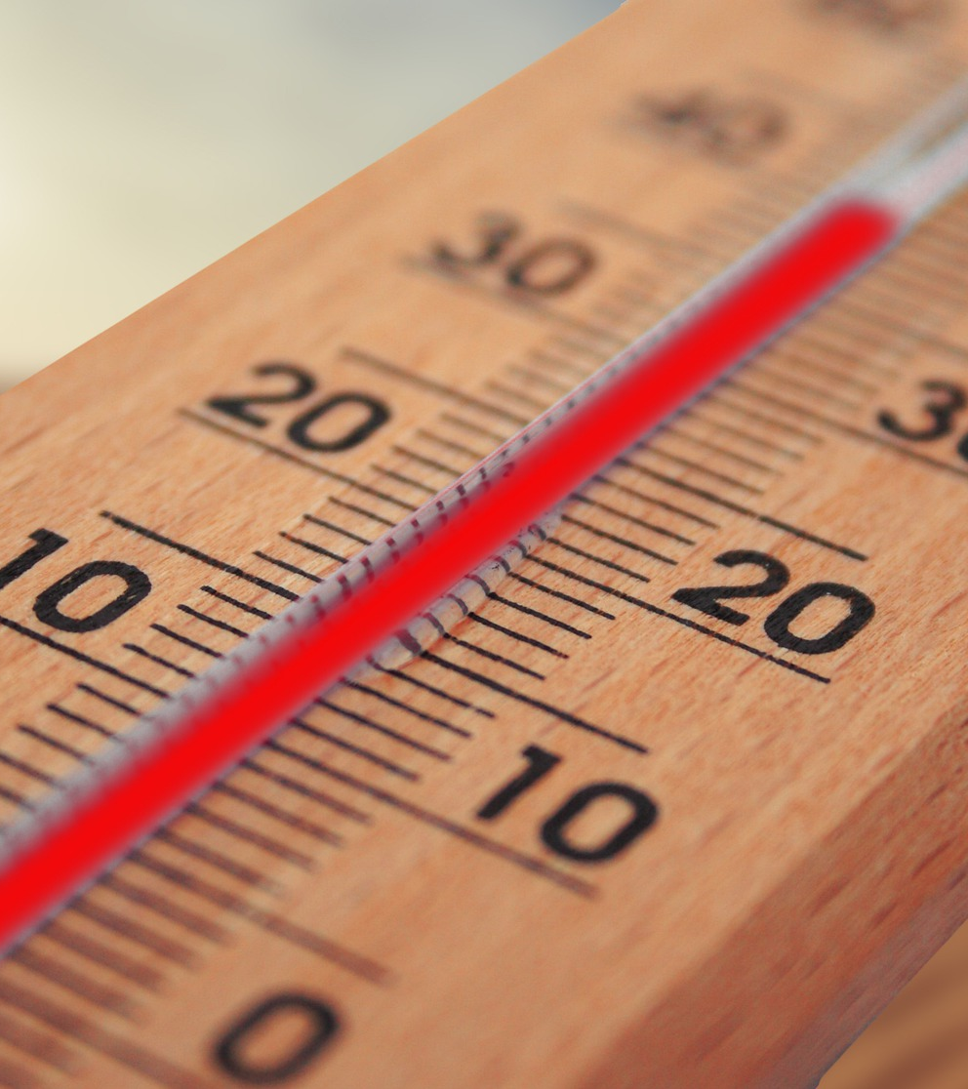
Perspectives & science
“A thermometer is not liberal or conservative” (Katharine Hayhoe)
What do you think Hayhoe meant - and what current issue does this link to?
Check your answer with the interview with her (Q3).
Notes:
The interview is found within this article.

Slide 4

History & perspectives
How does history differ from science in terms of the way knowledge is checked?
Why do you think that some people even argue that it is a ‘pseudoscience’?

Slide 5
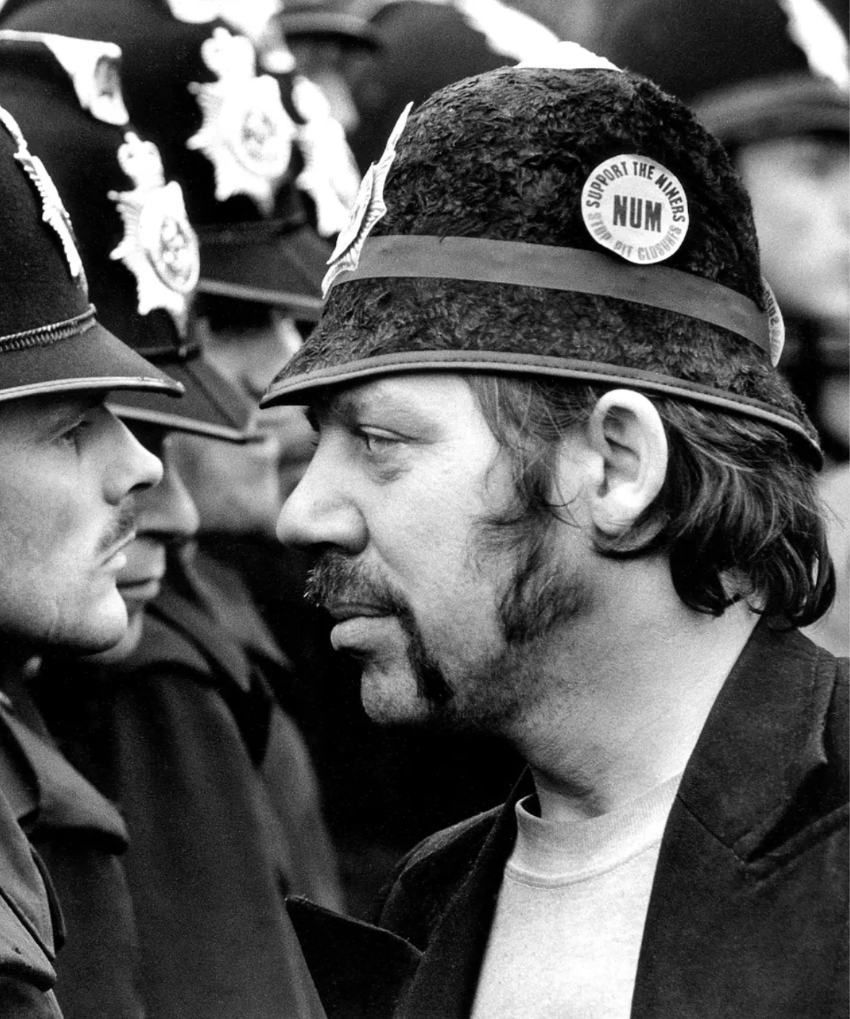
The UK Miners’ Strike - image 1
What impression do you get about this event from this picture, taken by Don McPhee, in June 1984?
Specifically, how tense does the situation seem to be?

Slide 6
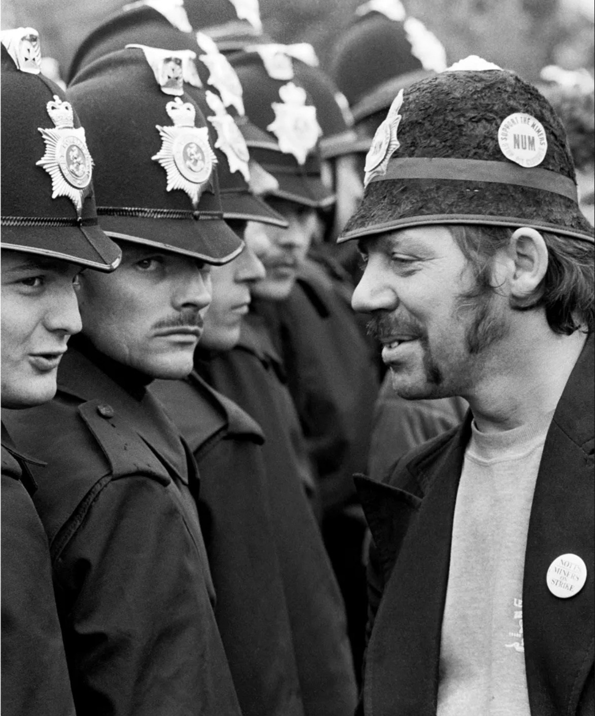
The UK Miners’ Strike - image 2
How does this photography (taken by Martin Jenkinson, a moment later) change your impression?
Which photo should we use as evidence for what happened?
Notes:
Images taken from this article.

Slide 7
Selecting evidence: the UK Miners’ Strike
The miners' strike was an attempt in the UK to prevent coal-mine closures in 1984-85.
It was led by Arthur Scargill of the National Union of Mineworkers (NUM) against the Conservative government of Prime Minister Margaret Thatcher, who wanted to reduce the power of trade unions.
The event divided those on the political left (who believe that governments should play a role in people’s lives to share the country’s wealth more equally) and those on the right (who believe that the economic markets should be allowed to determine the way wealth is distributed).
People’s political perspectives played a big role in how they viewed the event.
If you were on the left, you’d be more inclined to think the government was at fault, and the miners were simply trying to survive.
If you were on the right, you’d blame the miners, and try to portray them as aggressive criminals.
Which photo might each side select to support its perspective?
What are the implications of this, in terms of how we produce historical knowledge? Try to include ‘confirmation bias’ in your answer.

Slide 8

The dangers of different perspectives
History is written from different perspectives, so the same event is often portrayed differently according to the background and academic tradition of the historian - or other factors.
Look at Understanding Historical Perspectives via theoryofknowledge.net, and learn about one way in which a historical perspective can be misused.
Add your thoughts to the perspectives sheet (the first one is done for you), and then talk to other groups to find out what they discovered to complete the sheet.
Notes:
This is the page - Understanding Historical Perspectives.
Give each pair or group one quote to focus on - see next slide and the perspectives sheet for what these are.

Slide 9
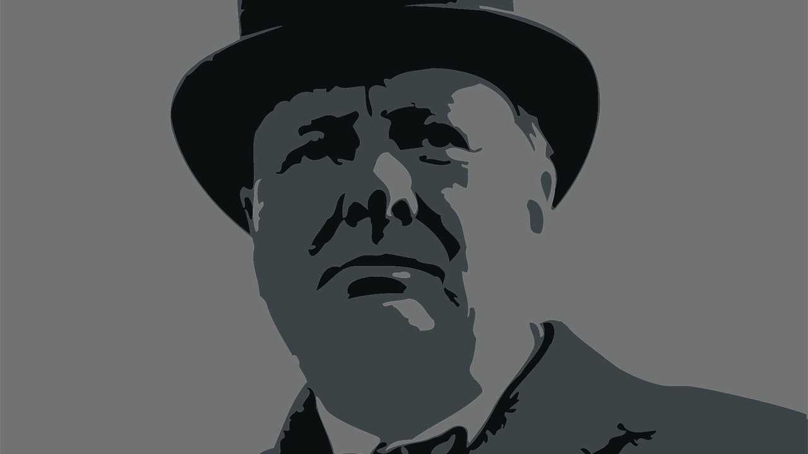
“An entire career can be built on the trick of contrariness”
“History is past politics and politics present history”
“There are facts, there are opinions, and there are lies”
“The rebirth of control over history”
“Reality-suffocating myth”

Slide 10

Links to the TOK exhibition
Related exhibition prompt Does some knowledge belong only to particular communities of knowers? (IAP-14)
Refer to the ideas from this lesson to answer this question.
For example, think about who history is written for: particular communities of knowers, or as wide an audience as possible (and how this depends on who is writing it, and why).
Which objects could help to illustrate your answer?
Notes:
Optional slide, if you want to help students to take ownership of the IA prompts (IAPs) for the TOK exhibition
For more ideas on relevant IAPs, see the ‘Linking this lesson to the course’ slide

Slide 11

Overall, which ‘misuse’ of perspectives would you say is most problematic when it comes to learning ‘the truth’ about the past? Explain your answer.
Notes:
See the BQ4 assessment tracker for suggestions on providing feedback, and recording students’ progress

Slide 12
Linking this lesson to the course
During this lesson, we consider the highlighted aspects of the TOK course
The images used in the presentation slides can also give students ideas about selecting exhibition objects; see also our link below to specific IA prompts
CORE THEME | OPTIONAL THEMES | AREAS OF KNOWLEDGE | TOK ASSESSMENT
Knowledge & the knower | Indigenous societies | The arts | The TOK essay
 | Language | History
 | Politics | The human sciences | The TOK exhibition Could be linked to IAP-8 (certainty), IAP-12 (bias), IAP-14 (communities)
 | Religion | Mathematics
 | Technology | The natural sciences

Slide 13
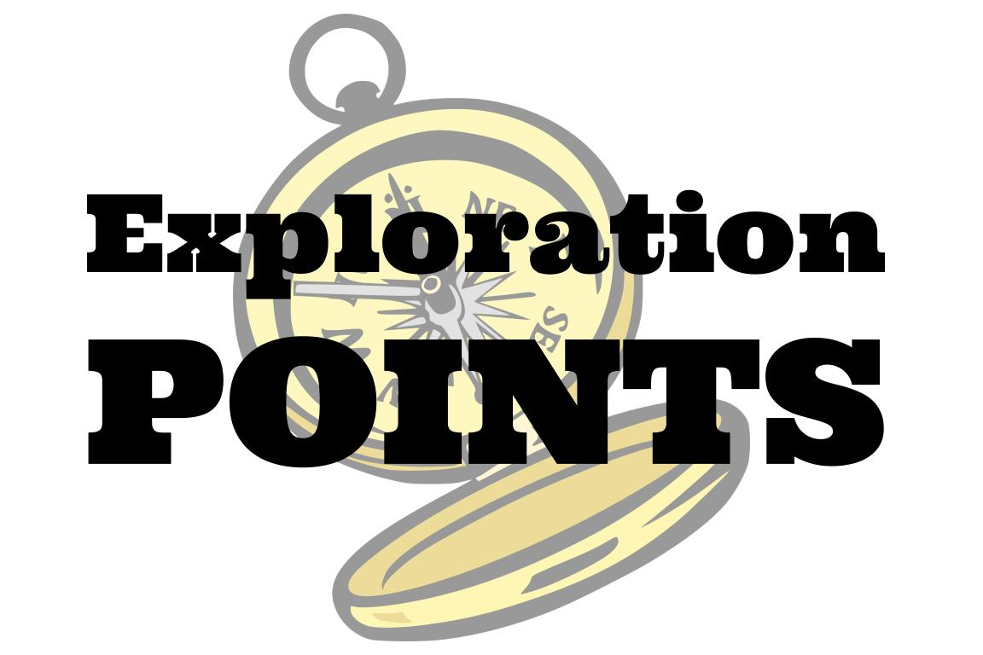
Explore the TOK themes and areas of knowledge in more depth via a range of thinkers, media sources, and other resources, in our EXPLORATION POINTS DOCUMENTS.
Access the documents via the links below. You’ll also find the EP icons on all of the TOK course pages of the site to help you unpack the quotes, KQs, and real-life situations that you find there.
CORE THEME
Knowledge & the knower
OPTIONAL THEMES
Indigenous societies
Language
Politics
Religion
Technology
AREAS OF KNOWLEDGE
The arts
History
Human sciences
Mathematics
Natural sciences
Notes:
Use this slide to access the ‘Exploration Points’ notes for BQ4, which will help students to develop a deeper knowledge of any TOK theme or area of knowledge. This will not only help them to master the TOK course in general, but also craft a great exhibition or essay.
Be ready to provide more guidance on how to use this resource - ie, which media sources to focus on, which questions to address, which TED talks to watch, and which key terms and ideas to understand.

