Slide 1


BJ 581
BQ4 Perspectives Lesson 9
I can explain how our present-day assumptions and biases can determine how we understand the past
Notes:
See how this lesson links to the course by viewing the final slide
Key TOK terms appear in a red font
This lesson could be left out of the unit (students could be given this time to work on their BQ4 exhibitions), but it gives a useful RLS about how our assumptions can mislead us when it comes to the production of historical knowledge.

Slide 2

Starter
What do you imagine a Viking Warrior looked like?
Sketch and label a diagram to illustrate your idea.

Slide 3
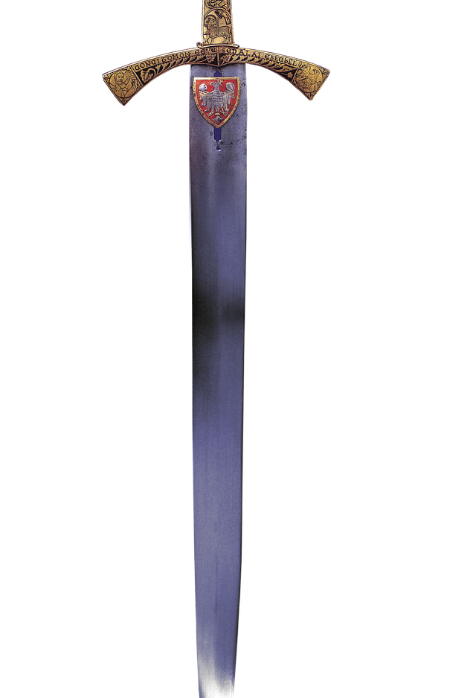
Group thinking
Look at the list of items uncovered by Swedish archaeologists in the 1880s in a Viking grave (this find was given the name Bj 581)
What conclusions can we draw about the type of person this was, their lifestyle, their importance, role in society, and any other details?
Shields
Axe
Spear
Sword
A battle knife
Bow with a set of heavy armour-piercing arrows
Two horses (a mare and a stallion)
A set of game pieces - perhaps from hnefatafl (a early version of chess)

Slide 4
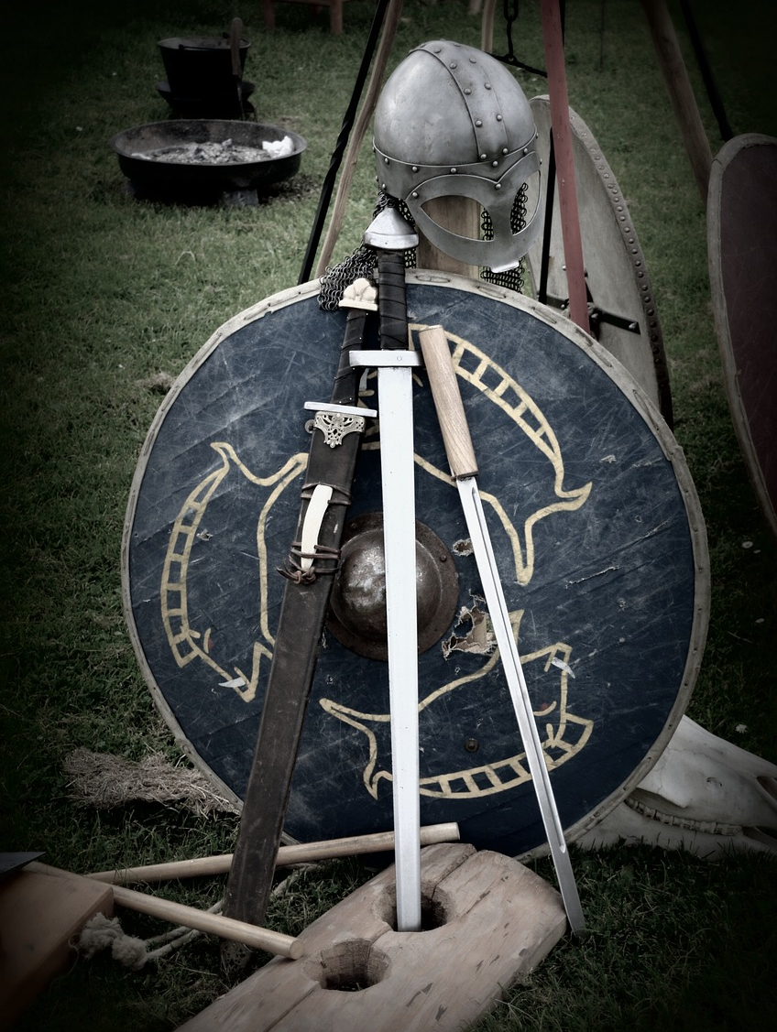
Using assumptions to produce knowledge
What assumptions are your conclusions based on (eg - weapons indicate a warrior)?
What is the origin of these assumptions (eg - you’ve seen present-day movies with Vikings, etc.)?
Overall, do you think your assumptions are valid?

Slide 5
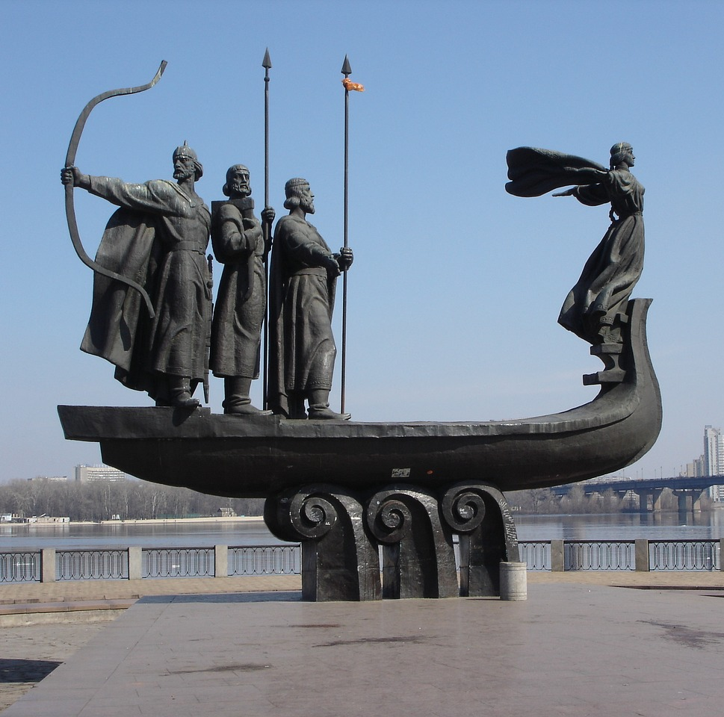
Challenging our assumptions
Can you guess the one fundamentally misleading assumption (=bias) that everyone made?
(Clue - the creators of this statue in Kiev made it too)
Notes:
A valid assumption is a hypothesis; an invalid one is a bias. Discuss!

Slide 6

Bj 581 was a woman
Notes:
Explore more here.
Pink for women?!

Slide 7
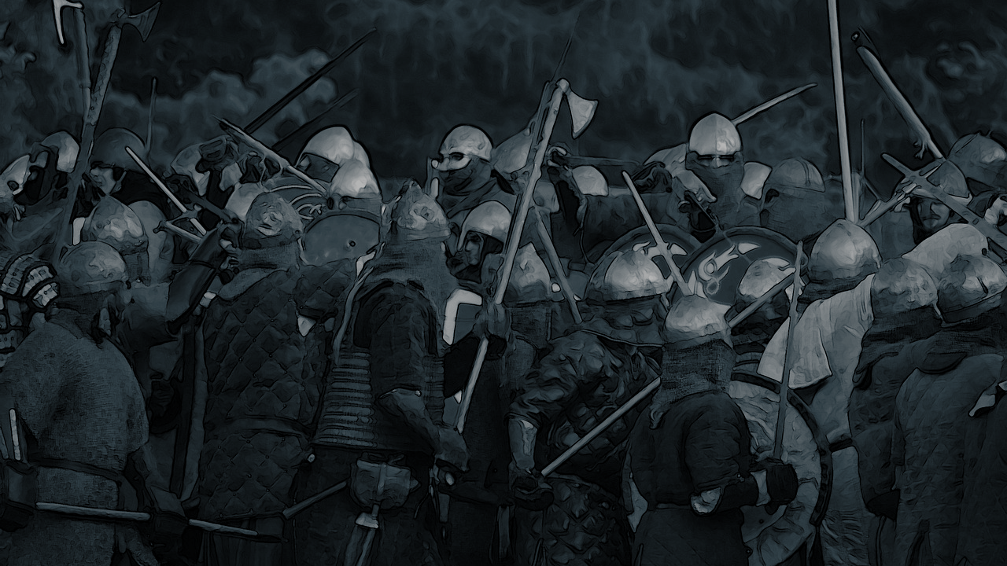
How does this knowledge change our perception of both this archaeological find (Bj 581), and the Vikings in general?
Does this extend further than the Vikings - and even history?
Notes:
This should lead onto a big discussion.
Yes, it does extend further than the Vikings - it permeates every aspect of history, and even other areas of knowledge as well (here’s an article on science and gender bias).

Slide 8

Links to the TOK exhibition
Related exhibition prompt Can new knowledge change established values or beliefs? (IAP-11)
Refer to the ideas from this lesson to answer this question.
For example, think about how our assumptions about the way society works in the present and the past can lead us astray - and why it’s necessary to learn from knowledge such as this.
Which objects could help to illustrate your answer?
Notes:
Optional slide, if you want to help students to take ownership of the IA prompts (IAPs) for the TOK exhibition
For more ideas on relevant IAPs, see the ‘Linking this lesson to the course’ slide

Slide 9

What are the implications of basing our understanding of history on false assumptions (biases)? How can we avoid this trap?
Notes:
See the BQ4 assessment tracker for suggestions on providing feedback, and recording students’ progress

Slide 10
Linking this lesson to the course
During this lesson, we consider the highlighted aspects of the TOK course
The images used in the presentation slides can also give students ideas about selecting exhibition objects; see also our link below to specific IA prompts
CORE THEME | OPTIONAL THEMES | AREAS OF KNOWLEDGE | TOK ASSESSMENT
Knowledge & the knower | Indigenous societies | The arts | The TOK essay
 | Language | History
 | Politics | The human sciences | The TOK exhibition Could be linked to IAP-11 (belief), IAP-12 (bias)
 | Religion | Mathematics
 | Technology | The natural sciences

Slide 11
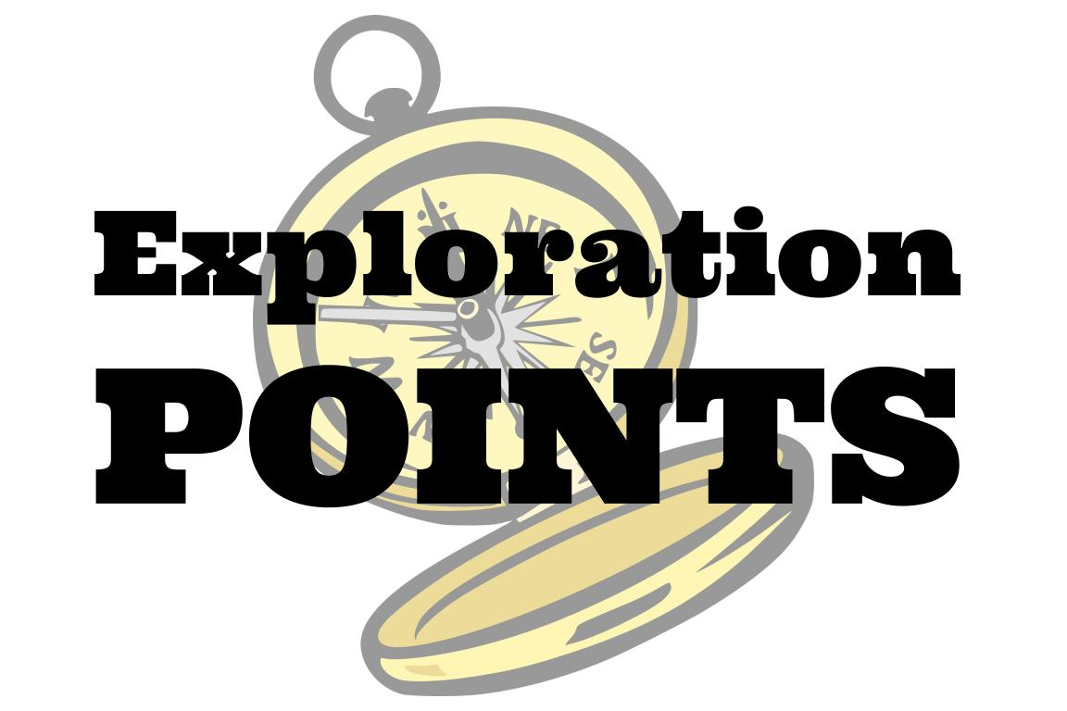
Explore the TOK themes and areas of knowledge in more depth via a range of thinkers, media sources, and other resources, in our EXPLORATION POINTS DOCUMENTS.
Access the documents via the links below. You’ll also find the EP icons on all of the TOK course pages of the site to help you unpack the quotes, KQs, and real-life situations that you find there.
CORE THEME
Knowledge & the knower
OPTIONAL THEMES
Indigenous societies
Language
Politics
Religion
Technology
AREAS OF KNOWLEDGE
The arts
History
Human sciences
Mathematics
Natural sciences
Notes:
Use this slide to access the ‘Exploration Points’ notes for BQ4, which will help students to develop a deeper knowledge of any TOK theme or area of knowledge. This will not only help them to master the TOK course in general, but also craft a great exhibition or essay.
Be ready to provide more guidance on how to use this resource - ie, which media sources to focus on, which questions to address, which TED talks to watch, and which key terms and ideas to understand.

