Slide 1
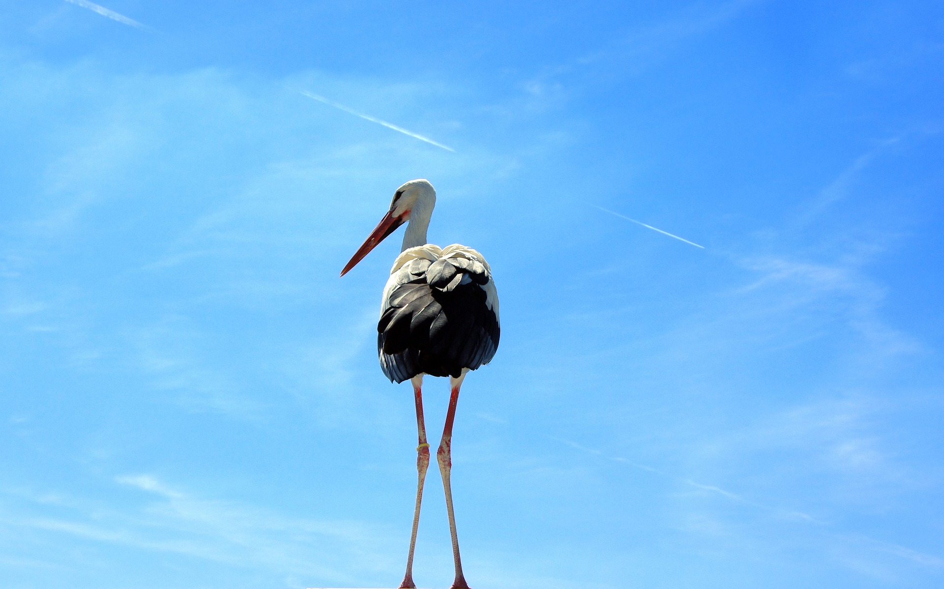

WRAPPING UP BQ5
BQ5 Creativity Lesson 11
I can answer Big Question 5, referring to the key terms, ideas, and thinkers from the unit
Notes:
See how this lesson links to the course by viewing the final slide
Key TOK terms appear in a red font

Slide 2

Starter
What was BQ5?
List one key idea we considered, and one key thinker we met.
Notes:
Debrief responses.
BQ5 is “How is new knowledge about the world created?”
Thinkers and ideas are listed on next slide.
The image links to our lesson on ‘Reconceiving art’ - and how our relationship with art (the novel, Nineteen Eighty-Four) constantly changes according to what is going on in society

Slide 3
What & who we’ve looked at in BQ5
Pablo Picasso
Steve Jobs
David Eagleman
Kellyanne Conway
Dorian Lynskey
George Orwell
Madeleine L’Engle
Shakespeare
Taylor Swift
Steven Pinker
Kory Stamper
Erin McKean
Gilbert Highet
John McWhorter
Albert Einstein
Sara Seager
Tom McLeish
James Clerk Maxwell
Stuart Firestein
Isaac Asimov
Louis Pasteur
Isaac Newton
Thomas Kuhn
Neil deGrasse Tyson
B.O.B.
Amy Wolff
Creativity
Connections
Bending, breaking, and blending
Derivation and extrapolation
The impossibility of originality
Alternative facts
Denotations and connotations of words
Language authorities
Descriptivism vs. prescriptivism
Texting as ‘miraculous’
Emojis
False starts and wrong turns
Scientific inspiration
Serendipity
Conscious ignorance
Farting around in the dark
Eureka moments
Standing on the shoulders of giants
Paradigm shifts
Science and social media
Speaking in public
The exhibition file
Notes:
Give students plenty of time to review this in groups. Check notes if necessary!
All tables should be able to briefly outline any/all of the ideas and thinkers - and link many of ideas to the thinkers.
Cold call, and reward accurate answers!

Slide 4

Kahoot!
Get into the same teams as last time.
Answer the Kahoot questions on BQ5...
Notes:
Kahoot is here.
Do this twice. Once in class, during which you can explain the answers. Then ask the students to do it again on their own.

Slide 5

Concluding tweets
With a partner, create two 280-character Tweets.
One should give an overall answer to BQ5 (“How is new knowledge about the world created”)
The other should outline a specific aspect of BQ5 (you’ll be allocated this)
Notes:
This is one version of the main lesson task. If you’d prefer to get your students to write a more formal, TOK essay-style conclusion, do slide 6 instead.
Allocate students different questions about BQ5 - see this document. Tweets can be collated on a shared document to give an overall summary of BQ4.

Slide 6

Writing a TOK essay-style conclusion
What is the purpose of a conclusion in a (TOK) essay?
Write a 150 word conclusion to BQ5 (‘How is new knowledge about the world created?’)
Include at least two of the concepts we’ve looked at and a quote from at least one of our thinkers (see the unit outline to help you)
Submit to Google Classroom.
Notes:
This is one version of the main lesson task. If you’d prefer to get your students to write a less formal, Tweet-style conclusion, do slide 5 instead.

Slide 7

Which idea from Big Question 5 made the biggest impression on you, and why?
Notes:
See the BQ5 assessment tracker for suggestions on providing feedback, and recording students’ progress.

Slide 8
Linking this lesson to the course
During this lesson, we consider the highlighted aspects of the TOK course
The images used in the presentation slides can also give students ideas about selecting exhibition objects; see also our link below to specific IA prompts
CORE THEME | OPTIONAL THEMES | AREAS OF KNOWLEDGE | TOK ASSESSMENT
Knowledge & the knower | Indigenous societies | The arts | The TOK essay
 | Language | History
 | Politics | The human sciences | The TOK exhibition Could be linked to a lot of the prompts, as this lesson wraps up the BQ
 | Religion | Mathematics
 | Technology | The natural sciences

Slide 9

Explore the TOK themes and areas of knowledge in more depth via a range of thinkers, media sources, and other resources, in our EXPLORATION POINTS DOCUMENTS.
Access the documents via the links below. You’ll also find the EP icons on all of the TOK course pages of the site to help you unpack the quotes, KQs, and real-life situations that you find there.
CORE THEME
Knowledge & the knower
OPTIONAL THEMES
Indigenous societies
Language
Politics
Religion
Technology
AREAS OF KNOWLEDGE
The arts
History
Human sciences
Mathematics
Natural sciences
Notes:
Use this slide to access the ‘Exploration Points’ notes for BQ5, which will help students to develop a deeper knowledge of any TOK theme or area of knowledge. This will not only help them to master the TOK course in general, but also craft a great exhibition or essay.
Be ready to provide more guidance on how to use this resource - ie, which media sources to focus on, which questions to address, which TED talks to watch, and which key terms and ideas to understand.

