Slide 1


RECONCEIVING ART
BQ5 Creativity Lesson 4
I can explain why the way we interpret and understand art changes over time
Notes:
See how this lesson links to the course by viewing the final slide
Key TOK terms appear in a red font

Slide 2
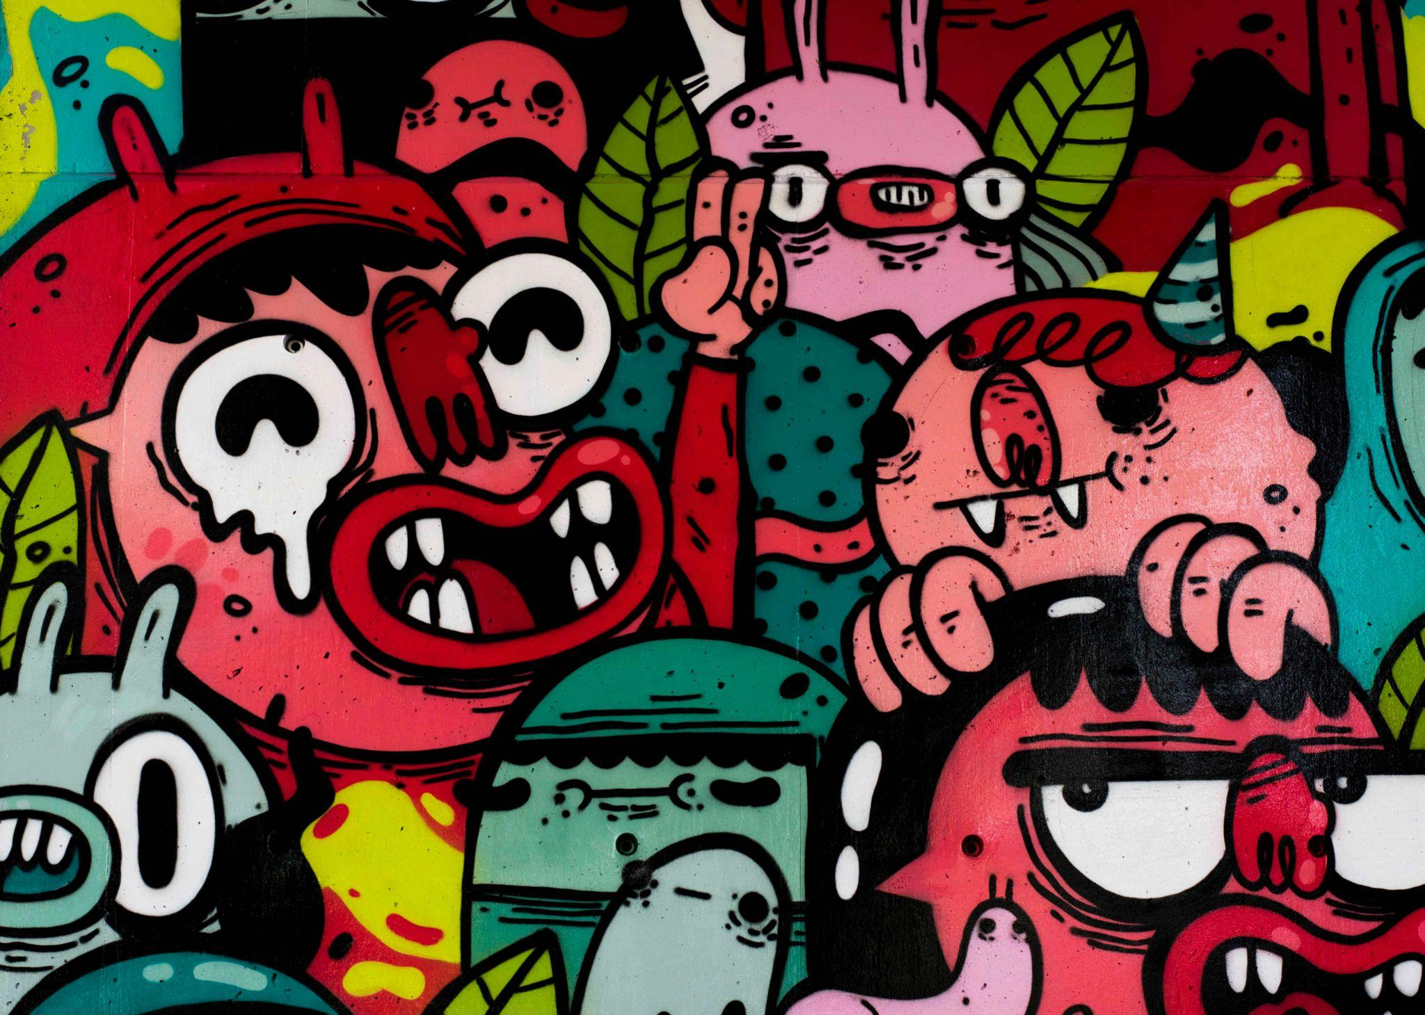
Starter
How has your taste in the arts (music, films, books, visual arts, etc.) changed over time?
Why do our artistics tastes change over time?
Notes:
Quite a nice question to explore - which touches on what art it, and what its purpose is
Our artistic preferences are personal, and as our personality changes over time, so do those preferences
What we ‘need’ during any particular period in our lives may depend on what’s happening during that period
For example, if we are going through a break-up, we may be more interested art dealing with that theme. Try to mention what people watched during the Coronavirus - this will be explored on the next slide

Slide 3

Outbreak
Wolfgang Petersen, 1995
Why did this film become massively popular 25 years after it was released?
What else became popular during the Coronavirus shut-down, and why?
Notes:
Animated slide. Watch trailer, then reveal the first question. Then reveal the second.
Obviously it became popular because of COVID-19.
But why? Get students to really think about this. What drives people to indulge in art forms that mirror what’s going on in society (mimesis)? Are we looking to learn something? Does it help us to see our own experiences and feelings expressed within an art form? A great discussion! Use other examples (Contagion, etc.) to explore and support points.

Slide 4

“Alternative facts”
Watch the video featuring Kellyanne Conway (Counselor to former President Trump) responding to the allegation that Press Secretary Sean Spicer had lied to the press.
Why do you think sales of George Orwell’s novel Nineteen Eighty-Four spiked after this interview?

Slide 5

Nineteen Eighty-Four
“For a book to have these multiple meanings that seem to be relevant at very different times in history for different reasons is remarkable.”
Which three examples does Dorian Lynskey give to support this analysis?
Notes:
The whole video lasts 4.56 minutes, and is well worth watching.
However, if you want to shorten it, you can watch from 3.50 until the end

Slide 6

Nineteen Eighty-Four over time
Research one individual or group that has been inspired by Nineteen Eighty-Four.
What was/is their political perspective? Which event or issue sparked their interest in Orwell’s ideas?
Exchange your ideas with the other groups in the class
What does this indicate about the way art is constantly subject to reinterpretation by its audience?
Notes:
John Birch Society - https://twitter.com/The_JBS/status/943903973333000192
David Bowie in 1974 - https://www.rollingstone.com/culture/culture-news/flashback-david-bowies-failed-attempt-to-adapt-george-orwells-1984-198314/
Edward Snowden in 2013 - https://www.youtube.com/watch?v=ByC-YEU3fpk
Christopher Hitchens on North Korea in 2000 - https://www.youtube.com/watch?v=P8-Vr_r36Fg (first 2 minutes)
The CIA making film adaptations of 1984 in 1956 - https://www.nytimes.com/2000/03/18/books/how-the-cia-played-dirty-tricks-with-culture.html
Lee Harvey Oswald’s copy of 1984 in 1963 - https://texashistory.unt.edu/ark:/67531/metapth49443/
If you want an alternative/additional example of art being constantly reconceived over time, check out this excellent article on Caspar David Friedrich’s The Wanderer.

Slide 7

Links to the TOK exhibition
Related exhibition prompt How might the context in which knowledge is presented influence whether it is accepted or rejected? (IAP-24)
Refer to the ideas from this lesson to answer this question.
For example, think about how the socio-political context shapes the way we view and interact with the arts.
Which objects could help to illustrate your answer?
Notes:
Optional slide, if you want to help students to take ownership of the IA prompts (IAPs) for the TOK exhibition

Slide 8

“Great art transcends its culture and touches on that which is eternal.” (Madeleine L'Engle)
Does today’s lesson support this idea? Can you think of any other examples?
Notes:
See the BQ5 assessment tracker for suggestions on providing feedback, and recording students’ progress.

Slide 9
Linking this lesson to the course
During this lesson, we consider the highlighted aspects of the TOK course
The images used in the presentation slides can also give students ideas about selecting exhibition objects; see also our link below to specific IA prompts
CORE THEME | OPTIONAL THEMES | AREAS OF KNOWLEDGE | TOK ASSESSMENT
Knowledge & the knower | Indigenous societies | The arts | The TOK essay
 | Language | History
 | Politics | The human sciences | The TOK exhibition Could be linked to IAP-9 (interpretation), IAP-11 (beliefs), IAP-24 (context)
 | Religion | Mathematics
 | Technology | The natural sciences

Slide 10

Explore the TOK themes and areas of knowledge in more depth via a range of thinkers, media sources, and other resources, in our EXPLORATION POINTS DOCUMENTS.
Access the documents via the links below. You’ll also find the EP icons on all of the TOK course pages of the site to help you unpack the quotes, KQs, and real-life situations that you find there.
CORE THEME
Knowledge & the knower
OPTIONAL THEMES
Indigenous societies
Language
Politics
Religion
Technology
AREAS OF KNOWLEDGE
The arts
History
Human sciences
Mathematics
Natural sciences
Notes:
Use this slide to access the ‘Exploration Points’ notes for BQ5, which will help students to develop a deeper knowledge of any TOK theme or area of knowledge. This will not only help them to master the TOK course in general, but also craft a great exhibition or essay.
Be ready to provide more guidance on how to use this resource - ie, which media sources to focus on, which questions to address, which TED talks to watch, and which key terms and ideas to understand.

