Slide 1
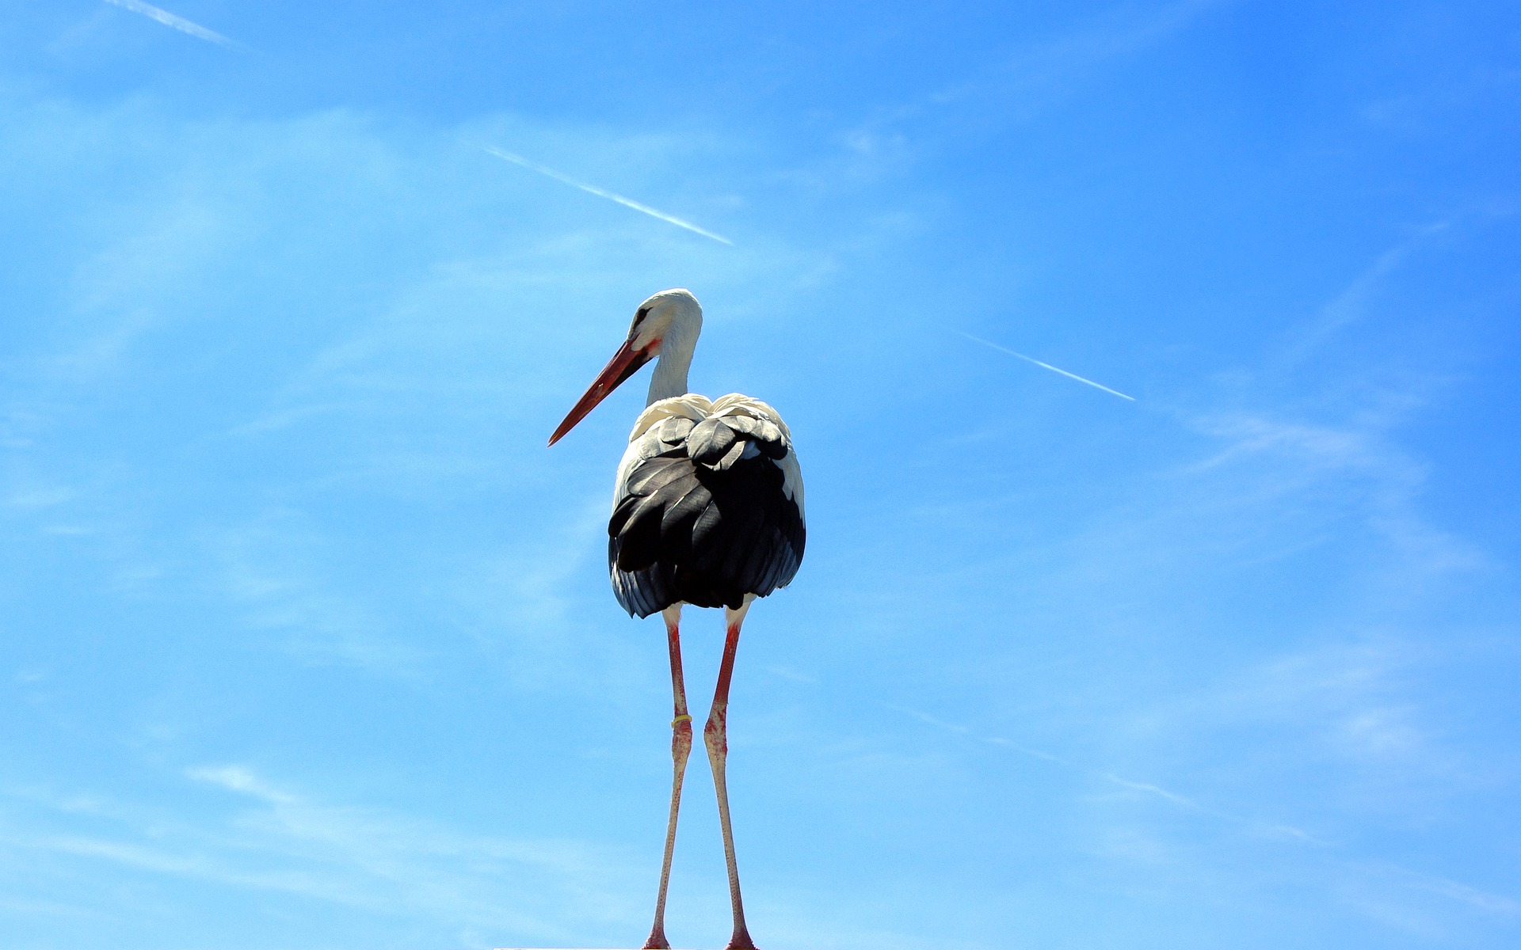

STANDING ON THE SHOULDERS OF GIANTS?
BQ5 Creativity Lesson 9
I can describe the way scientific and mathematical knowledge develops over time
Notes:
See how this lesson links to the course by viewing the final slide
Key TOK terms appear in a red font

Slide 2

Starter
“You can never solve a problem on the level on which it was created.” (Albert Einstein)
What do you think he meant?
Notes:
Science always has to improve in order to advance.
The process of producing knowledge leads us to deepen and sharpen our understanding of the universe.
Scientific knowledge is only ever PROVISIONAL - and is constantly being replaced or revised (although we’ll be thinking about that in this lesson).

Slide 3

Viewpoint 1 - ‘Eureka’ moments
What is a ‘Eureka’ or ‘aha’ moment?
Do you think knowledge is produced in this way? Think of some arguments for and against ‘Eureka moments’ as methods of producing knowledge
Read the article on plate tectonics. Does it support or refute the idea of ‘Eureka moments’?
Notes:
For - it matches our own experiences when we suddenly realise something, and ‘the penny drops’. Sometimes an idea just comes to us. Against - these realisations are built on understandings of concepts that we didn’t create, be they the language used to express the idea, or the ideas themselves.
See this quote from the article on how the theory of plate tectonics was discovered: “Although seen as an "aha!" moment, it was actually a long run-up to that point with a group of committed scientists all sprinting and dipping for the line in 1966/67/68.” The article is quite a long one, so students can just focus on that section.
Link back to the article we read earlier in this unit (here).

Slide 4

Viewpoint 2: standing on the shoulders of giants
“If I have seen further it is by standing on the shoulders of Giants.” Isaac Newton
Copy down the quote.
What do you think Newton meant?
What does this suggest about the way new ideas in science (and other fields) appear?
Can you think of examples? Start with your own understanding of the natural world.
Are there any problems with this model?
Notes:
Potential problems might be that it suggests knowledge is an inevitable accumulation of ideas that build on the ones that come before them.
Students can check out this short article to hone their understanding of what he meant.

Slide 5

Viewpoint 3: paradigm shifts
Read through the discussion point document on the work of Thomas Kuhn
What are Kuhn’s ‘paradigm shifts’, and how do they differ from the other two viewpoints about the development of knowledge?
What example is given on the site, and can you think of other paradigm shifts (in science and non-science)?
Notes:
Kuhn argues that scientific development is much broader than isolated ‘Eureka moments’, so he differs from viewpoint 1. He argues that new theories are generally a break with the past - he refers to ‘violent revolutions’ in science - so not the cumulative approach summed up in Newton’s quote. There are many paradigm shifts that could be used as suitable examples - mention obvious examples such as evolution and geocentrism vs heliocentrism, evolution, and refer back to the way texting represents a paradigm shift in how we communicate.

Slide 6
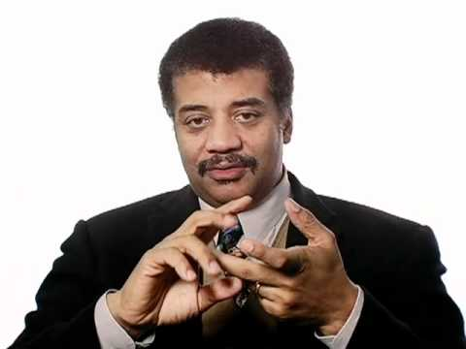
Science and society
How does Neil deGrasse Tyson’s ideas add to our understanding of the way science advances?
Notes:
Science doesn’t progress in a vacuum - there are political, social, and economic factors that push science forwards (or not).
Often, this involves competition (although this can also harm progress).
He contrasts this with how the arts progress - worth considering with students.

Slide 7

Links to the TOK exhibition
Related exhibition prompt How can we know that current knowledge is an improvement upon past knowledge? (IAP-13)
Refer to the ideas from this lesson to answer this question.
For example, think about how we evaluate the extent to which new theories improve our understanding of the world compared to pre-existing ones.
Which objects could help to illustrate your answer?
Notes:
Optional slide, if you want to help students to take ownership of the IA prompts (IAPs) for the TOK exhibition

Slide 8

How does science advance? Refer to the ideas and thinkers of the lesson to argue your point.
Notes:
See the BQ5 assessment tracker for suggestions on providing feedback, and recording students’ progress.

Slide 9
Linking this lesson to the course
During this lesson, we consider the highlighted aspects of the TOK course
The images used in the presentation slides can also give students ideas about selecting exhibition objects; see also our link below to specific IA prompts
CORE THEME | OPTIONAL THEMES | AREAS OF KNOWLEDGE | TOK ASSESSMENT
Knowledge & the knower | Indigenous societies | The arts | The TOK essay
 | Language | History
 | Politics | The human sciences | The TOK exhibition Could be linked to IAP-13 (improvement), IAP-30 (imagination), IAP-33 (development)
 | Religion | Mathematics
 | Technology | The natural sciences

Slide 10

Explore the TOK themes and areas of knowledge in more depth via a range of thinkers, media sources, and other resources, in our EXPLORATION POINTS DOCUMENTS.
Access the documents via the links below. You’ll also find the EP icons on all of the TOK course pages of the site to help you unpack the quotes, KQs, and real-life situations that you find there.
CORE THEME
Knowledge & the knower
OPTIONAL THEMES
Indigenous societies
Language
Politics
Religion
Technology
AREAS OF KNOWLEDGE
The arts
History
Human sciences
Mathematics
Natural sciences
Notes:
Use this slide to access the ‘Exploration Points’ notes for BQ5, which will help students to develop a deeper knowledge of any TOK theme or area of knowledge. This will not only help them to master the TOK course in general, but also craft a great exhibition or essay.
Be ready to provide more guidance on how to use this resource - ie, which media sources to focus on, which questions to address, which TED talks to watch, and which key terms and ideas to understand.

