Slide 1


INTRODUCTION TO BQ6
BQ6 Experts Lesson 1
I can compare and contrast BQ6 within the context of different areas of knowledge
Notes:
See how this lesson links to the course by viewing the final slide
Key TOK terms appear in a red font

Slide 2
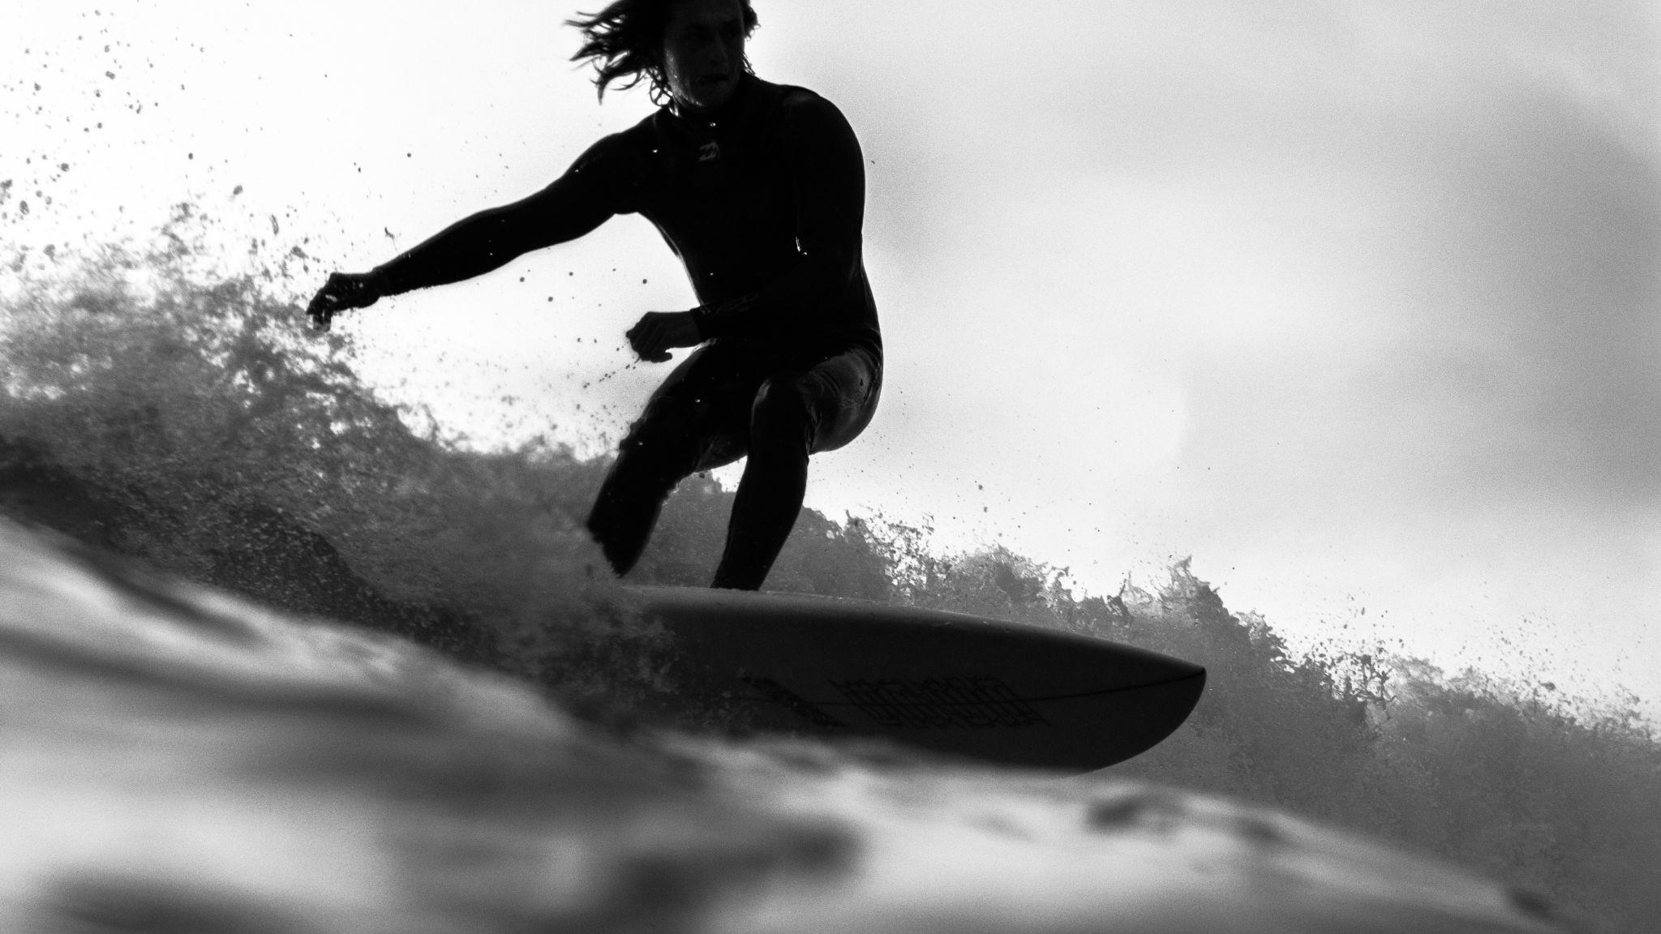
Starter
In what area do you consider yourself an expert?
What qualifies you to make this claim?
Notes:
Strictly speaking, the image shows an expert in ‘knowing how’ rather than ‘knowing that’ (which is what we’re interested in). But for the purposes of this question, this distinction doesn’t matter.

Slide 3

Image or reality?
From the following list, distinguish the real attributes of an expert from the ones that are based on image alone.
Possessing skills
Being famous
Having a diploma or certificate
Possessing experience
Being trained
Being respected by others
Having a large social media following
Being wealthy
Having a title such as ‘doctor’ or ‘professor’
Winning a competition or prize
Passing an exam
Having a ‘natural ability’ for something
Notes:
Correlation and causation!
Training, experience, skills and natural ability obviously all contribute directly towards being an expert (although they may only bring limited amounts of expertise on their own).
Some of the others may be correlated to expertise - but not cause it - such as being respected by others, having a title, and passing an exam.
Others may have absolutely no link at all, and may be the result of other factors (such as ‘luck’!), such as being wealthy, and having a large social media following.
Lots of scope for discussion here.

Slide 4
Discerning: definition
Showing insight and understanding. Able to make careful judgments about the quality, value, and interpret the meaning of things.
a discerning critic
a discerning traveller
a discerning judge of character
Synonyms: insightful, perceptive, prudent, sagacious, sage, sapient, wise
Why should we aspire to become a ‘discerning’ knower?
What advantages might being a ‘discerning knower’ give us?
Link this to the activity we’ve just done.

Slide 5
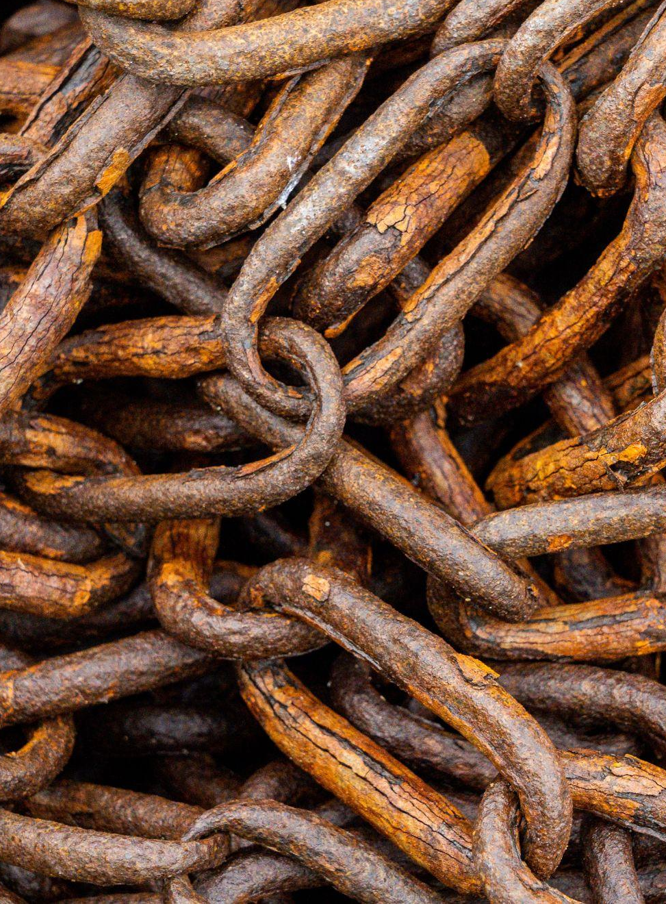
Linking the BQ to the AOKs
BQ5 asks: How do we become discerning knowers?
Select an AOK that you haven’t picked before. With a partner, discuss:
What distinguishes a ‘discerning’ from an ‘ordinary’ knower within this area of knowledge?
Who has responsibility within this AOK about who is regarded as an expert knower?
Present your ideas on an A3 sheet of paper. Make them as visual as possible (use limited text).
Notes:
It may be necessary to remind students of the 5 AOKs. It would be really nice by this stage if this is not the case...

Slide 6
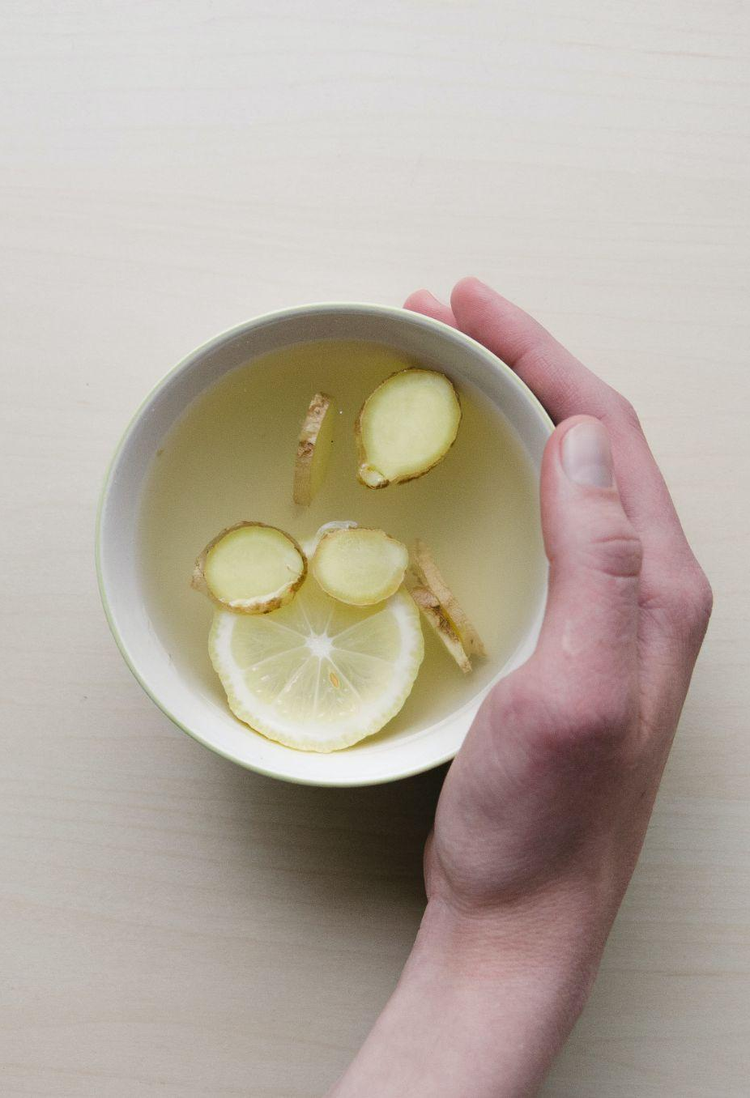
Real- world contexts
Follow the link to the RLS for your AOK. On your display, add:
A brief outline of your RLS and how it links to your AOK.
What this tells us about discerning knowers , and expert knowledge, within this area of knowledge.
Notes:
Links and guidance (students will need a lot of help to identify these ideas, although they’ll probably find a lot more). This is a chance to explain some of the characteristics of ideal RLSs: original, recent, significant, etc. Students should also draw on their own experiences.
The arts - This article provides an insight into a kind of knowledge linked to visual art that we might not otherwise be aware of - diagnostic skills, and ‘astute’ observation. Find out what Amy Herman does, and for whom, and then think about how this can help us to become ‘expert knowers’.
History - This RLS demonstrates what distinguishes one undisputed ‘expert’ in history - EH Carr. There are various quotes here, such as “The facts… are like fish on the fishmonger’s slab. The historian collects them, takes them home and cooks and serves them.” that are particularly useful.
The human sciences - This article looks at the importance of protecting ‘truth tellers’ in society, and facing up to facts about the world. It helps explore the dissonance that often exists between what we want to believe, and where the evidence leads us.
Mathematics - This RLS explores Bayesian theory, and considers why it is so applicable to the modern world, and also how the theory allows us to ‘reprogramme our intuition’ - which could be argued to be what being an expert in mathematics is all about.
The natural sciences - This video debunks certain myths about ‘detoxing’ our bodies, in contrast to the real science about what will rid your body of harmful substances.
The image links to the RLS for history...

Slide 7

Gallery walk
Talk to the other groups.
In which AOK is expertise most clearly identifiable?
In which AOK is it least clear about what constitutes an expert knower?
Add different coloured Post-Its with your answers to the right displays. Justify your responses.
Notes:
Provide two different coloured Post-Its - one for ‘most’, and one for ‘least’.
Students to write their responses on these, and stick to the corresponding displays.

Slide 8

Links to the TOK exhibition
Related exhibition prompt What role do experts play in influencing our consumption or acquisition of knowledge? (IAP-22)
Refer to the ideas from this lesson to answer this question.
For example, think about the extent to which we rely on experts to help us understand the different areas of knowledge and themes.
Which objects could help to illustrate your answer?
Notes:
Optional slide, if you want to help students to take ownership of the IA prompts (IAPs) for the TOK exhibition

Slide 9

“The only true wisdom is in knowing you know nothing.” (Socrates)
What do you think Socrates meant?
Does this mean that we can never be an expert knower about anything?
Notes:
Shorter version of the exit. To be added to the display
See the BQ6 assessment tracker for suggestions on providing feedback, and recording students’ progress.

Slide 10
“The only true wisdom is in knowing you know nothing.” (Socrates)
Write a TOK essay-style introduction to the Big Question, beginning with Socrates’s quote.
Notes:
Longer version of the exit. To be submitted on GC
Encourage students not to ‘parachute in’ a quote - ie, make sure it’s embedded in what they write, not just floating above it
See the BQ6 assessment tracker for suggestions on providing feedback, and recording students’ progress.

Slide 11
Linking this lesson to the course
During this lesson, we consider the highlighted aspects of the TOK course
The images used in the presentation slides can also give students ideas about selecting exhibition objects; see also our link below to specific IA prompts
CORE THEME | OPTIONAL THEMES | AREAS OF KNOWLEDGE | TOK ASSESSMENT
Knowledge & the knower | Indigenous societies | The arts | The TOK essay
 | Language | History
 | Politics | The human sciences | The TOK exhibition Could be linked to IAP-13 (improvement), IAP-22 (experts), IAP-29 (owns)
 | Religion | Mathematics
 | Technology | The natural sciences

Slide 12
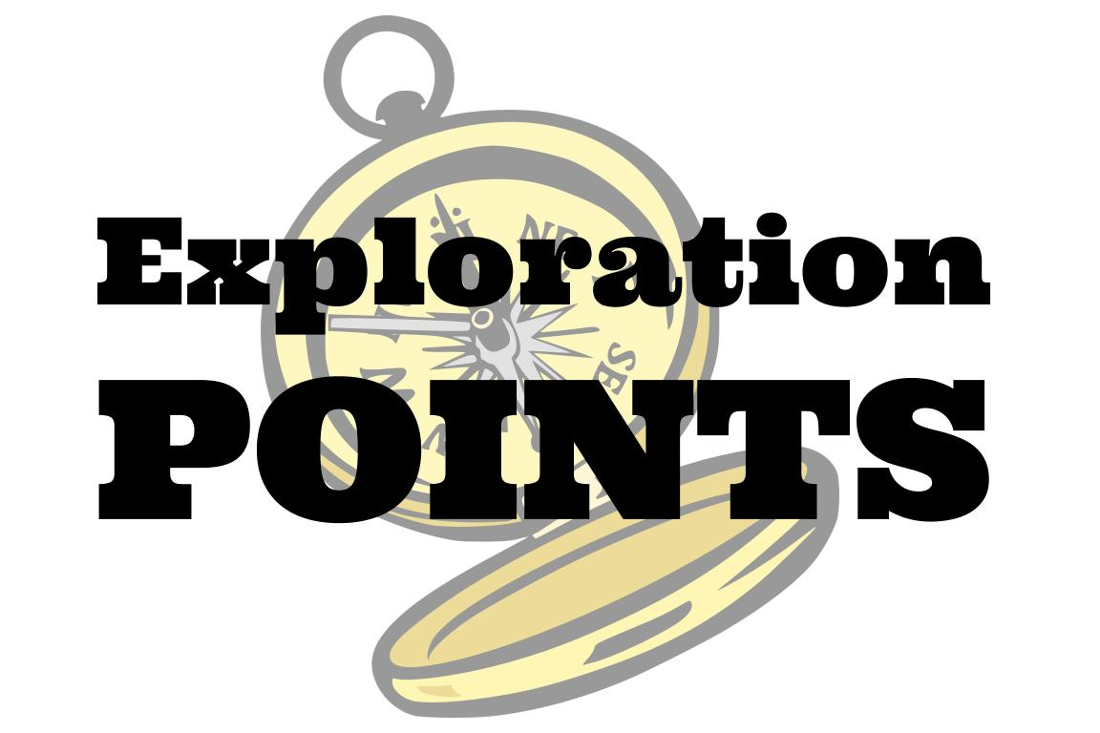
Explore the TOK themes and areas of knowledge in more depth via a range of thinkers, media sources, and other resources, in our EXPLORATION POINTS DOCUMENTS.
Access the documents via the links below. You’ll also find the EP icons on all of the TOK course pages of the site to help you unpack the quotes, KQs, and real-life situations that you find there.
CORE THEME
Knowledge & the knower
OPTIONAL THEMES
Indigenous societies
Language
Politics
Religion
Technology
AREAS OF KNOWLEDGE
The arts
History
Human sciences
Mathematics
Natural sciences
Notes:
Use this slide to access the ‘Exploration Points’ notes for BQ6, which will help students to develop a deeper knowledge of any TOK theme or area of knowledge. This will not only help them to master the TOK course in general, but also craft a great exhibition or essay.
Be ready to provide more guidance on how to use this resource - ie, which media sources to focus on, which questions to address, which TED talks to watch, and which key terms and ideas to understand.

