Slide 1


EMOTION VS. REASON?
BQ6 Experts Lesson 5
I can discuss the ‘true’ relationship between emotion and reason
Notes:
See how this lesson links to the course by viewing the final slide
Key TOK terms appear in a red font

Slide 2

Starter
Would you say that emotion helps or hinders your ability to reason effectively?
Be ready to justify your position with examples from your own life.

Slide 3
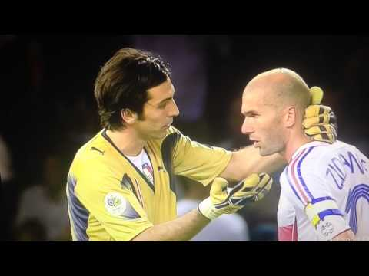
Zidane’s final game
Is this an example of someone being ‘overcome’ by emotion? Which emotion?
Notes:
Emphasise that this is one of the greatest ever football players, playing in the biggest game in the world, for his country (etc., etc) - and his decision seemed to be entirely overshadowed by his emotional state.

Slide 4
Emotion
A strong feeling such as love or anger, or strong feelings in general
Like a lot of men, he finds it hard to express his emotions
My mother was overcome with emotion and burst into tears
The British traditionally tend not to display much emotion in public
An as actor he could communicate a whole range of emotions
Reason
The ability of a healthy mind to think and make judgments, especially based on practical facts
We humans believe that we are the only animals to have the power of reason
He lost his reason when both his parent were killed in the crash
And did reason prevail over emotion?
He argued that morality could be conceptualized as a series of principles based on human reason
LOOKING AT THE RELATIONSHIP VIA LANGUAGE Do these definitions suggest an antagonistic or a complementary relationship? Focus on the words in blue to help you answer this question.
(Definitions based on the Cambridge English Dictionary)
Notes:
Control is the key to understand the differences, as defined here.
Emotion: ‘a strong feeling’, ‘overcome with emotion’ (=something that can’t be controlled); for reason: ‘a healthy mind’, ‘he lost his reason’, ‘reason prevail[ing] over emotion’ (something that gives us control, without which we are unable to navigate knowledge).

Slide 5
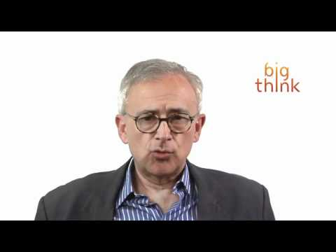
Rethinking emotion & reason - definitions
How did the Cambridge English Dictionary define ‘emotion’?
Clip 1: How does Antonio Damasio’s explanation of emotion differ from this (focus on what he says about what feelings are)?
Clip 2: Why did Damasio say we evolved emotions, and how do we use them?
Notes:
Video also here.
CED definition - ‘A strong feeling such as love or anger, or strong feelings in general’
Watch 0.00 - 3.00 minutes for an explanation of the difference between emotion and feelings. Discuss. Feelings are the awareness of emotions - this is a big difference from the CED definition. Emotions are universal; feelings vary according to culture, species, etc. We use language to heighten awareness of emotions (another example of how ways of knowing interlink)
Then watch from 5.30 - 8.30 for an answer to the second question on Damasio. Emotions are an ‘auto-pilot’ for actions that we should take that benefit us. They also provide us with a model for behaviour. This is aided by memory. This leads to what are often referred to as ‘hunches’.

Slide 6
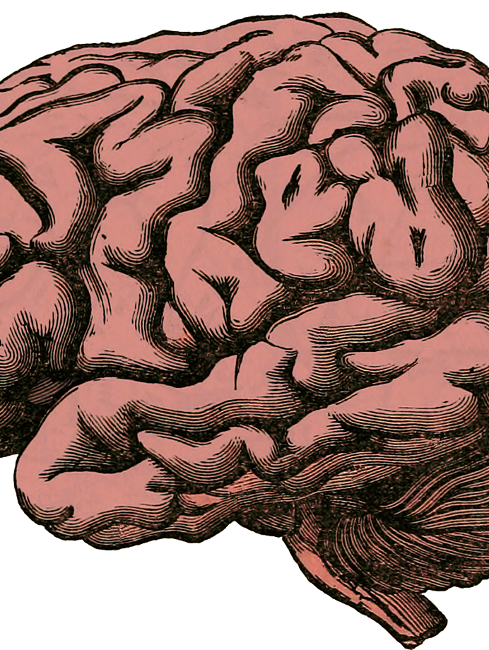
Rethinking emotion & reason - neuroscience
Watch The Brain - a Secret History by Dr Michael Mosley (BBC films, 2011)
What does ‘Dave’s’ case reveal about the relationship between emotion and reason?
Notes:
Clip is here. Watch from 45.20 - 55.40.
Dave suffered massive brain damage after the removal of a tumour. This left him unable to ‘feel’ his emotions. Tests on him also reveal a completely diminished ability to apply reason to decision-making.
Antonio Damasio argued that ‘emotional hunches’ (link to last slide) are the things that lead our decision making. In other words, without emotion, we cannot reason. This was a big step forward in terms of how we understand the relationship between emotion and reason.
Memory has in a sense replaced emotion for Dave - he remembers how he should feel, rather than being able to feel. This shows another form in which the ways of knowing interlink.

Slide 7
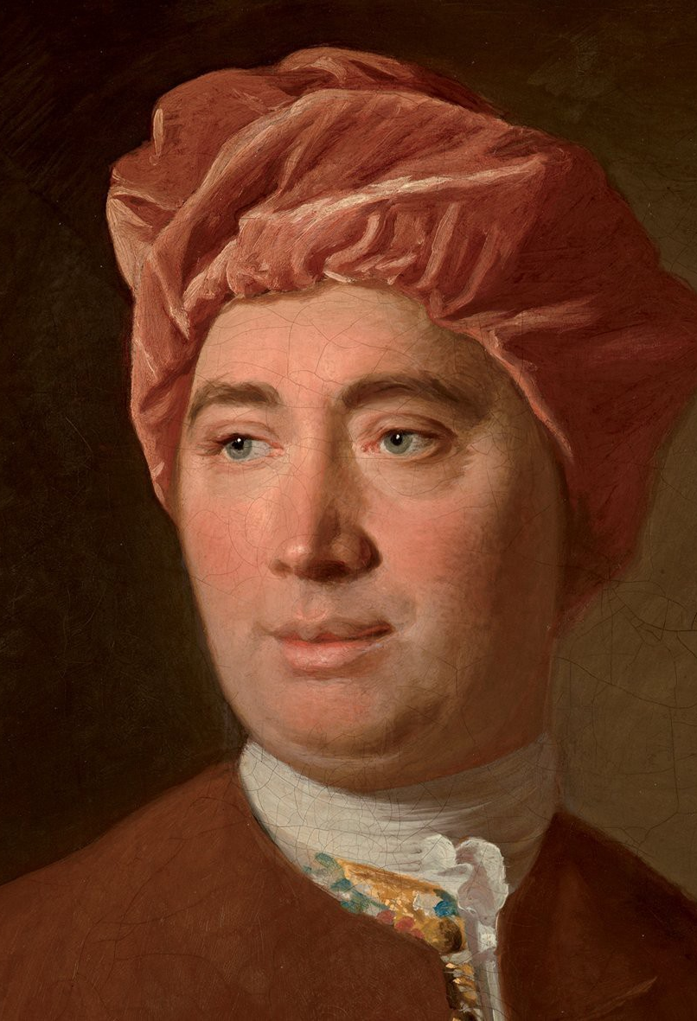
David Hume
“Reason is, and ought only to be the slave of the passions, and can never pretend to any other office than to serve and obey them.”
What did Hume mean?
Does this confirm the work of Damasio and Mosley?
Check your understanding by researching his life and work.

Slide 8

Rethinking rationality
Read this New Humanist article.
“The idea seems to be that being emotional precludes being rational, and we can select only one way of being at a time… Where did we get this confidence that emotion has no place in reasoning?”
Link what Eleanor Gordon-Smith says to what we’ve looked at today about the necessity of combining emotion with reason - particularly when it comes to trying to debate with people, and persuade them of your views.
Notes:
Optional slide.
This is a long article, which some students may find quite demanding, so it does require a significant amount of time for students to read and understand it.

Slide 9

Links to the TOK exhibition
Related exhibition prompt How does the way that we organize or classify knowledge affect what we know? (IAP-6)
Refer to the ideas from this lesson to answer this question.
For example, think about how reclassifying our definitions of ‘feelings’ and ‘emotions’ helps us to understand them more - and grasp how they shape the way we gain knowledge about the world.
Which objects could help to illustrate your answer?
Notes:
Optional slide, if you want to help students to take ownership of the IA prompts (IAPs) for the TOK exhibition

Slide 10
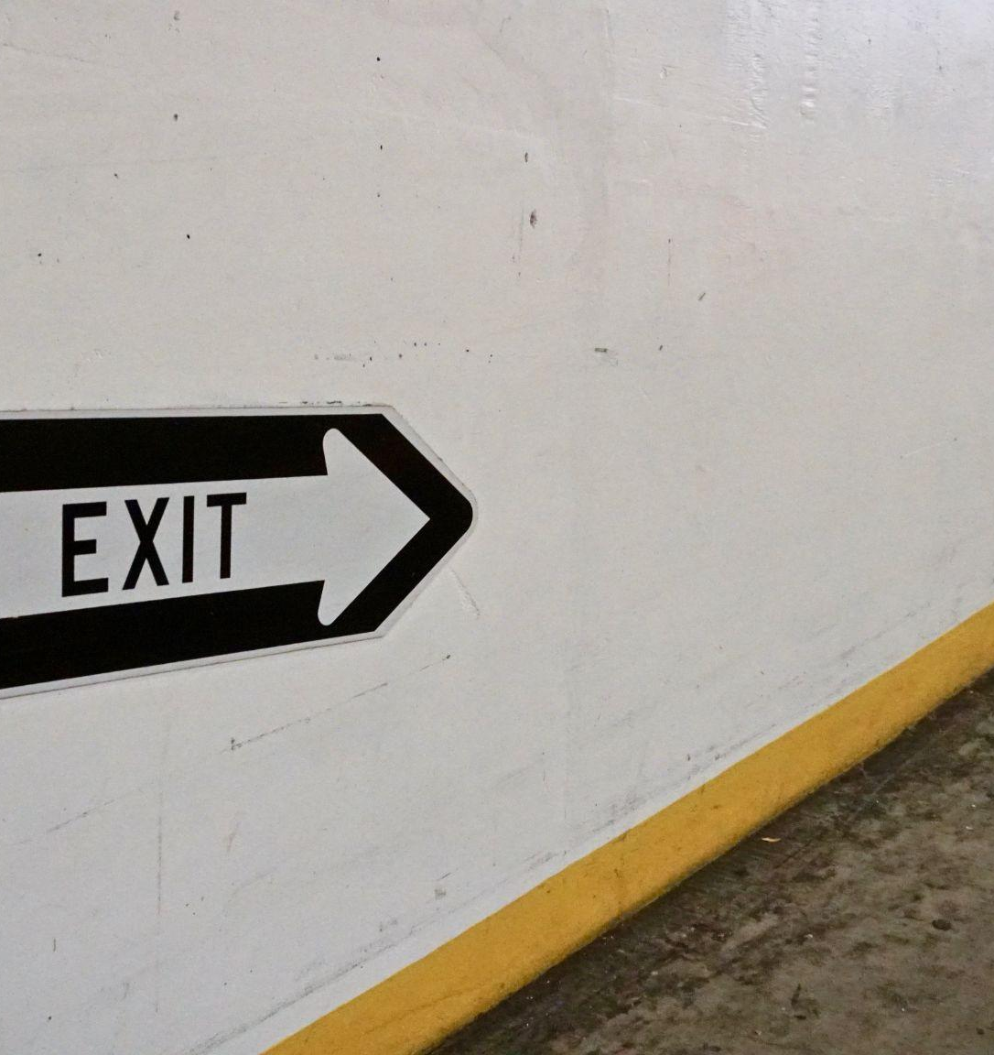
“Reason without emotion is nothing.” (Dr Michael Mosley)
Do you agree?
Has your opinion on the relationship between emotion and reason changed?
Notes:
See the BQ6 assessment tracker for suggestions on providing feedback, and recording students’ progress.

Slide 11
Linking this lesson to the course
During this lesson, we consider the highlighted aspects of the TOK course
The images used in the presentation slides can also give students ideas about selecting exhibition objects; see also our link below to specific IA prompts
CORE THEME | OPTIONAL THEMES | AREAS OF KNOWLEDGE | TOK ASSESSMENT
Knowledge & the knower | Indigenous societies | The arts | The TOK essay
 | Language | History
 | Politics | The human sciences | The TOK exhibition Could be linked to IAP-6 (organize), IAP-15 (constraints), IAP-31 (adequate)
 | Religion | Mathematics
 | Technology | The natural sciences

Slide 12

Explore the TOK themes and areas of knowledge in more depth via a range of thinkers, media sources, and other resources, in our EXPLORATION POINTS DOCUMENTS.
Access the documents via the links below. You’ll also find the EP icons on all of the TOK course pages of the site to help you unpack the quotes, KQs, and real-life situations that you find there.
CORE THEME
Knowledge & the knower
OPTIONAL THEMES
Indigenous societies
Language
Politics
Religion
Technology
AREAS OF KNOWLEDGE
The arts
History
Human sciences
Mathematics
Natural sciences
Notes:
Use this slide to access the ‘Exploration Points’ notes for BQ6, which will help students to develop a deeper knowledge of any TOK theme or area of knowledge. This will not only help them to master the TOK course in general, but also craft a great exhibition or essay.
Be ready to provide more guidance on how to use this resource - ie, which media sources to focus on, which questions to address, which TED talks to watch, and which key terms and ideas to understand.

