Slide 1


GENERALIZATIONS OR PARALYSIS BY ANALYSIS
BQ6 Experts Lesson 6
I can weigh up the pros and cons of producing knowledge via intuition
Notes:
See how this lesson links to the course by viewing the final slide
Key TOK terms appear in a red font

Slide 2
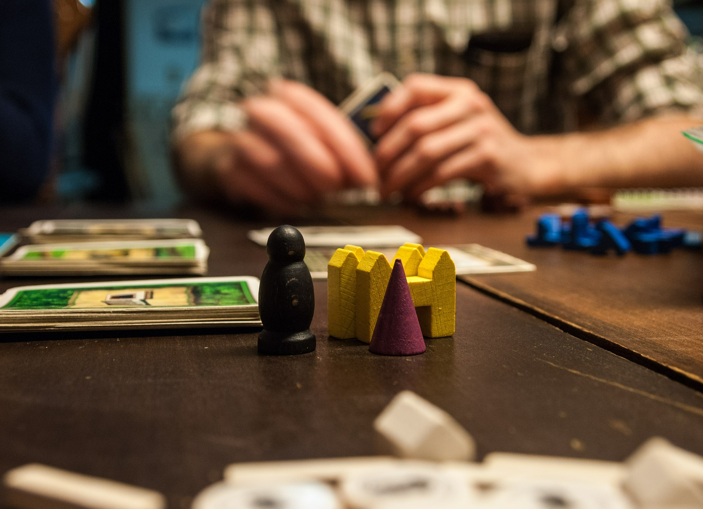
Starter
What do we mean by a ‘gut reaction’?
Do you ‘go with your gut’, or think things through?
Notes:
Image shows a board game, or game of cards - perhaps students can put themselves into this situation.
Bring in the word ‘intuition’ when you debrief this.

Slide 3
Thinking about intuition
Intuition is a spiritual faculty and does not explain, but simply points the way.
Florence Scovel Shinn
Read through the 5 quotes about intuition.
What do they tell us about:
How intuition works
What intuition is for
The benefits, and the limitations, of intuition
The only real valuable thing is intuition.
Albert Einstein
Intuition is the clear conception of the whole at once.
Johann Kaspar Lavater
Intuition will tell the thinking mind where to look next.
Jonas Salk
Many ideas happen to us. We have intuition, we have feeling, we have emotion, all of that happens, we don't decide to do it. We don't control it.
Daniel Kahneman

Slide 4
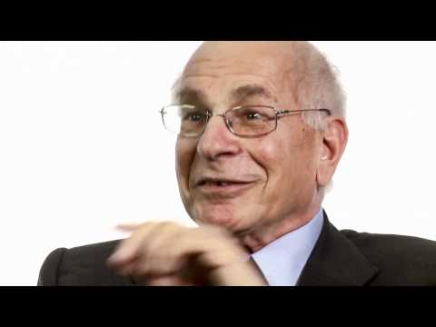
Daniel Kahneman: thinking fast & slow
What are ‘system 1’ and ‘system 2’ thinking?
What are the advantages of both types of thinking? In your answer, mention prejudice, stereotypes, reducing biases, and paralysis by analysis
Which real-life situation does he place the failure of thinking within?
Notes:
Video also here.
Worth outlining DK’s credentials on this (Nobel Prize-winner, etc.), and his book ‘Thinking Fast, and Thinking Slow’.
You reduce this to generalizations vs. paralysis by analysis - hence the title of the lesson.
He discusses the 2008 economic crash, and how various biases led us to the disaster (- links to human sciences).

Slide 5

The dangers of intuition - mathematics
Watch the first minute of the Monty Hall problem video.
What would you have done?
Watch the rest of the video.
Why do most people get this wrong?
What does this reveal about trusting our intuition when it comes to mathematics?
Notes:
You can also check out the problem as featured in Brooklyn-99 or Vox.
See alternative way of delivering this lesson on slide 8.

Slide 6
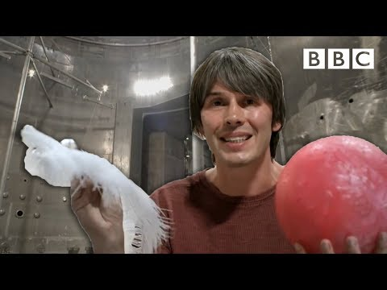
Problems of intuition: natural sciences
How can our intuition mislead us when it comes to understanding laws within the natural sciences (eg the ‘true’ nature of gravity).
Can you think of any other intuitive feelings about the natural world that might lead us astray?
Notes:
Video also here.
Eg - flat earth theory.
See alternative way of delivering this lesson on slide 8.

Slide 7
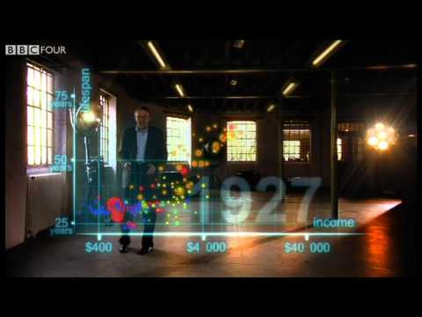
Problems of intuition: human sciences
How many of Hans Rosling’s statistics surprise you?
What does this tell you about the way in which we understand the world via our intuitive feelings?
Notes:
Optional slide.
Video also here.
You may not have time to consider the human sciences as well.
You can see much more by Hans Rosling at TED (he is one of the most viewed TED speakers)
Rather than getting students to work through each slide separately, you can assign different groups the different AOKs to work on individually, then ask them to swap what they found out about, and what it tells us about intuition.

Slide 8

Links to the TOK exhibition
Related exhibition prompt What counts as knowledge?(IAP-1)
Refer to the ideas from this lesson to answer this question.
For example, think about whether knowledge gained via intuition really qualifies as knowledge.
Which objects could help to illustrate your answer?
Notes:
Optional slide, if you want to help students to take ownership of the IA prompts (IAPs) for the TOK exhibition

Slide 9

When should we rely on our intuition?
When should we be careful about trusting it?
Notes:
See the BQ6 assessment tracker for suggestions on providing feedback, and recording students’ progress.

Slide 10
Linking this lesson to the course
During this lesson, we consider the highlighted aspects of the TOK course
The images used in the presentation slides can also give students ideas about selecting exhibition objects; see also our link below to specific IA prompts
CORE THEME | OPTIONAL THEMES | AREAS OF KNOWLEDGE | TOK ASSESSMENT
Knowledge & the knower | Indigenous societies | The arts | The TOK essay
 | Language | History
 | Politics | The human sciences | The TOK exhibition Could be linked to IAP-1 (knowledge), IAP-19 (justification), IAP-31 (adequate)
 | Religion | Mathematics
 | Technology | The natural sciences

Slide 11

Explore the TOK themes and areas of knowledge in more depth via a range of thinkers, media sources, and other resources, in our EXPLORATION POINTS DOCUMENTS.
Access the documents via the links below. You’ll also find the EP icons on all of the TOK course pages of the site to help you unpack the quotes, KQs, and real-life situations that you find there.
CORE THEME
Knowledge & the knower
OPTIONAL THEMES
Indigenous societies
Language
Politics
Religion
Technology
AREAS OF KNOWLEDGE
The arts
History
Human sciences
Mathematics
Natural sciences
Notes:
Use this slide to access the ‘Exploration Points’ notes for BQ6, which will help students to develop a deeper knowledge of any TOK theme or area of knowledge. This will not only help them to master the TOK course in general, but also craft a great exhibition or essay.
Be ready to provide more guidance on how to use this resource - ie, which media sources to focus on, which questions to address, which TED talks to watch, and which key terms and ideas to understand.

